Slide 1
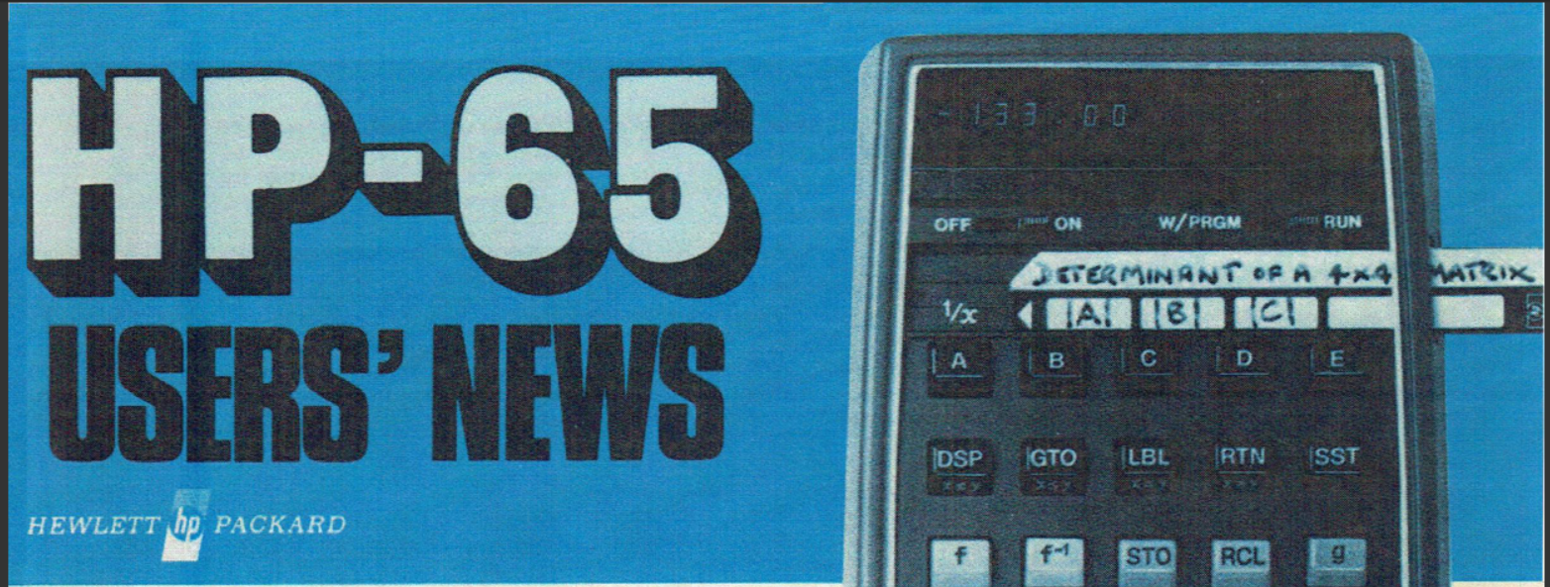
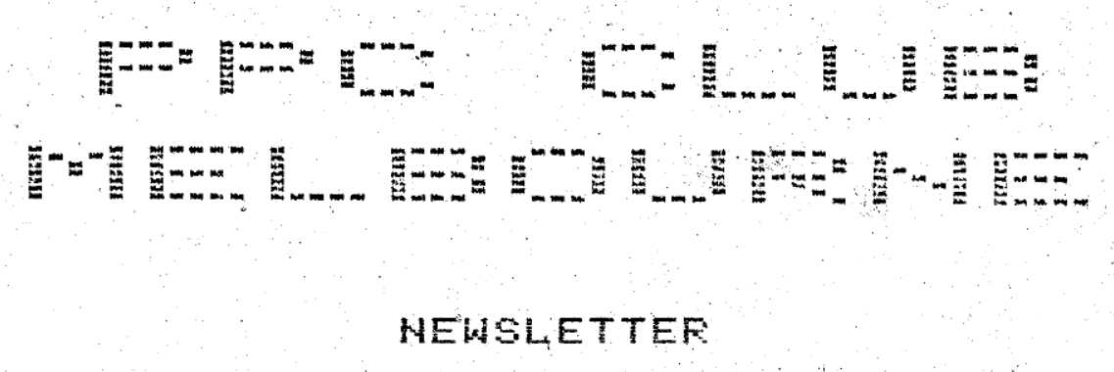
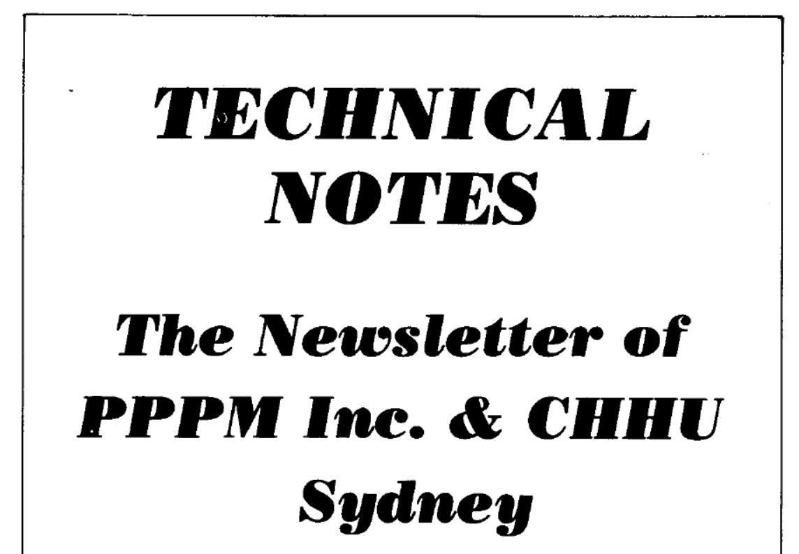
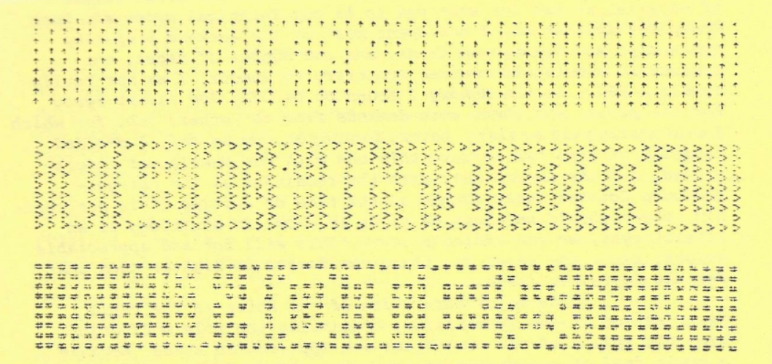
Archiving the HP Handhelds User Groups
Jake Schwartz
1

Slide 2
Starting in early 1998 / Initial announcement at Philly PPC Chapter
2

Slide 3
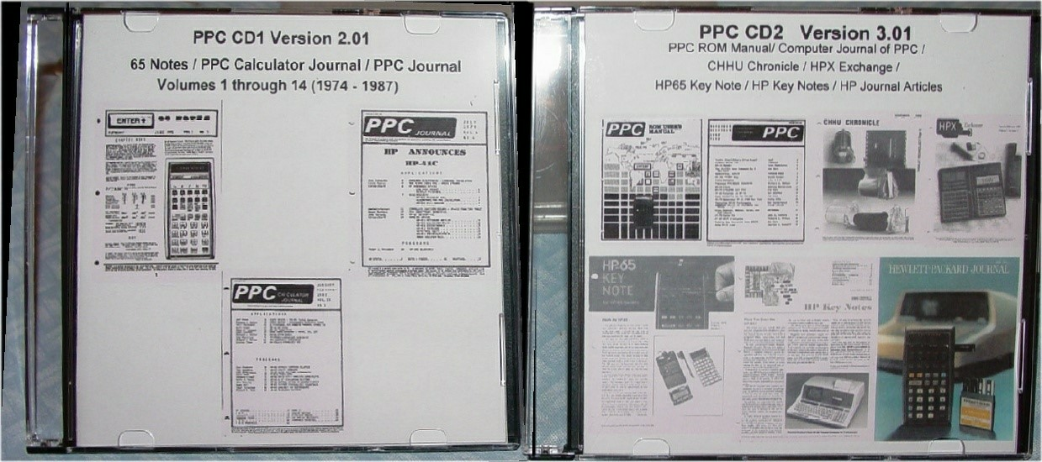
1998: A CD Set is Born
3

Slide 4
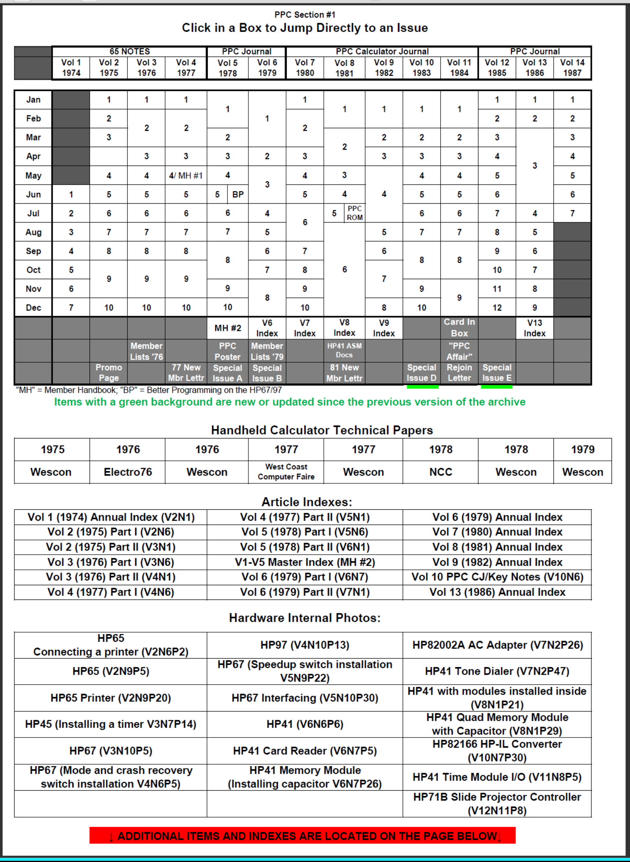
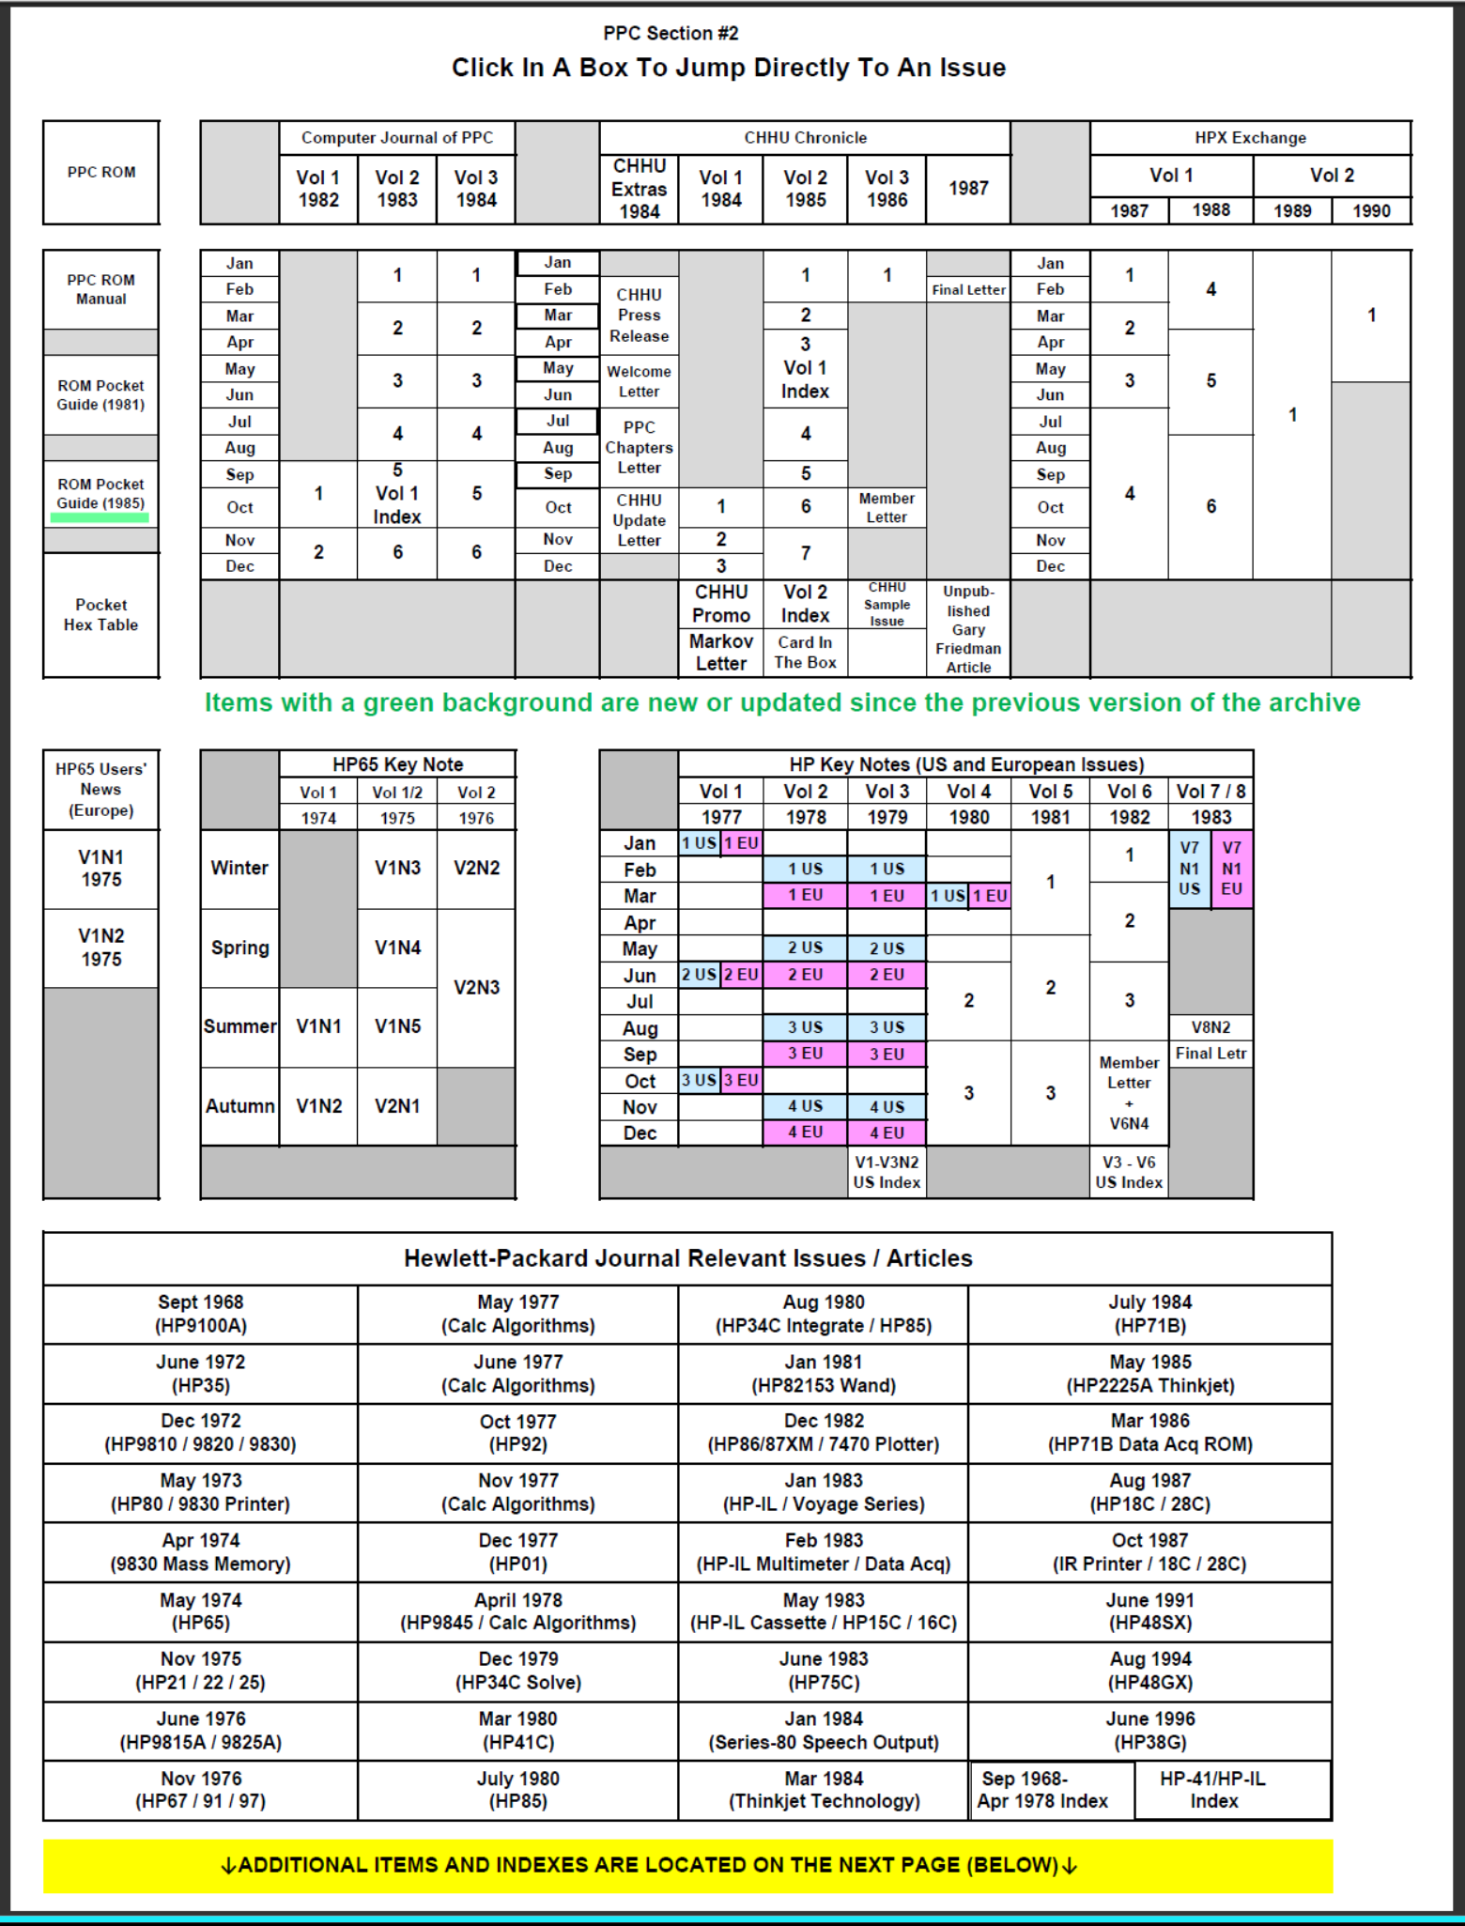
CD1 & CD2 “Jump Tables”
4

Slide 5
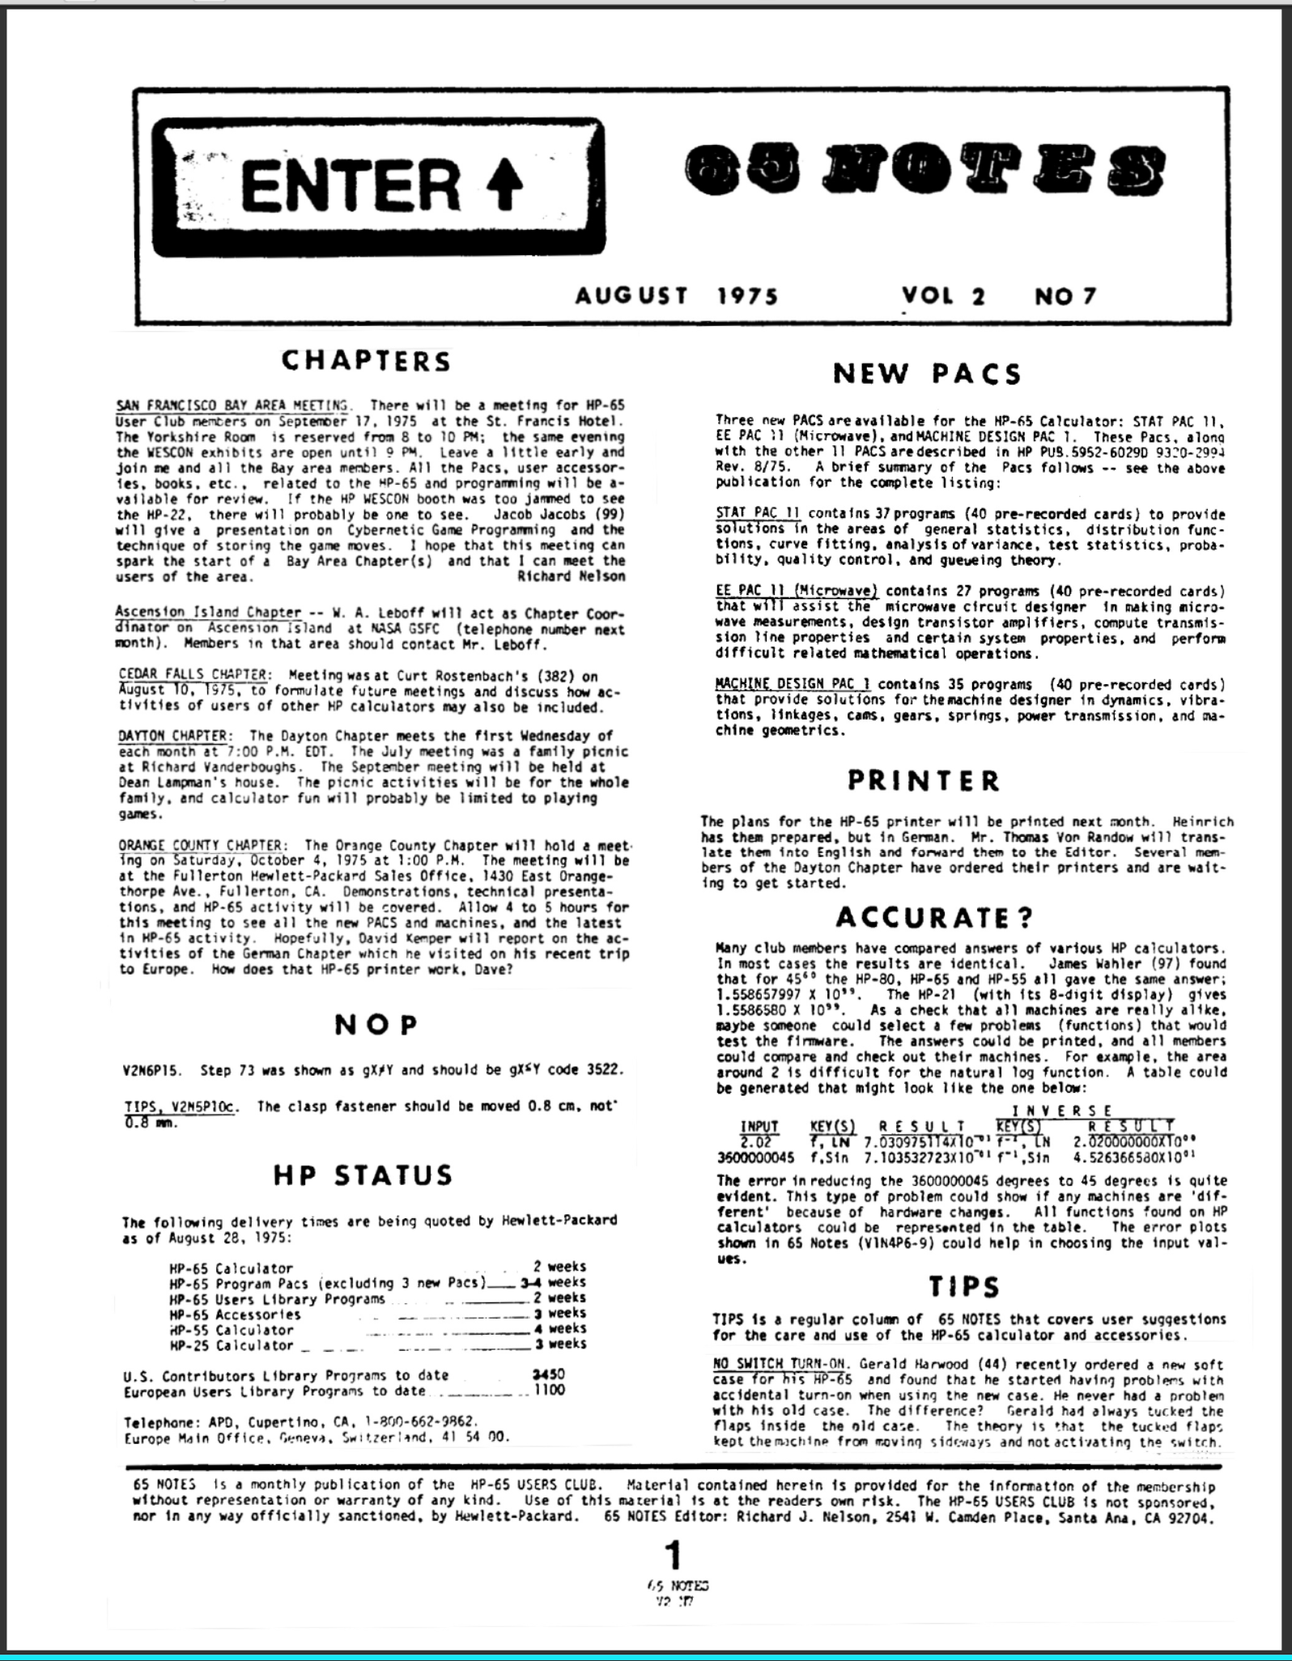
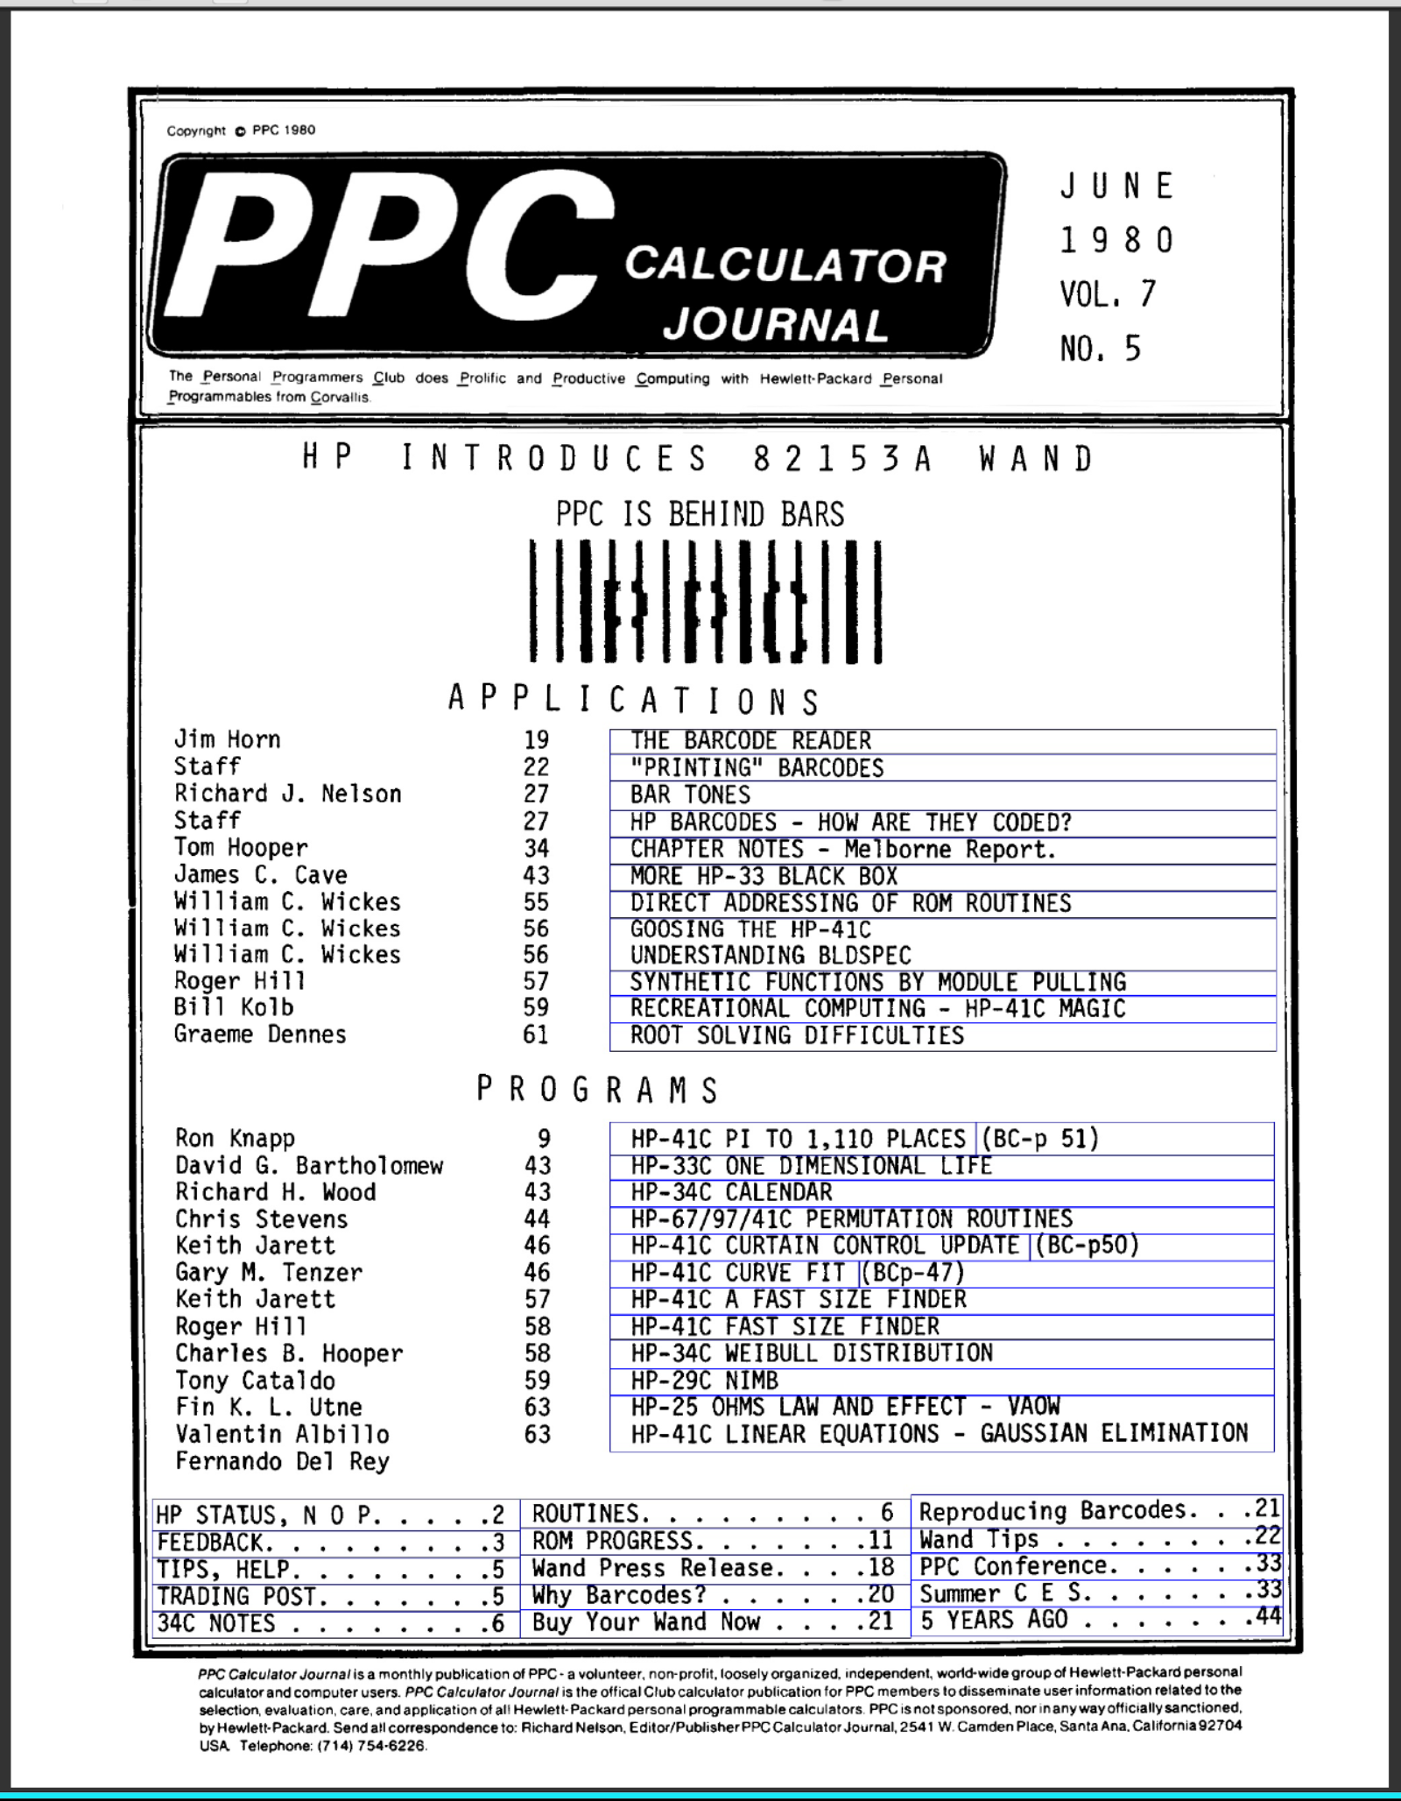
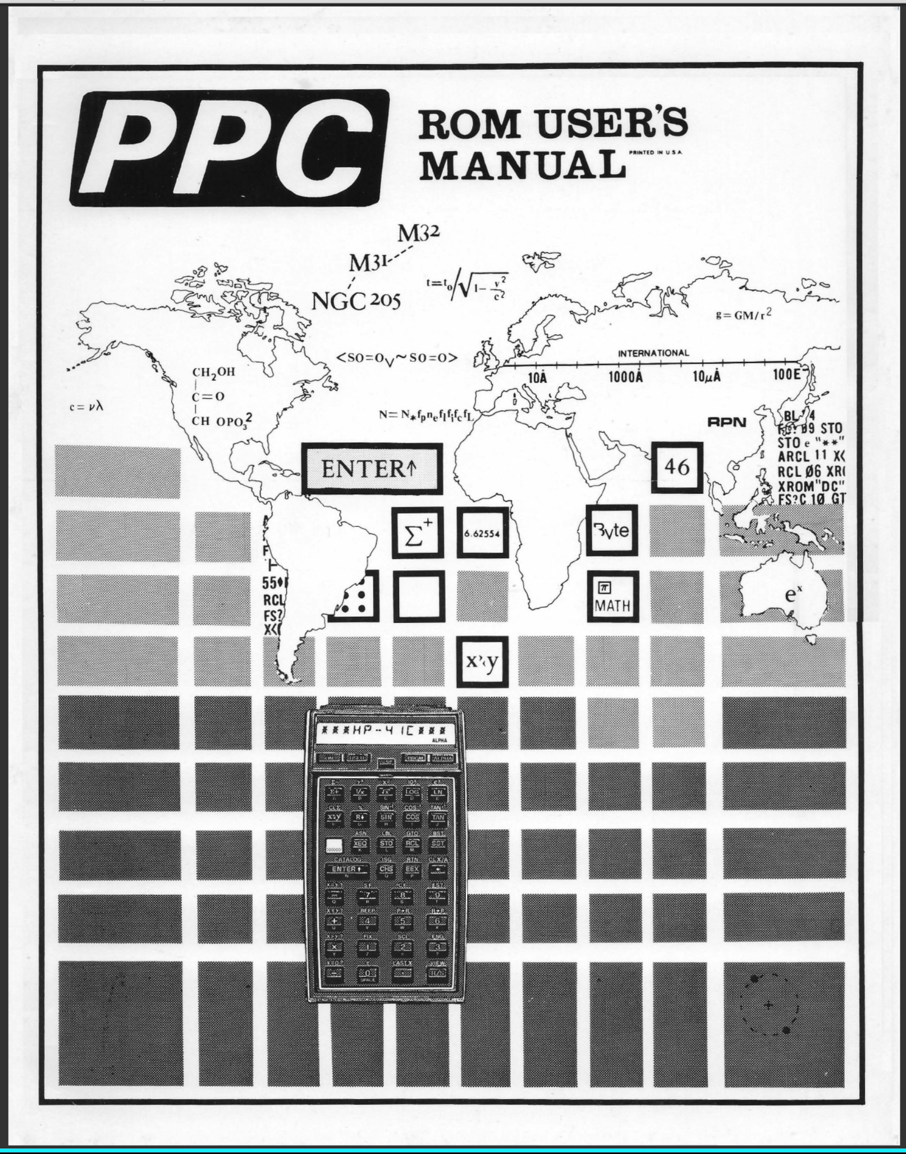
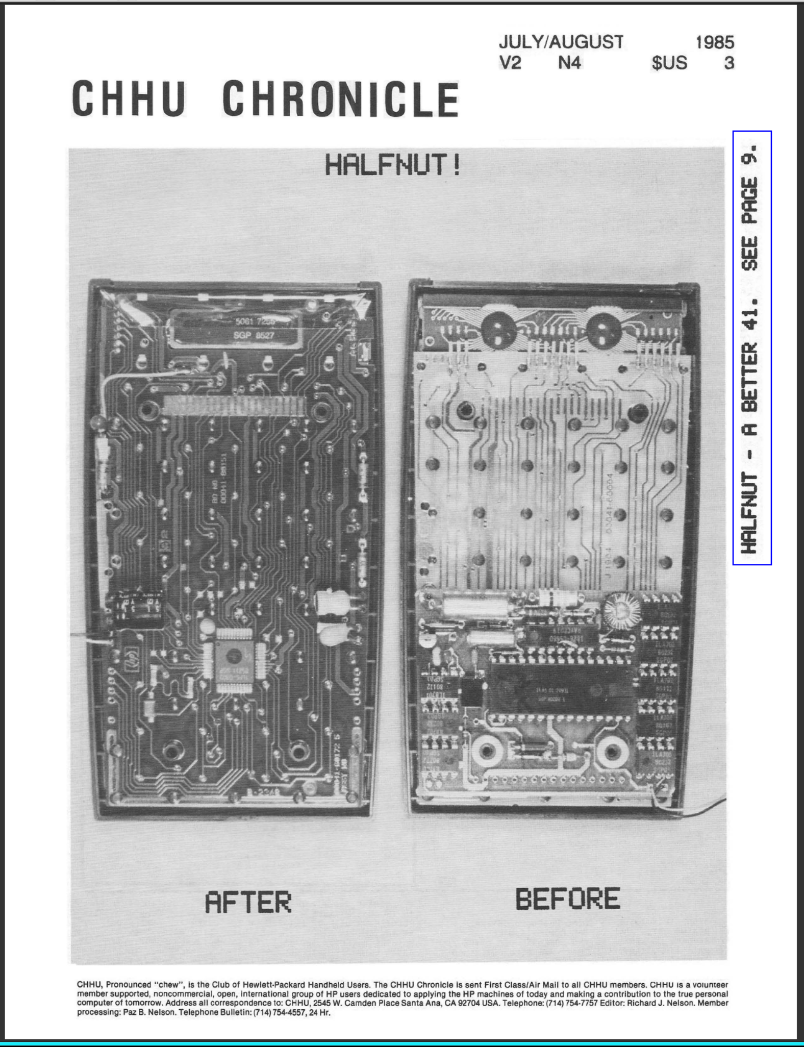
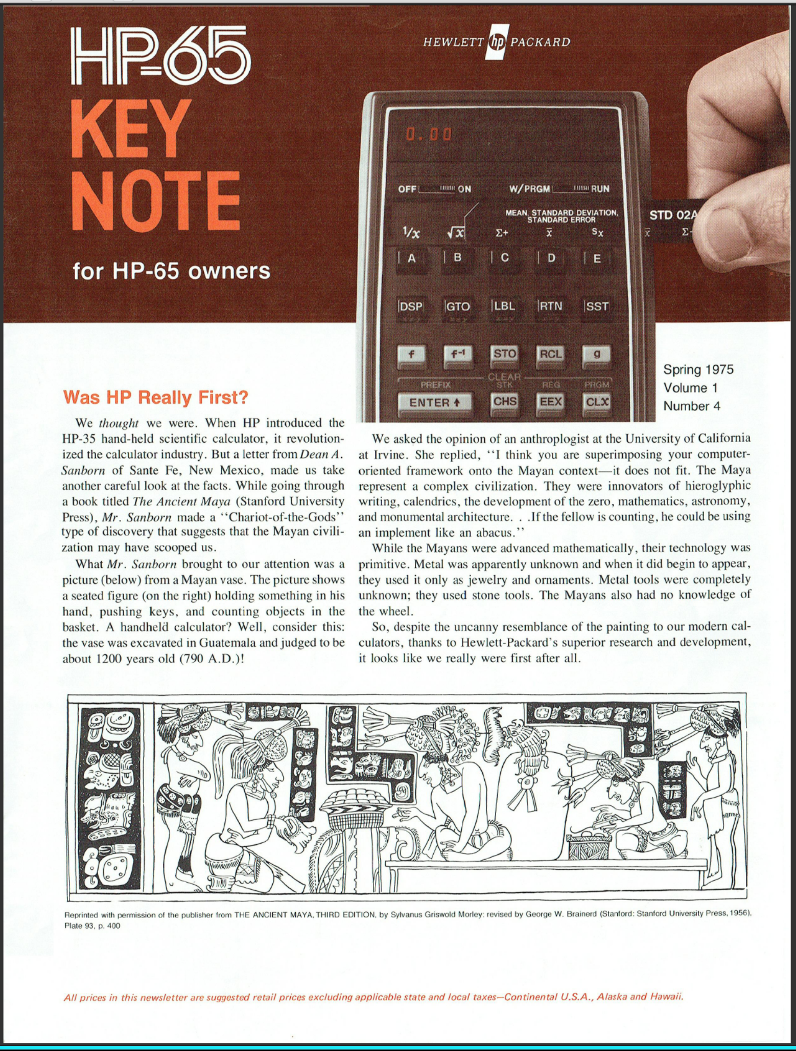
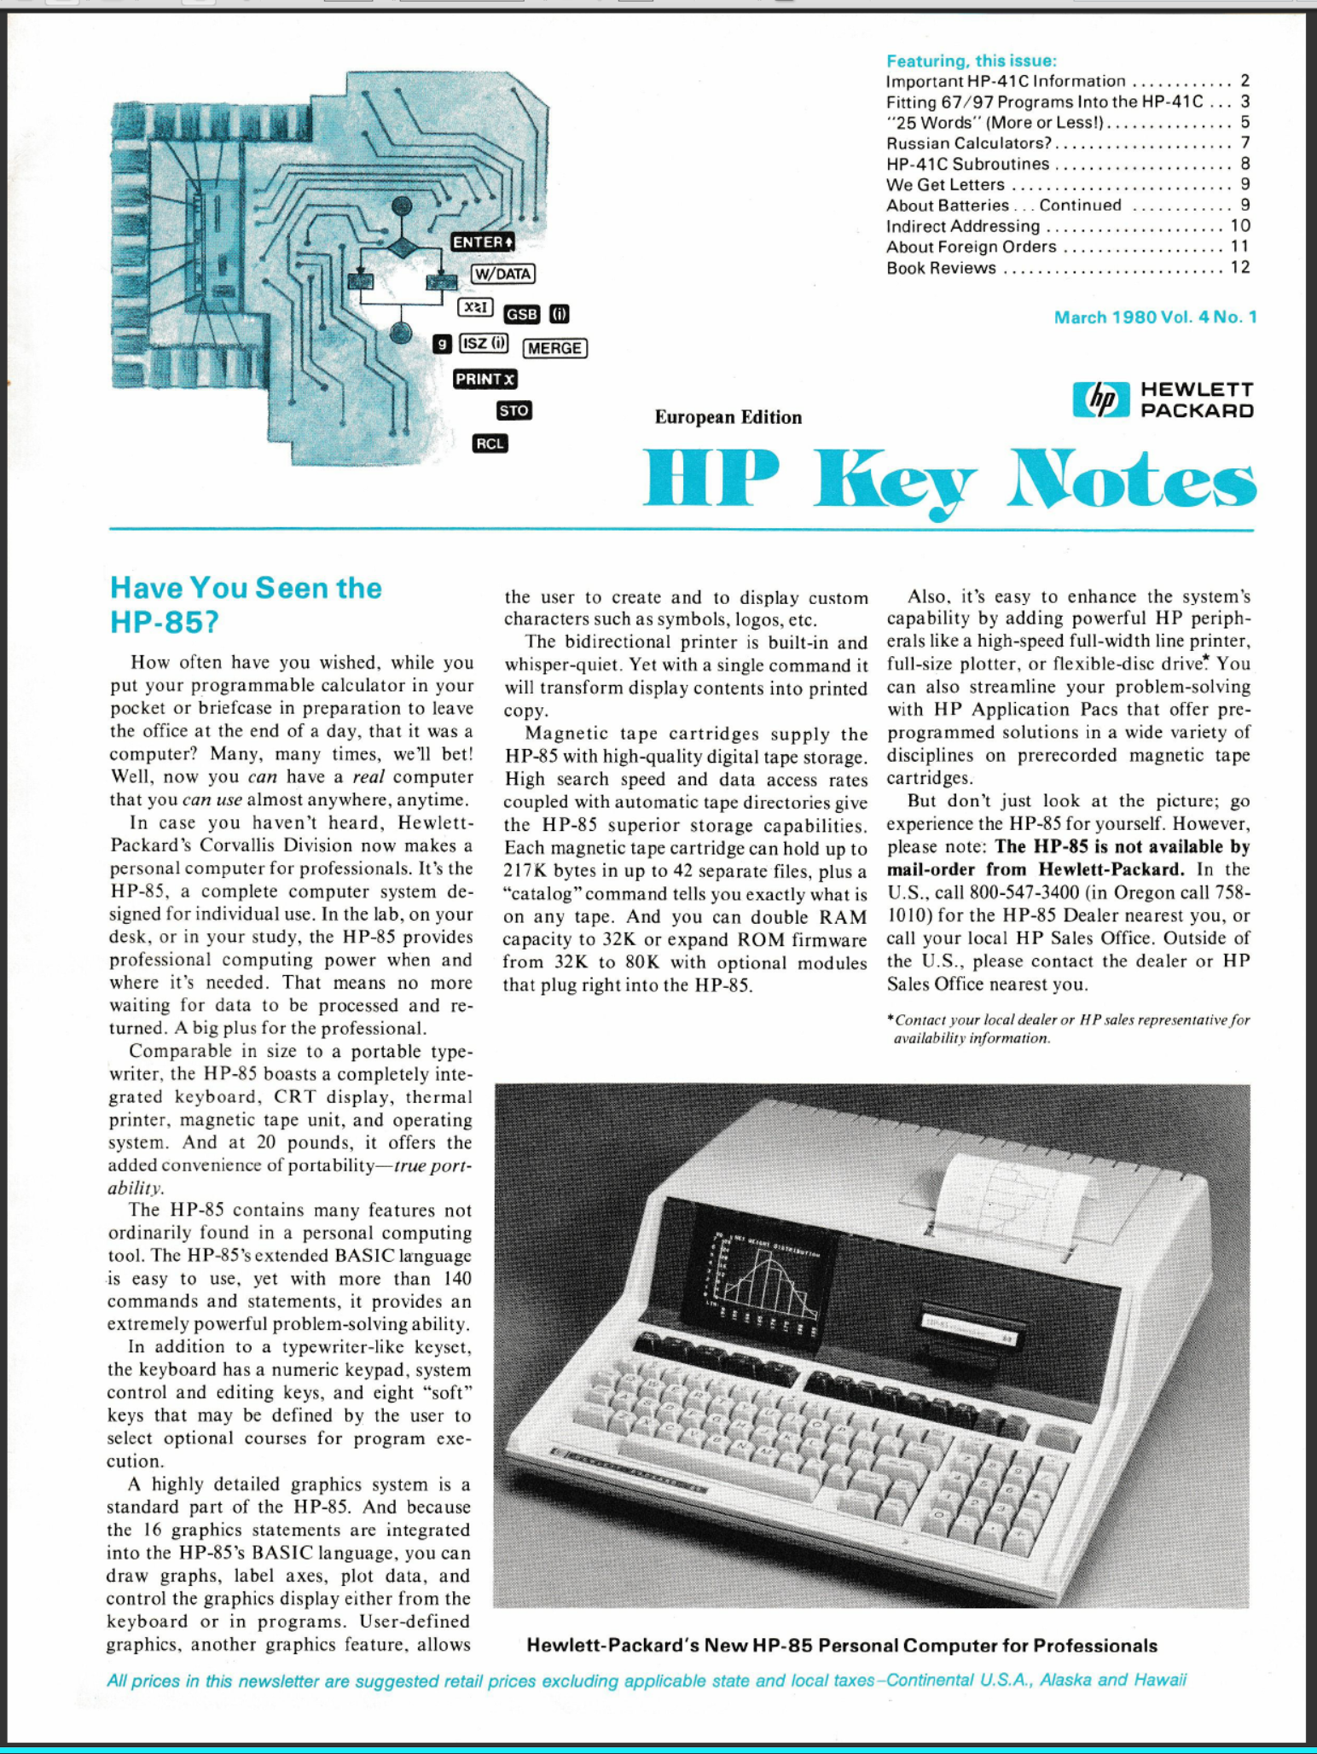
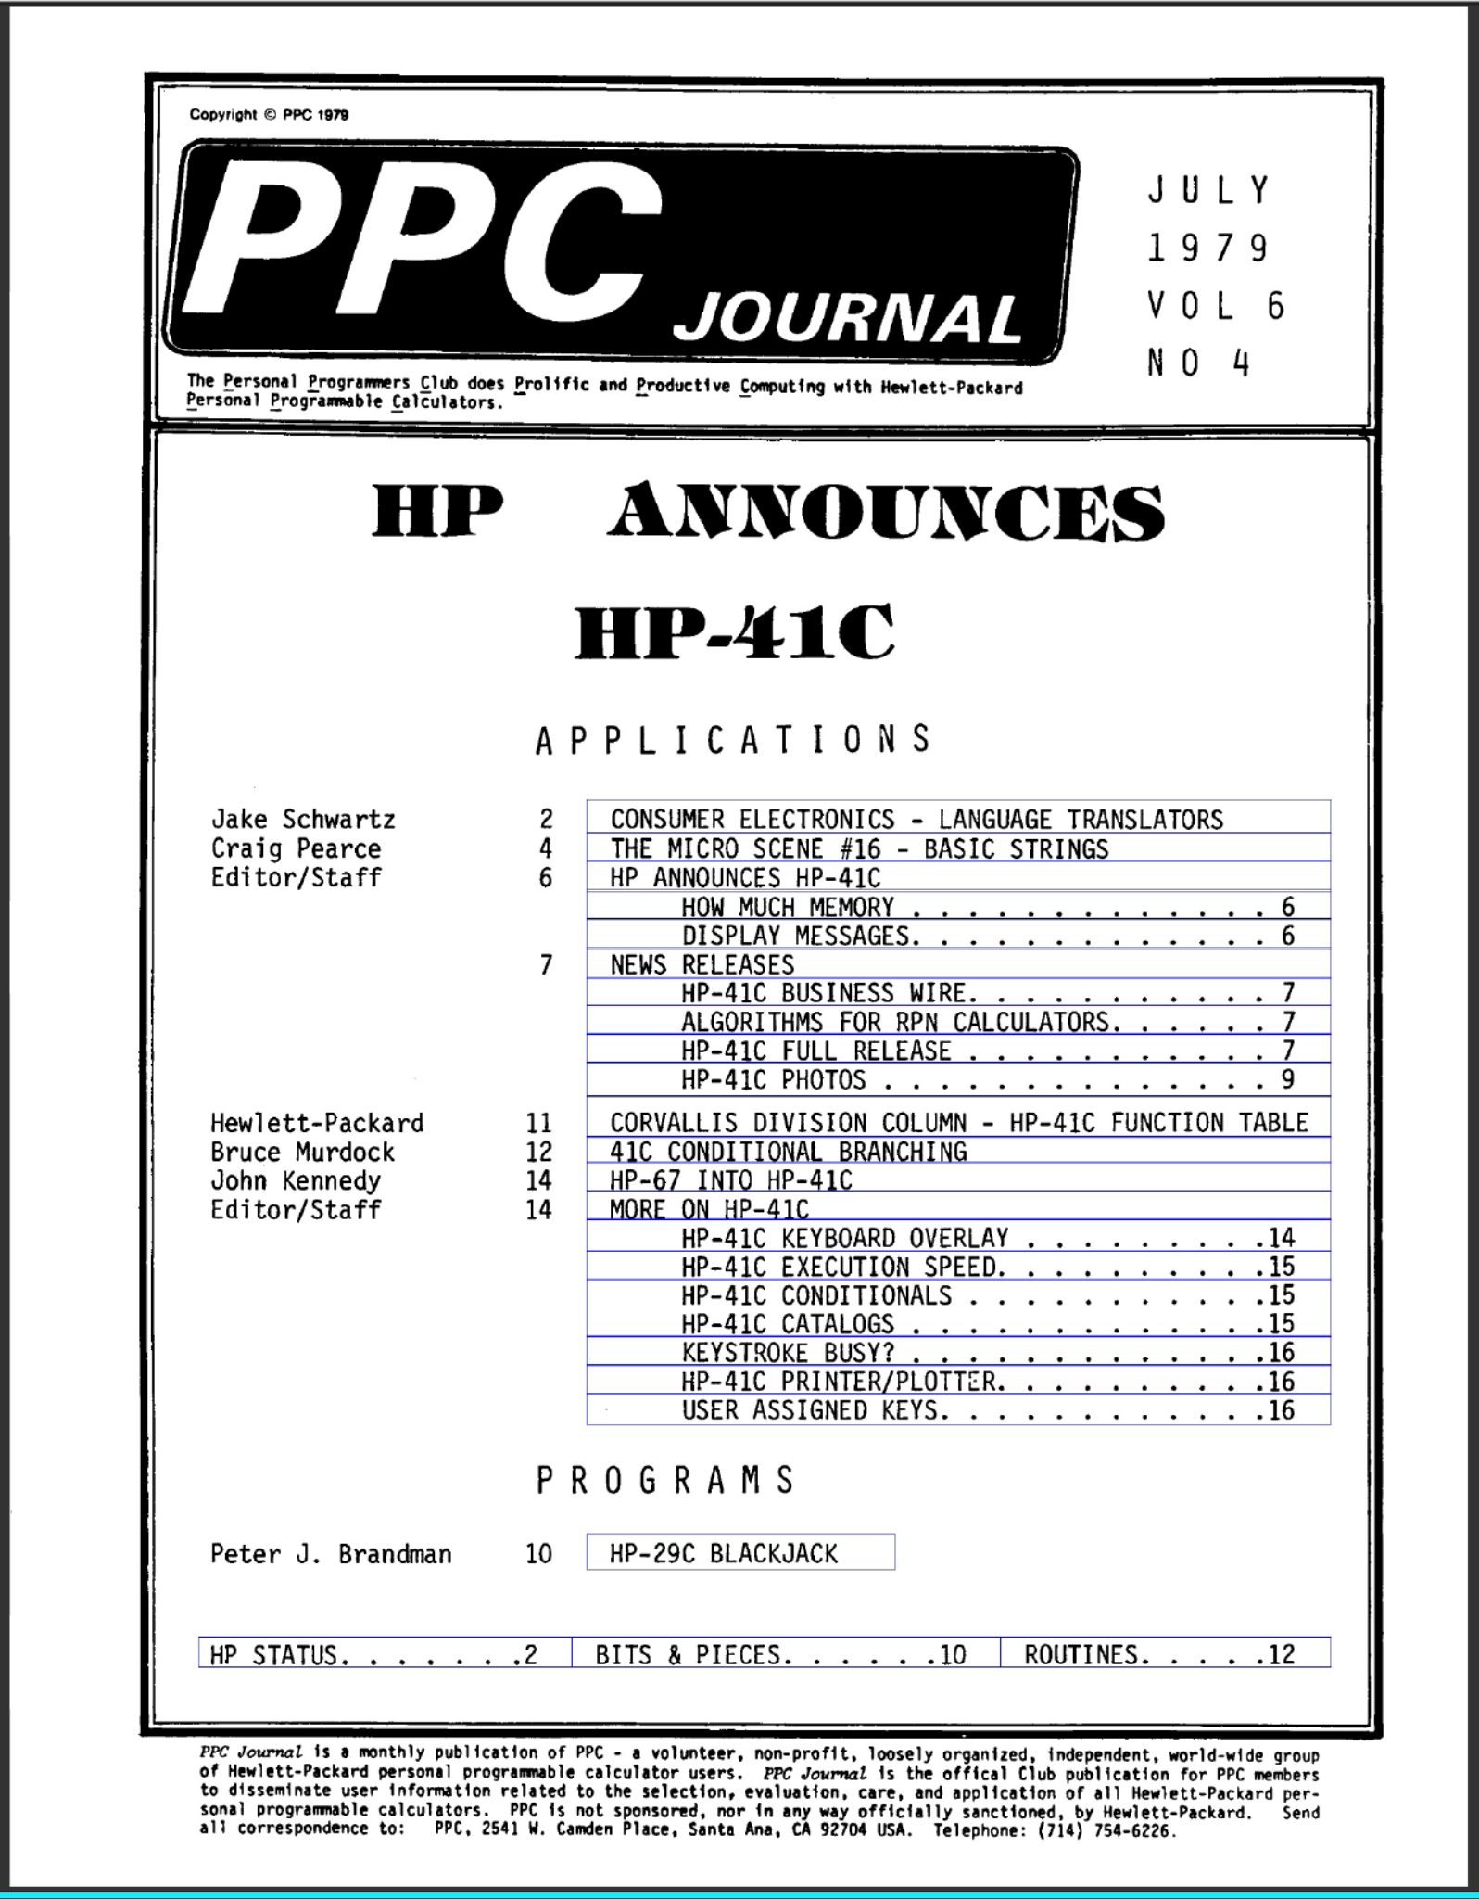
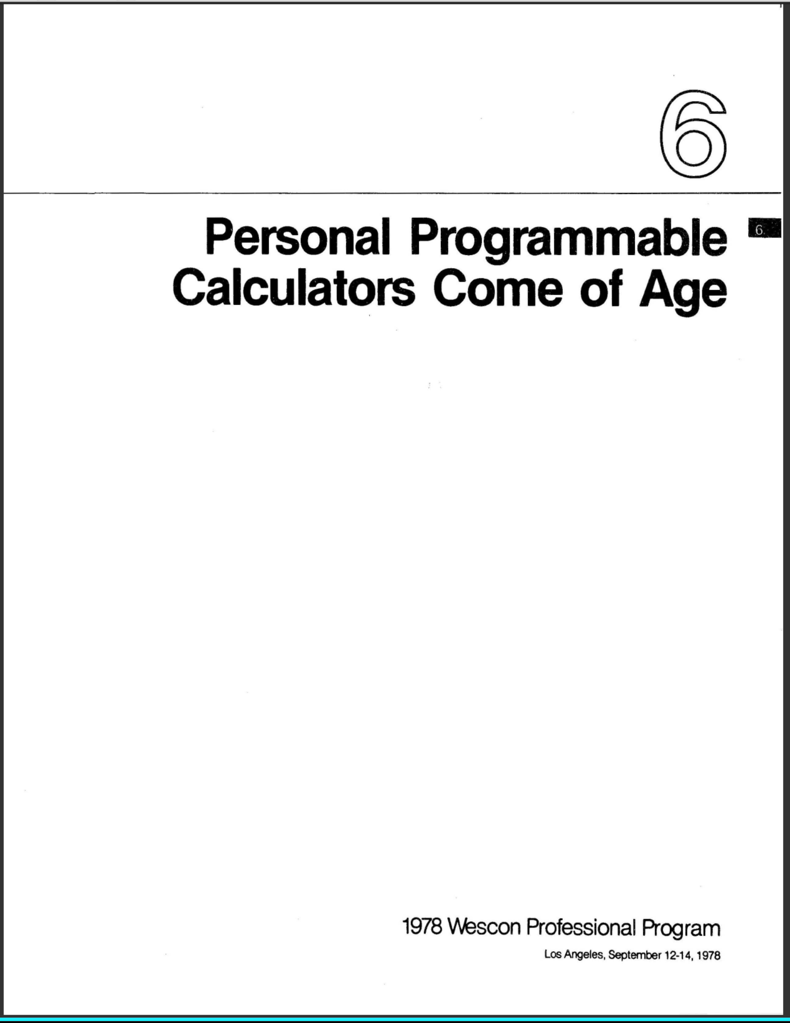
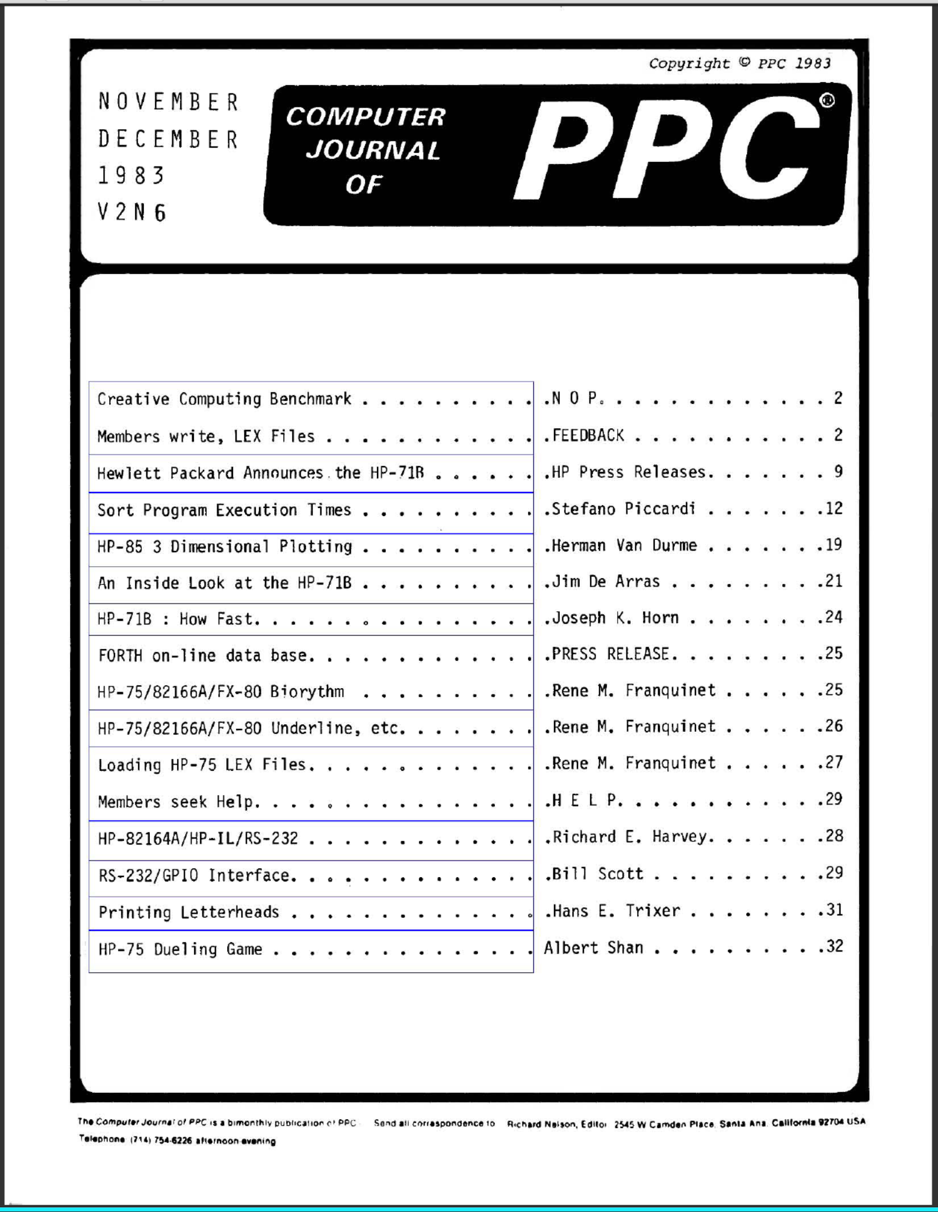
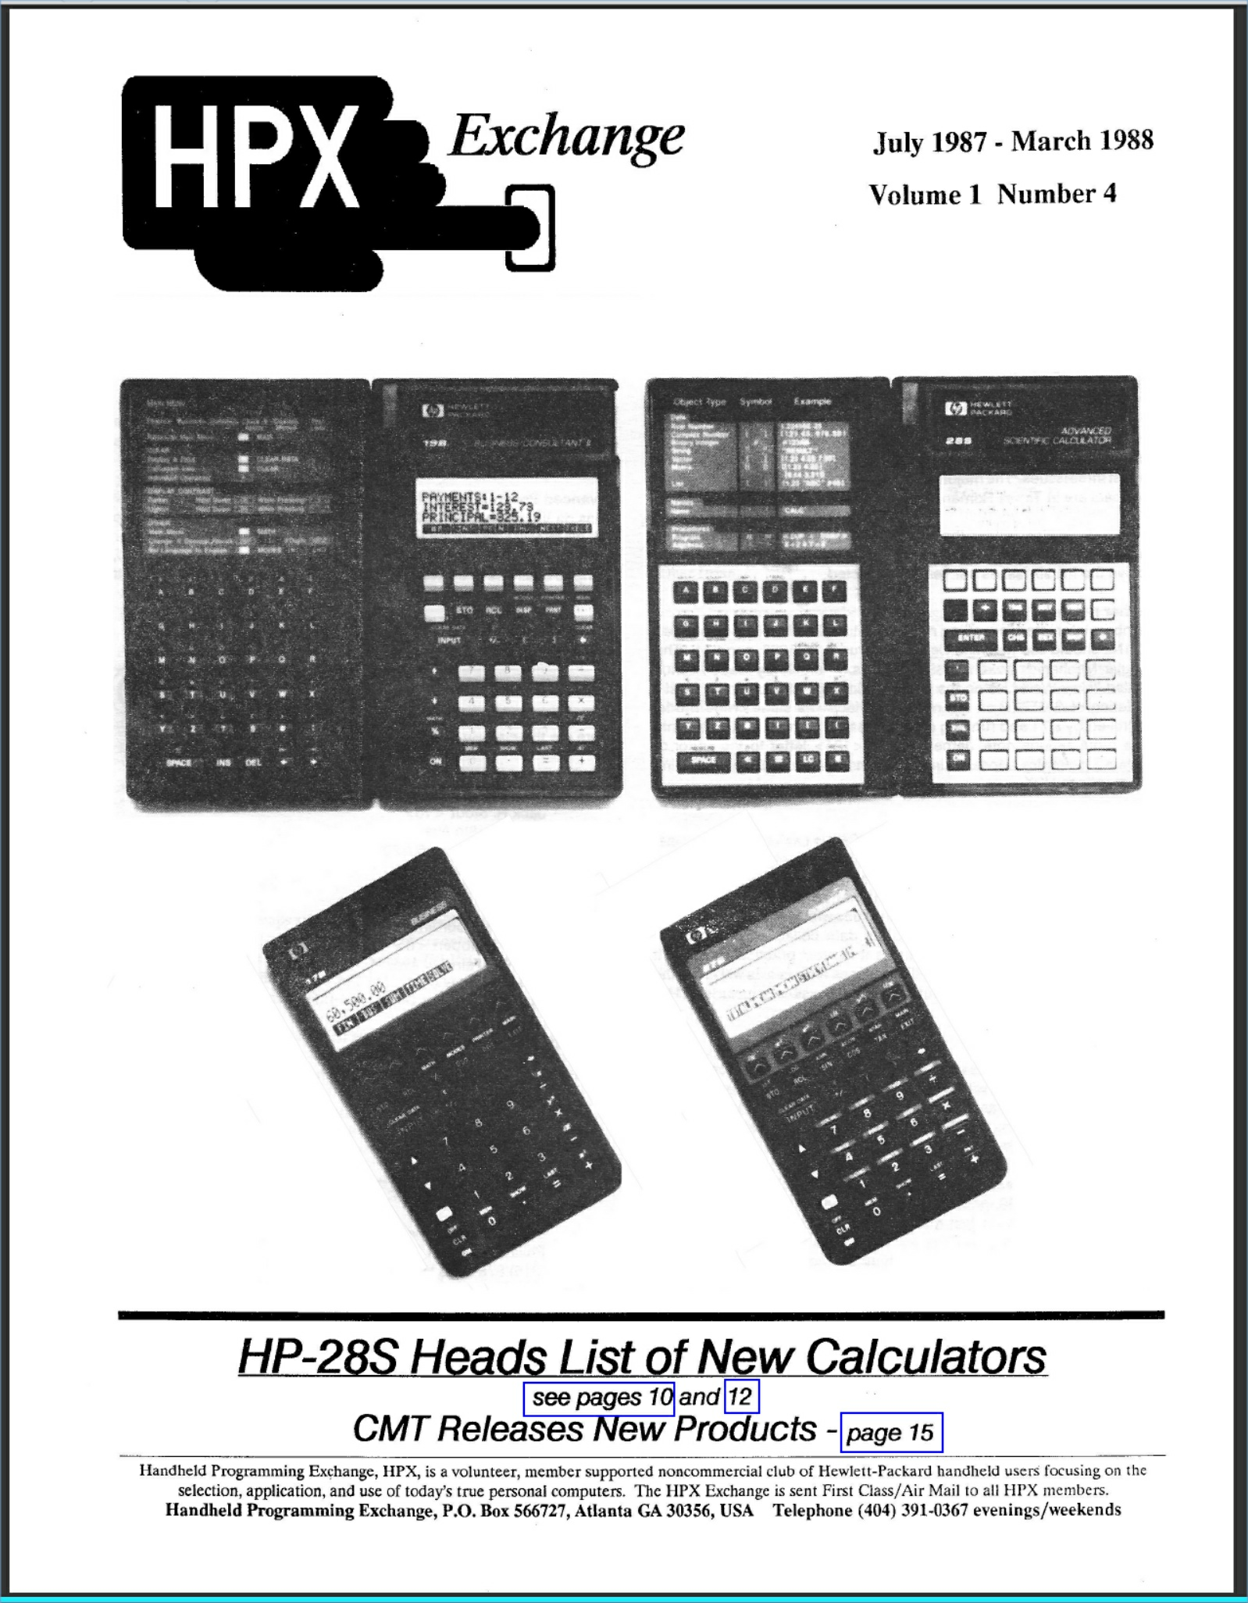
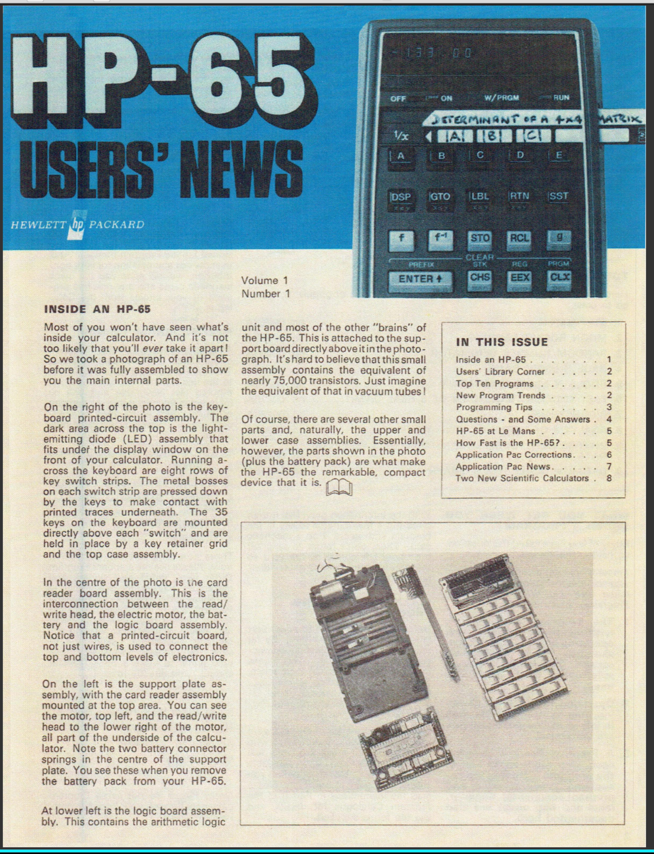
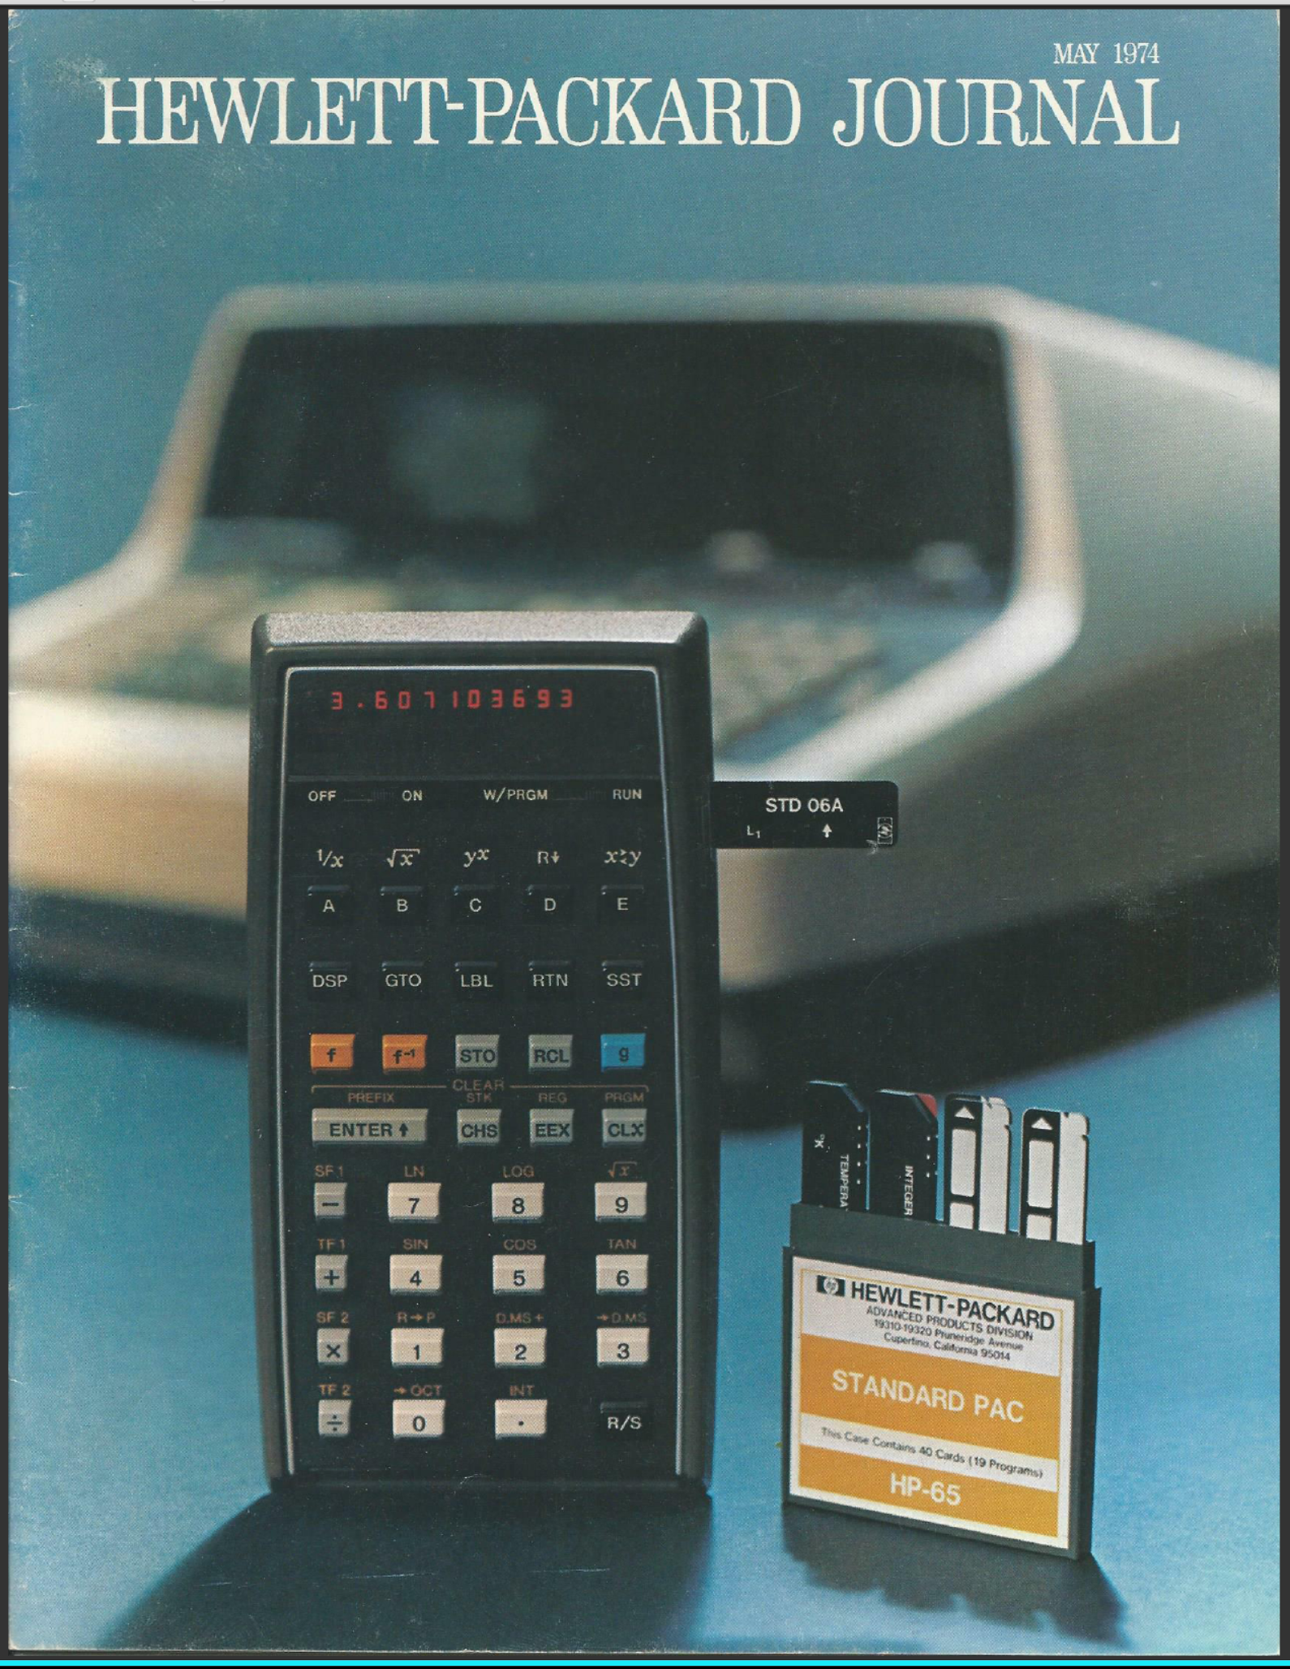
CD1 & CD2 Contents
5

Slide 6
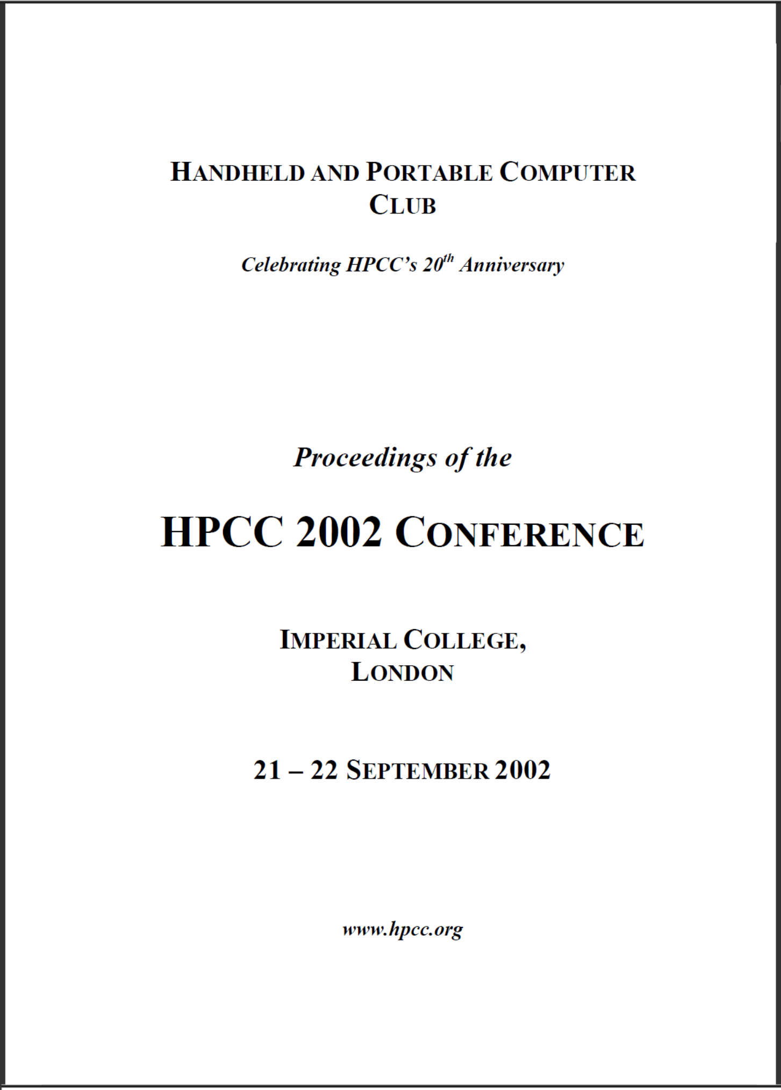
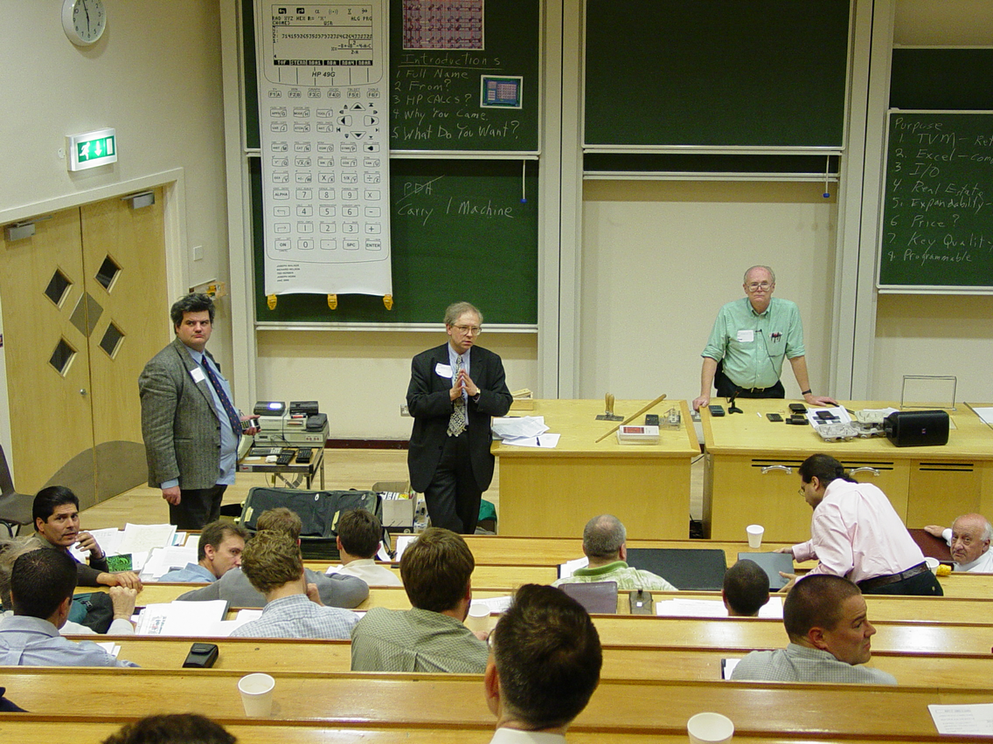
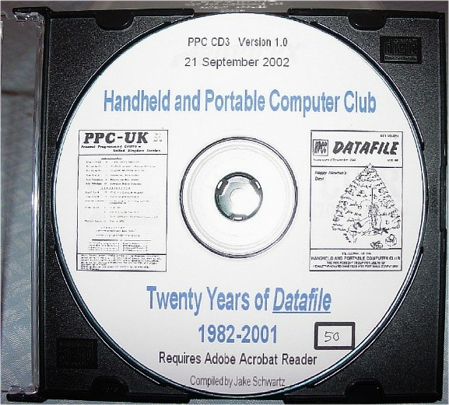
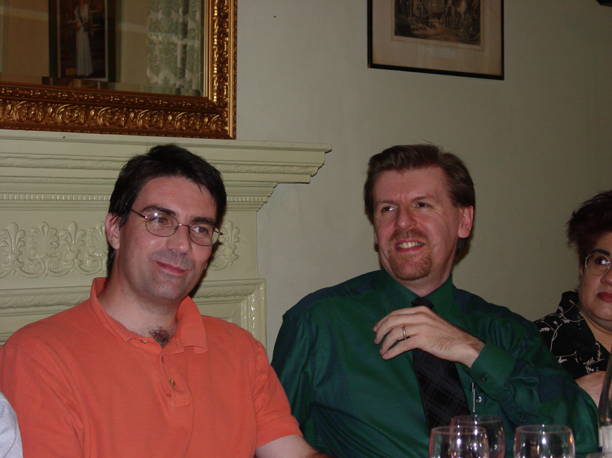
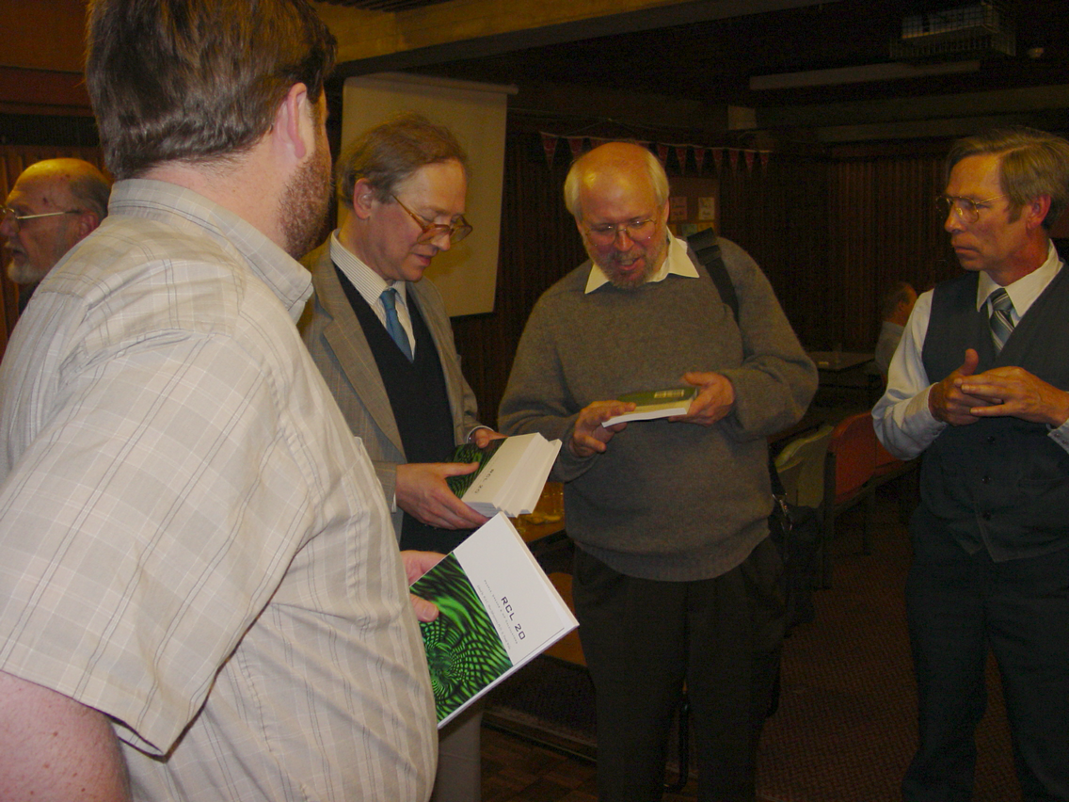
2002: CD3: 20 Years of Datafile
In conjunction with HPCC2002 Conference
6

Slide 7
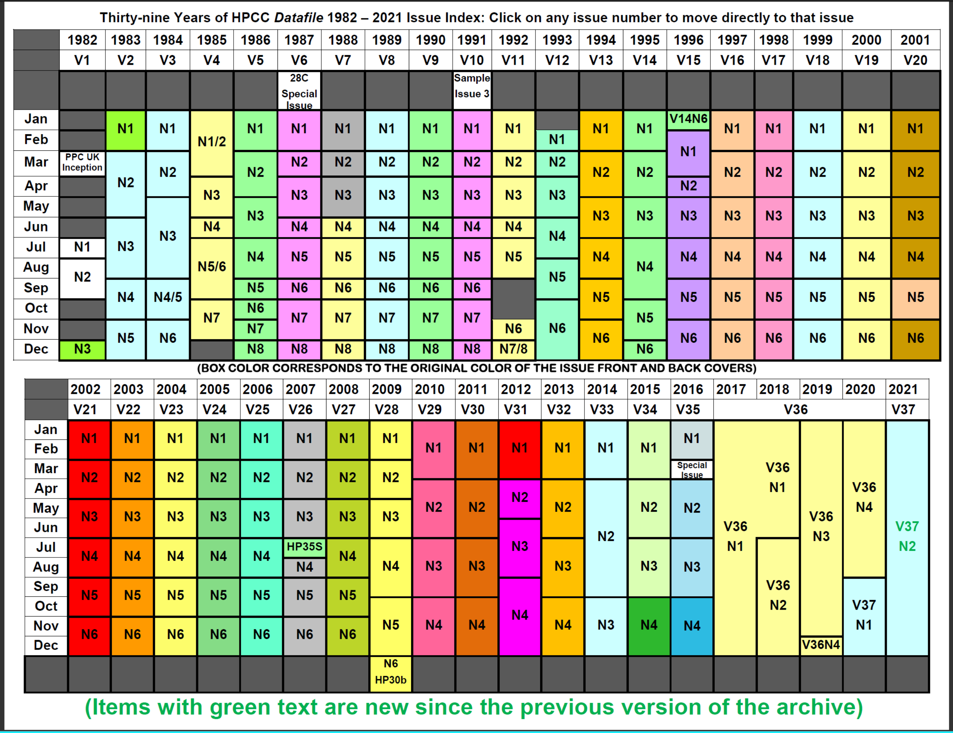
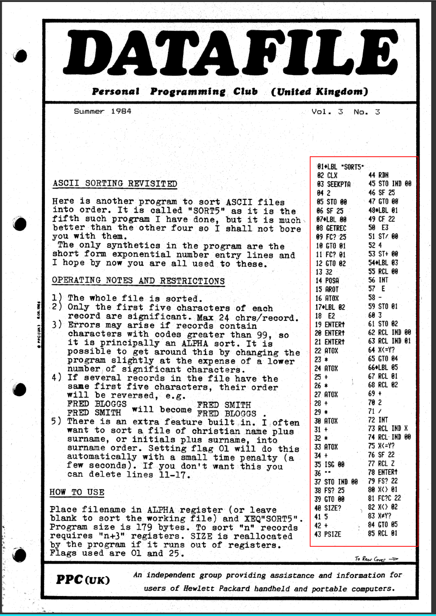
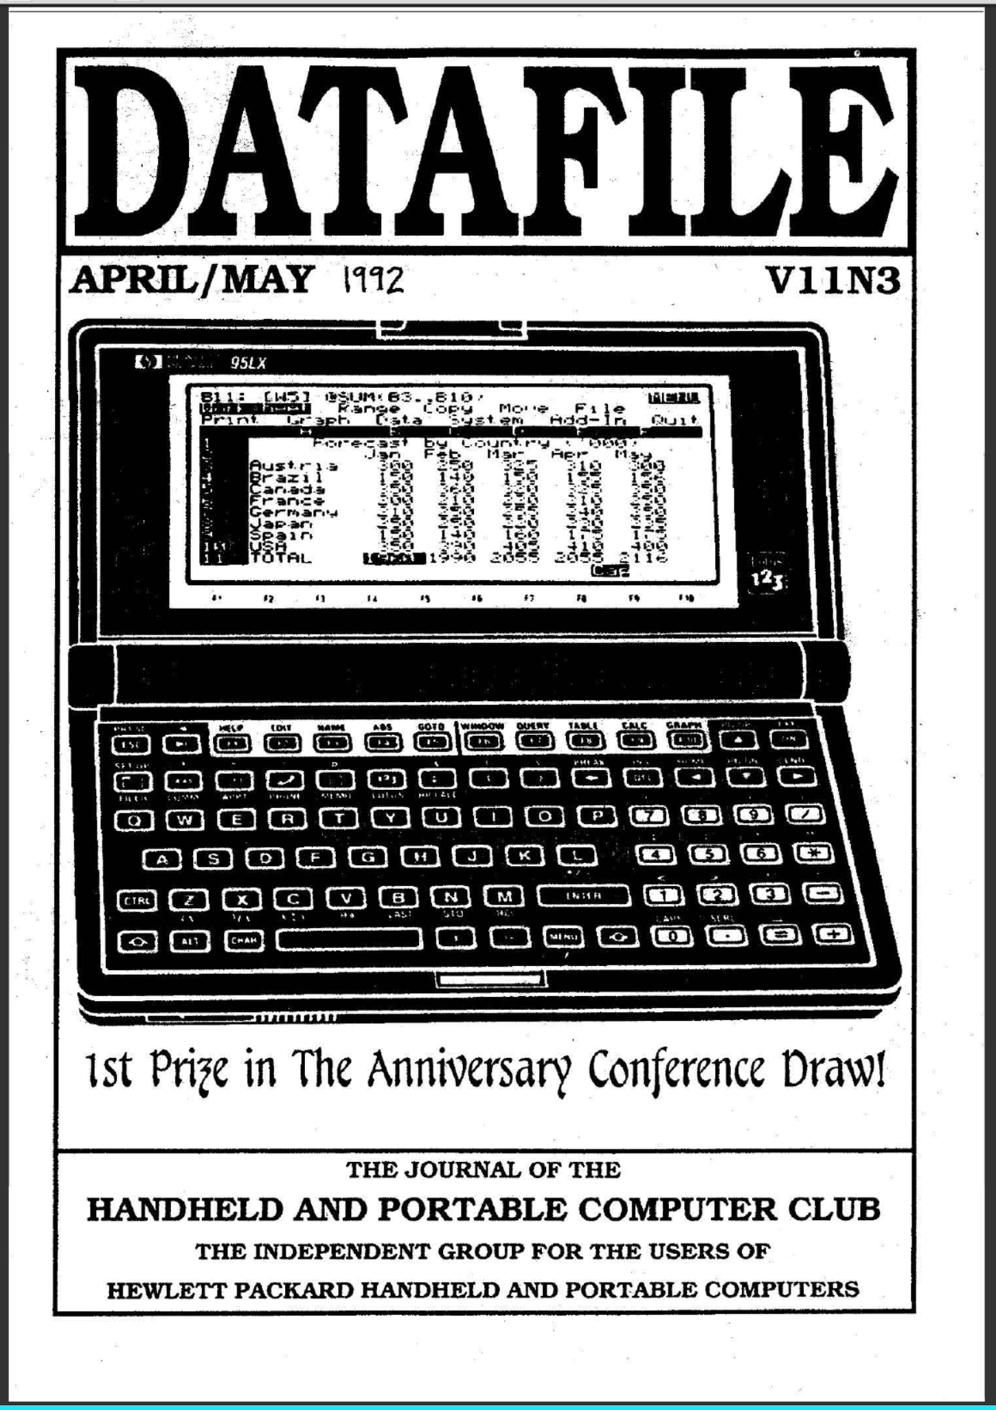
The Current CD3 “Jump Table”
7

Slide 8
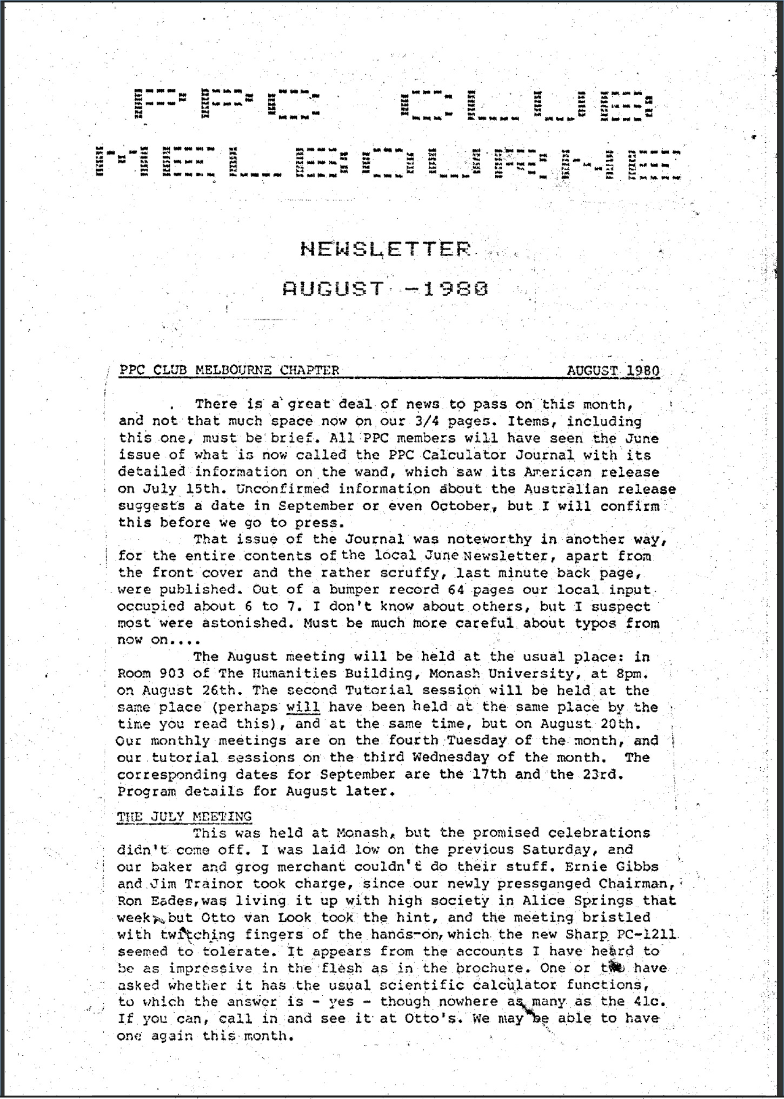
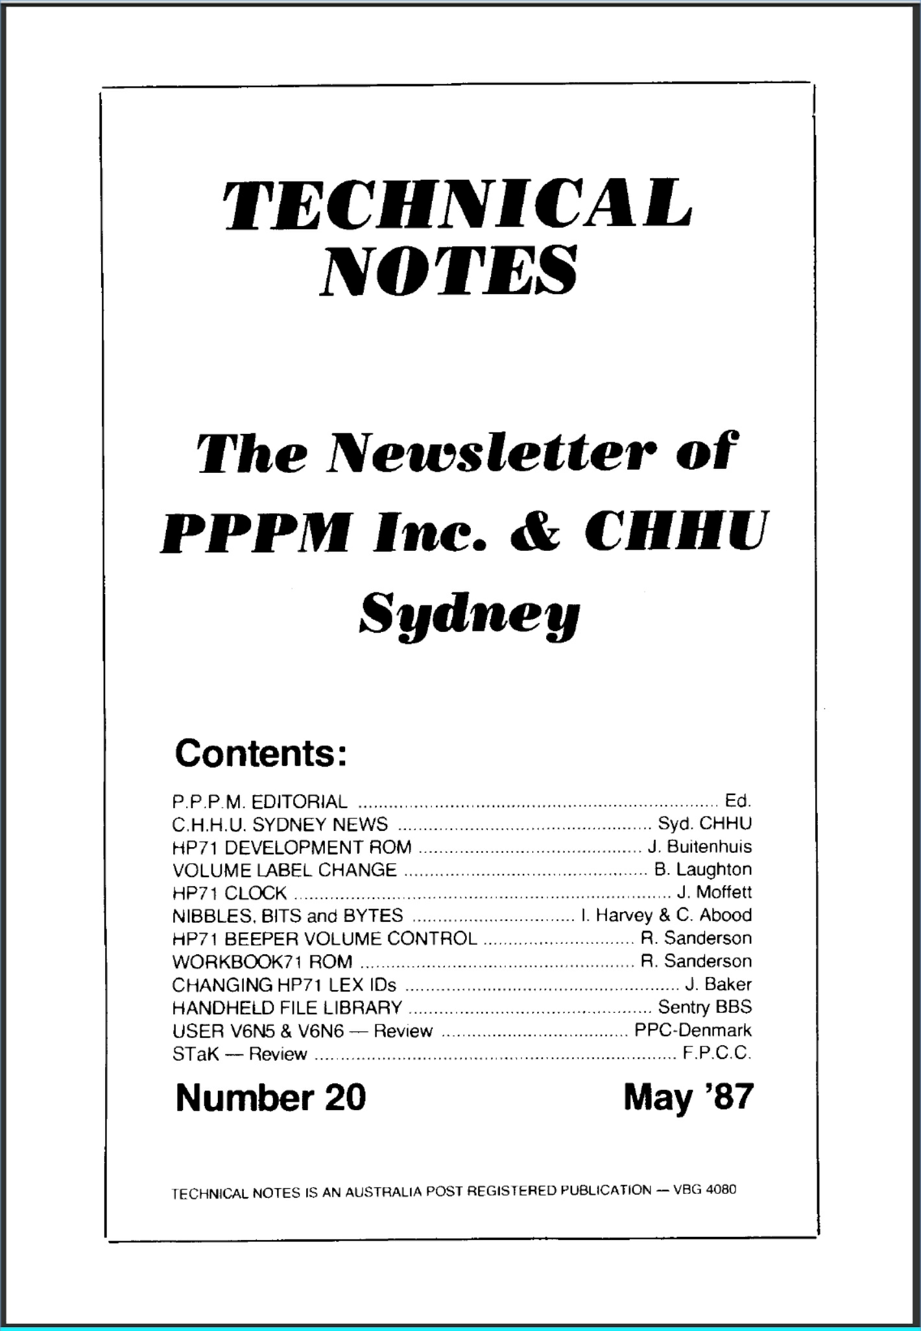
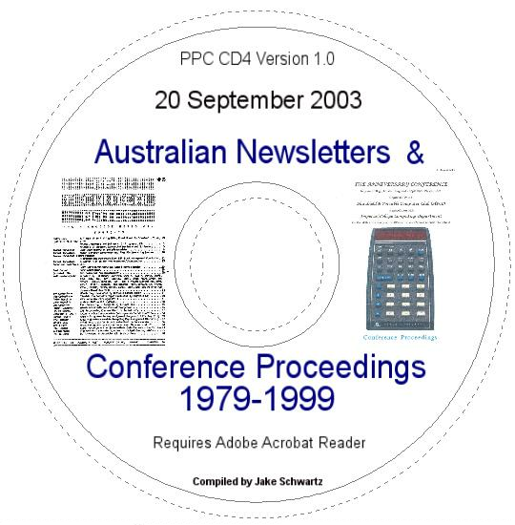
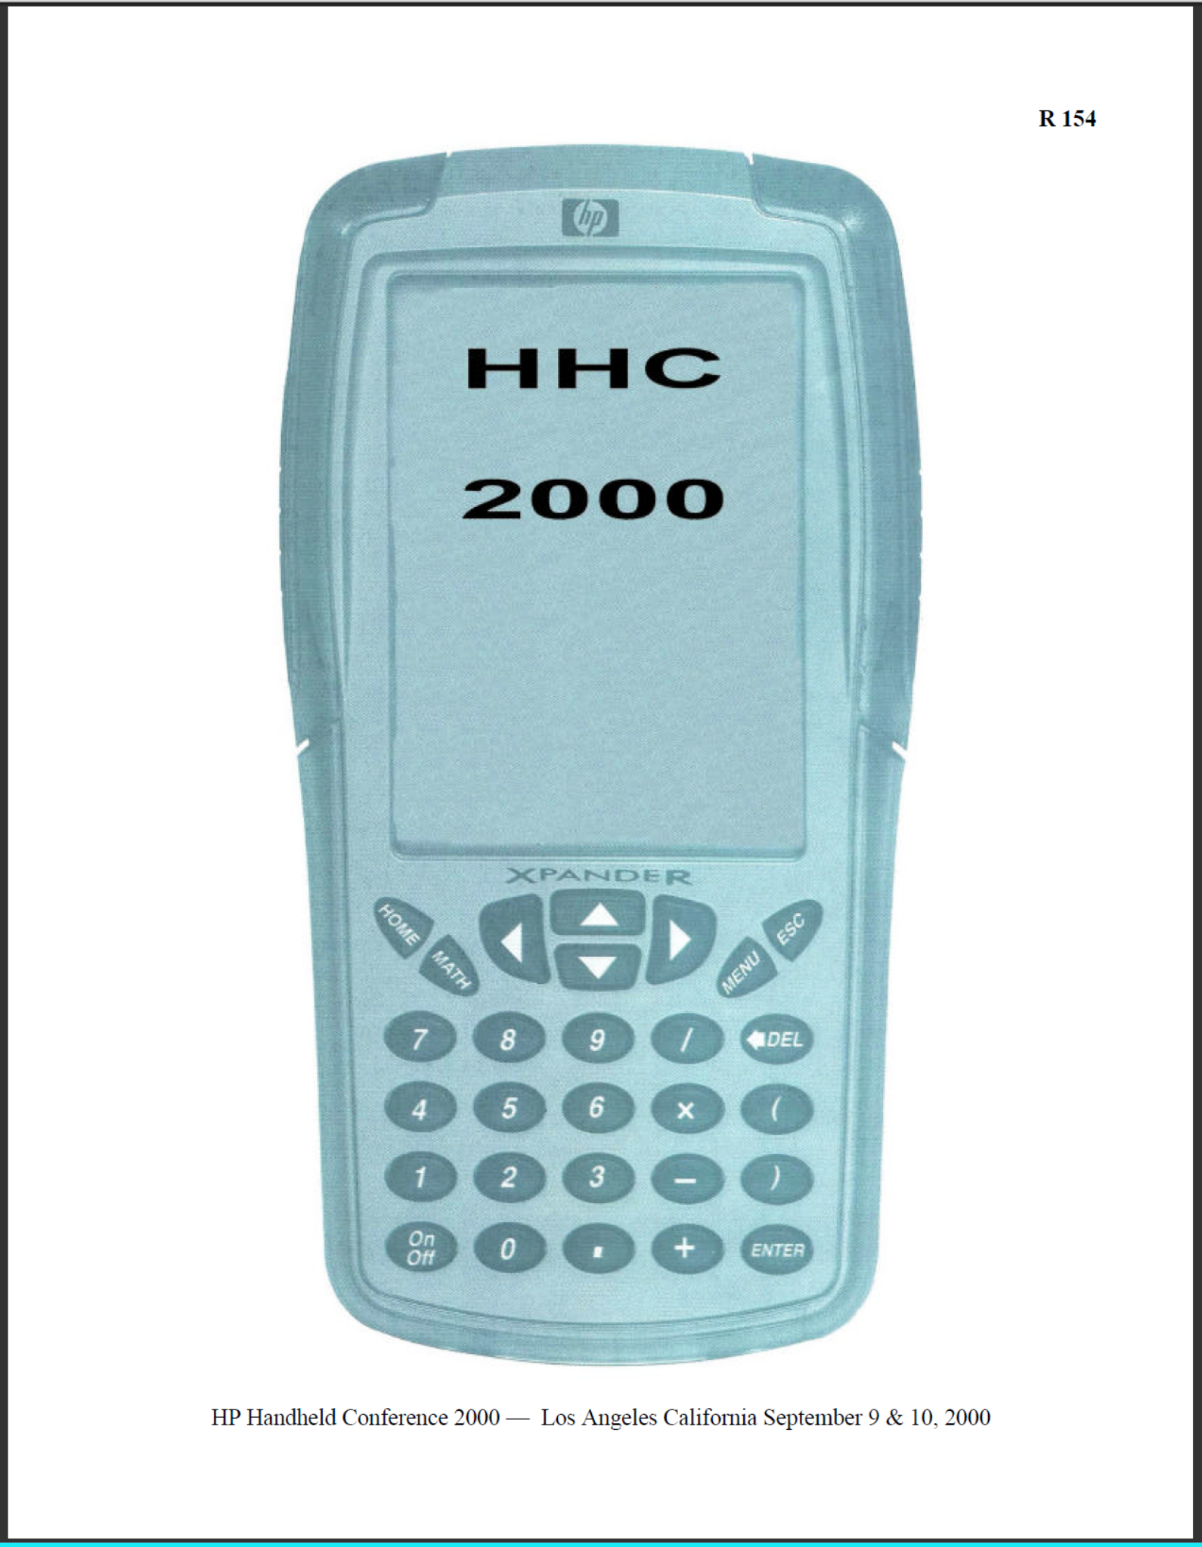
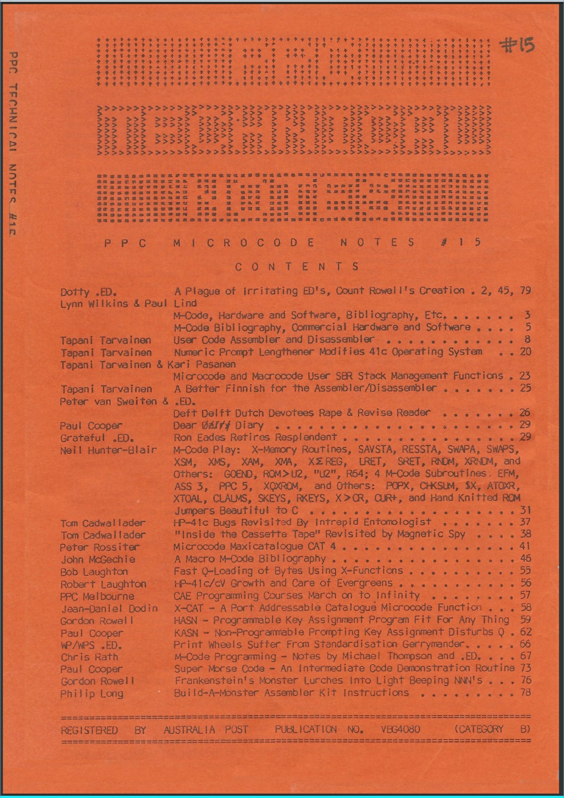
A Year Later, CD4 Was Created
8

Slide 9
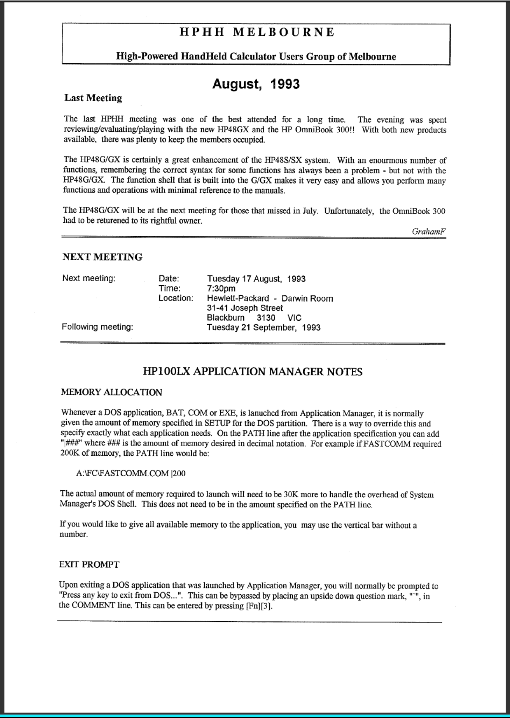
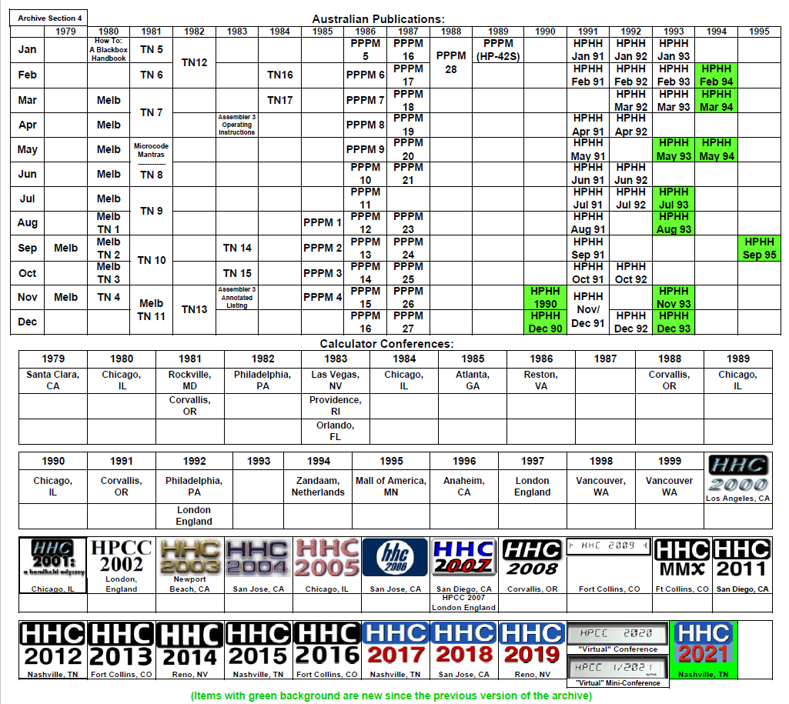
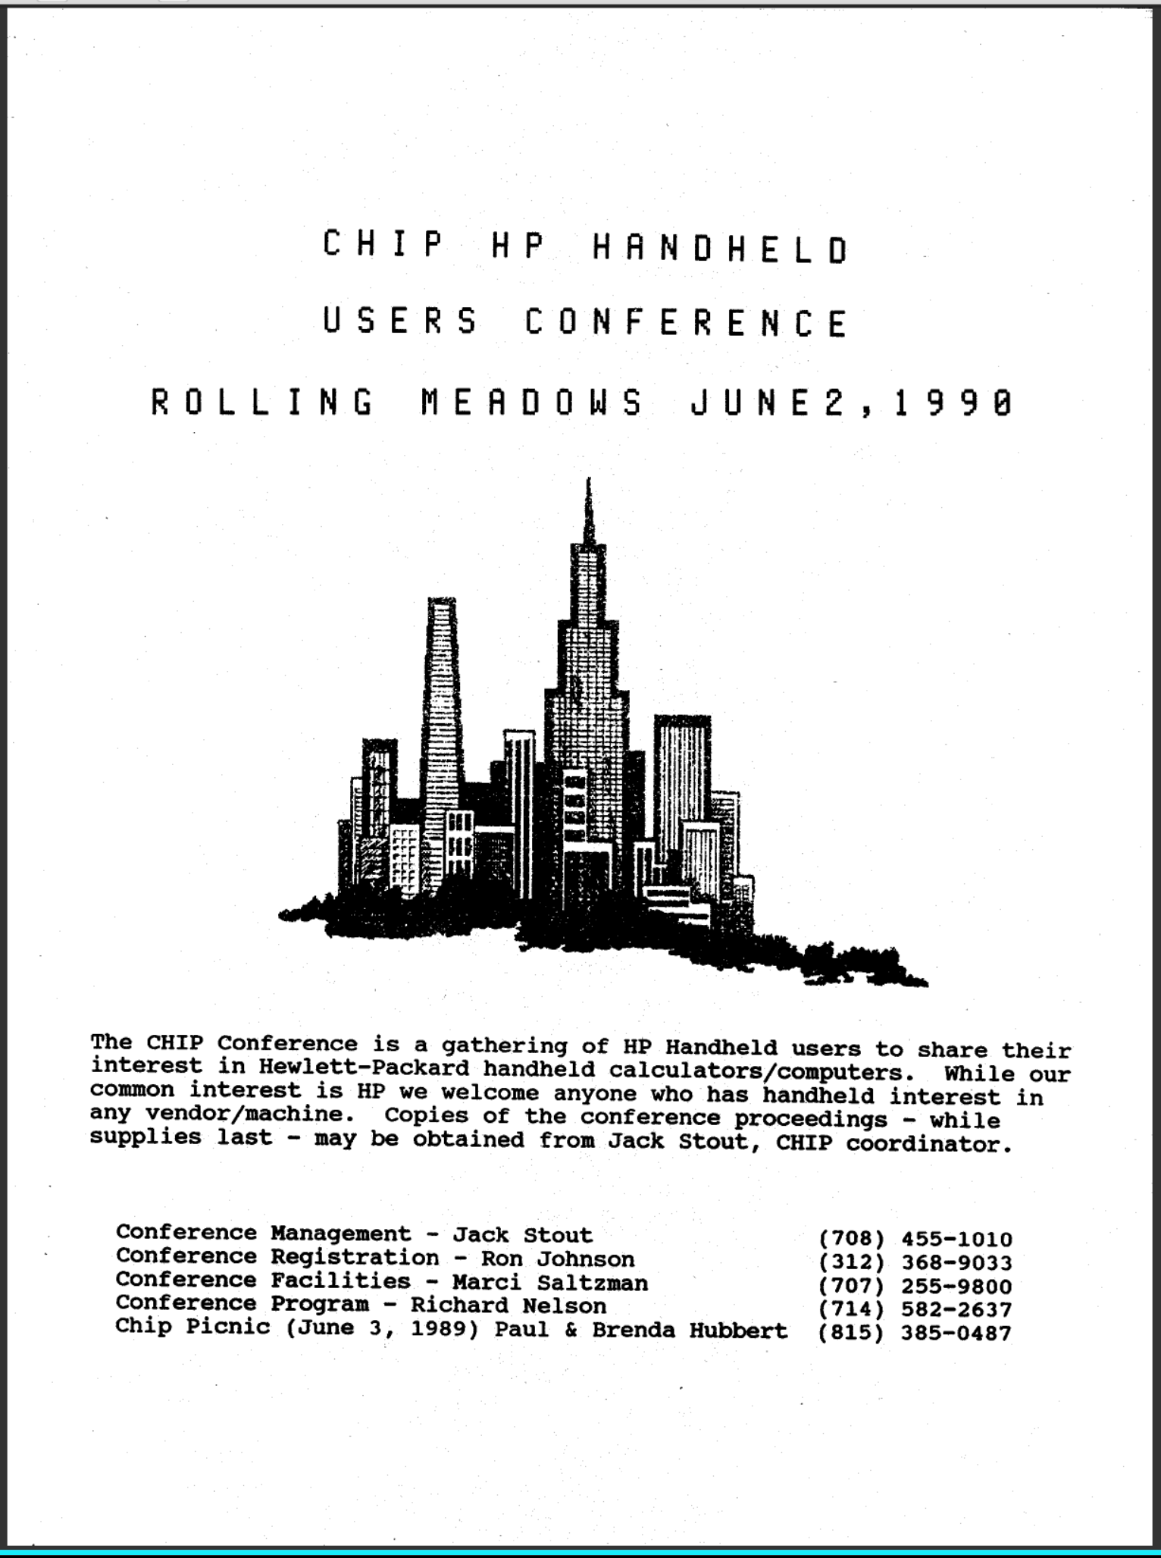
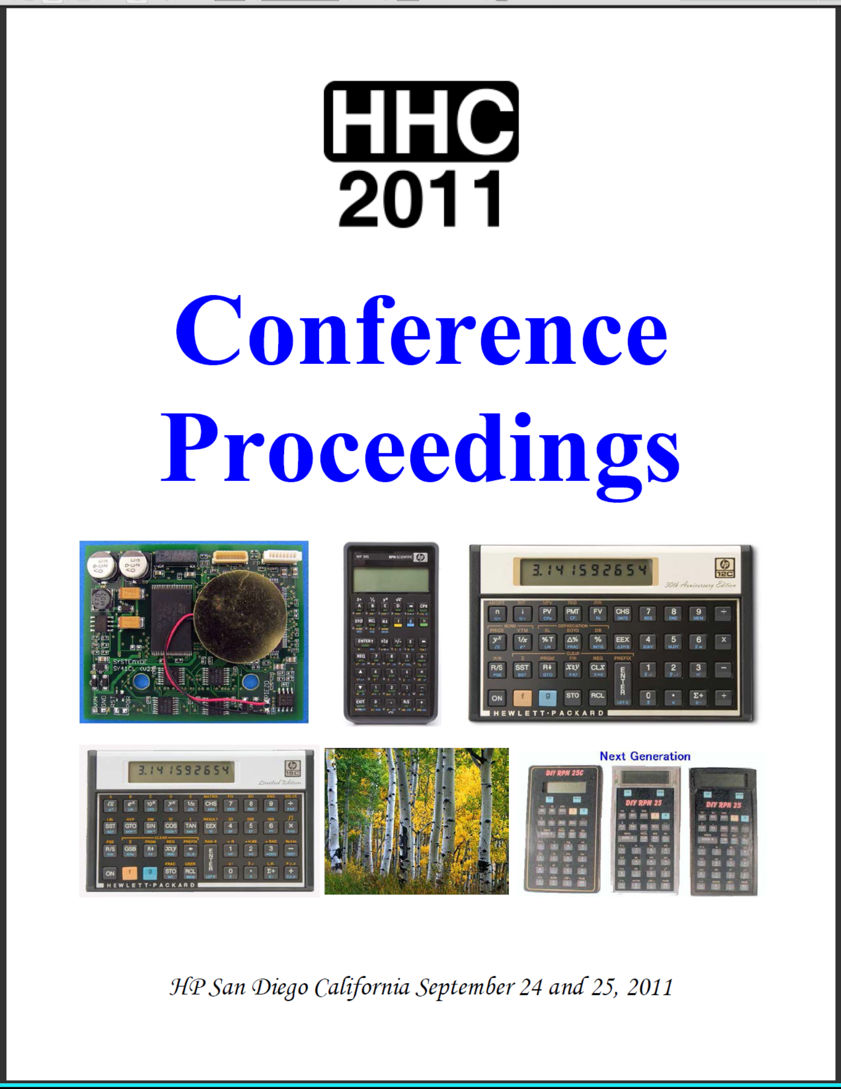
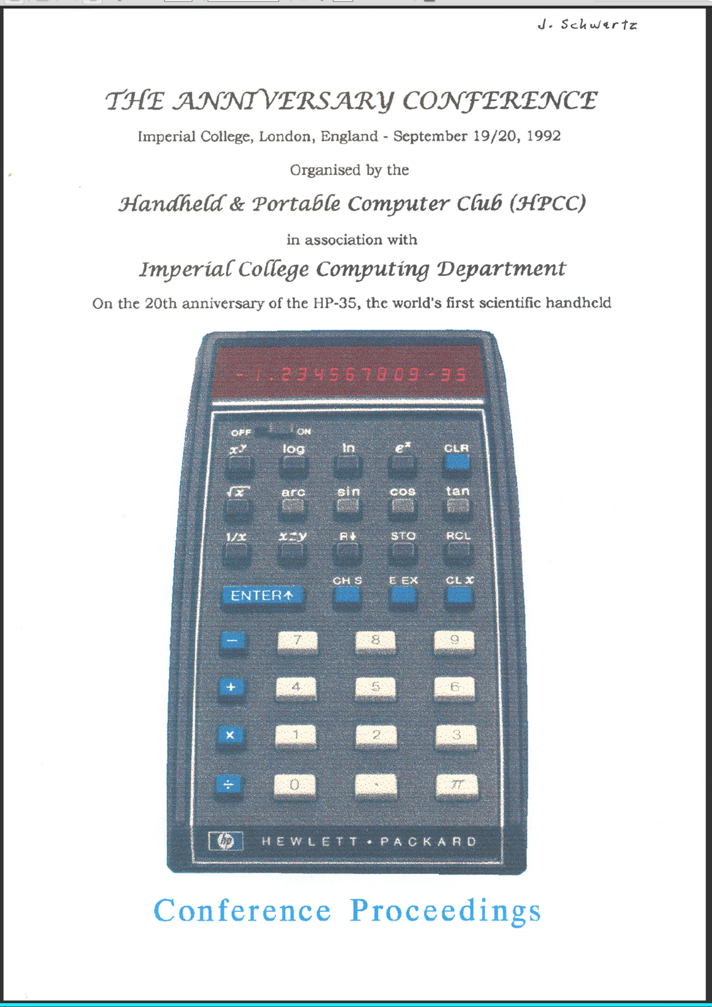
The Current Section-4 “Jump Table”
9

Slide 10
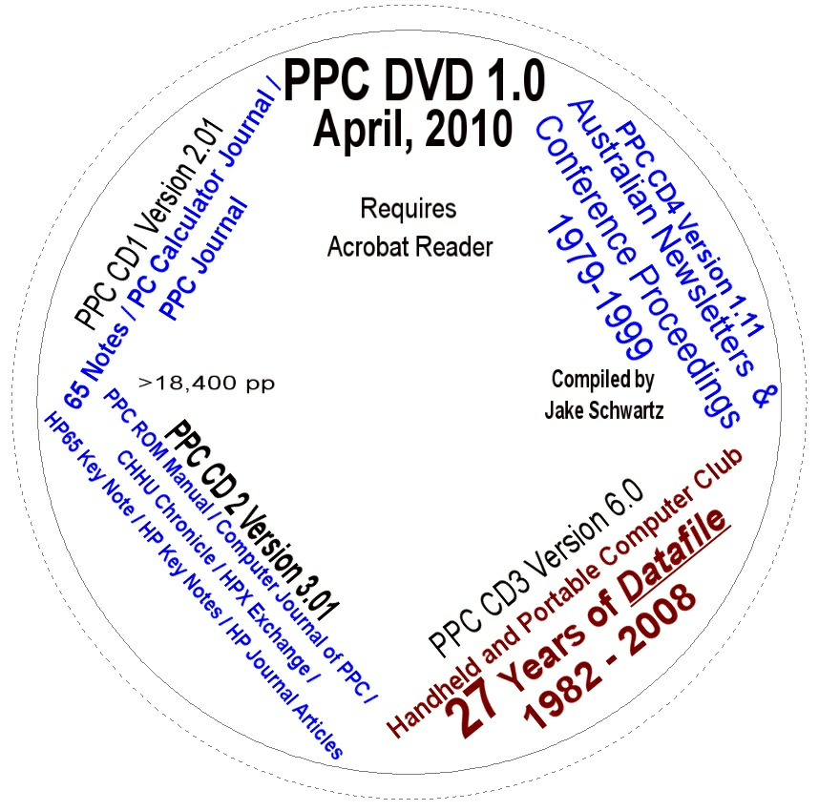
2010: Combining the 4 CDs
10

Slide 11
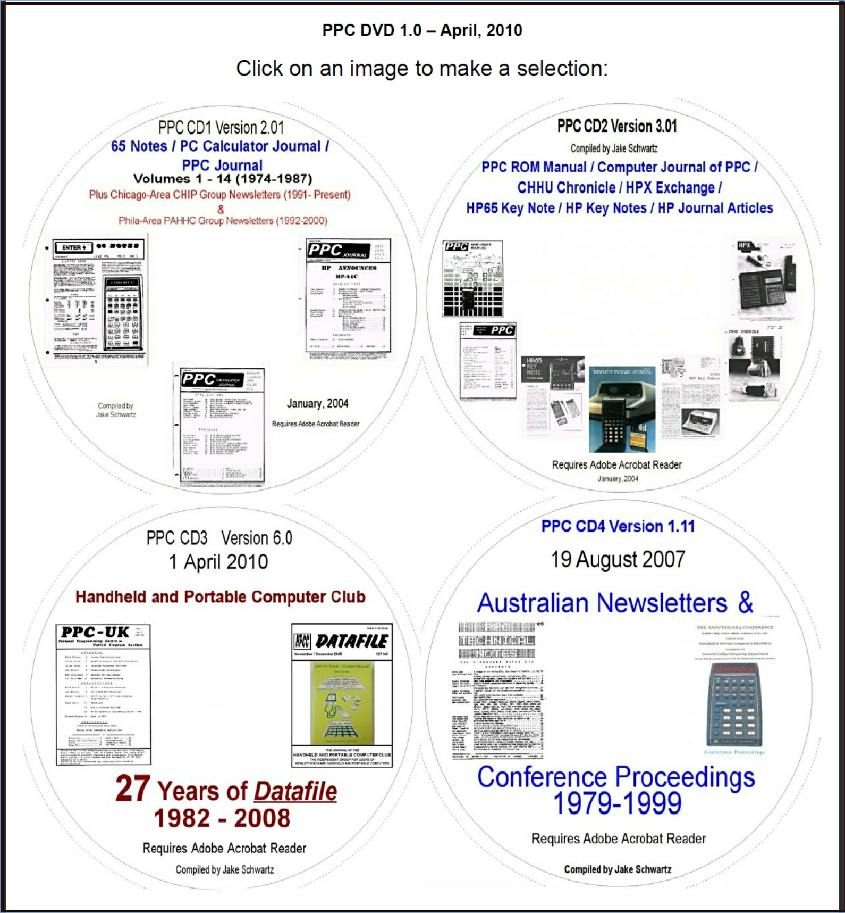
2010: Initial Starting Point
11

Slide 12
2016: Adding EduCALC Materials
Original Start Page With EduCALC
Current EduCALC Jump Page
12

Slide 13
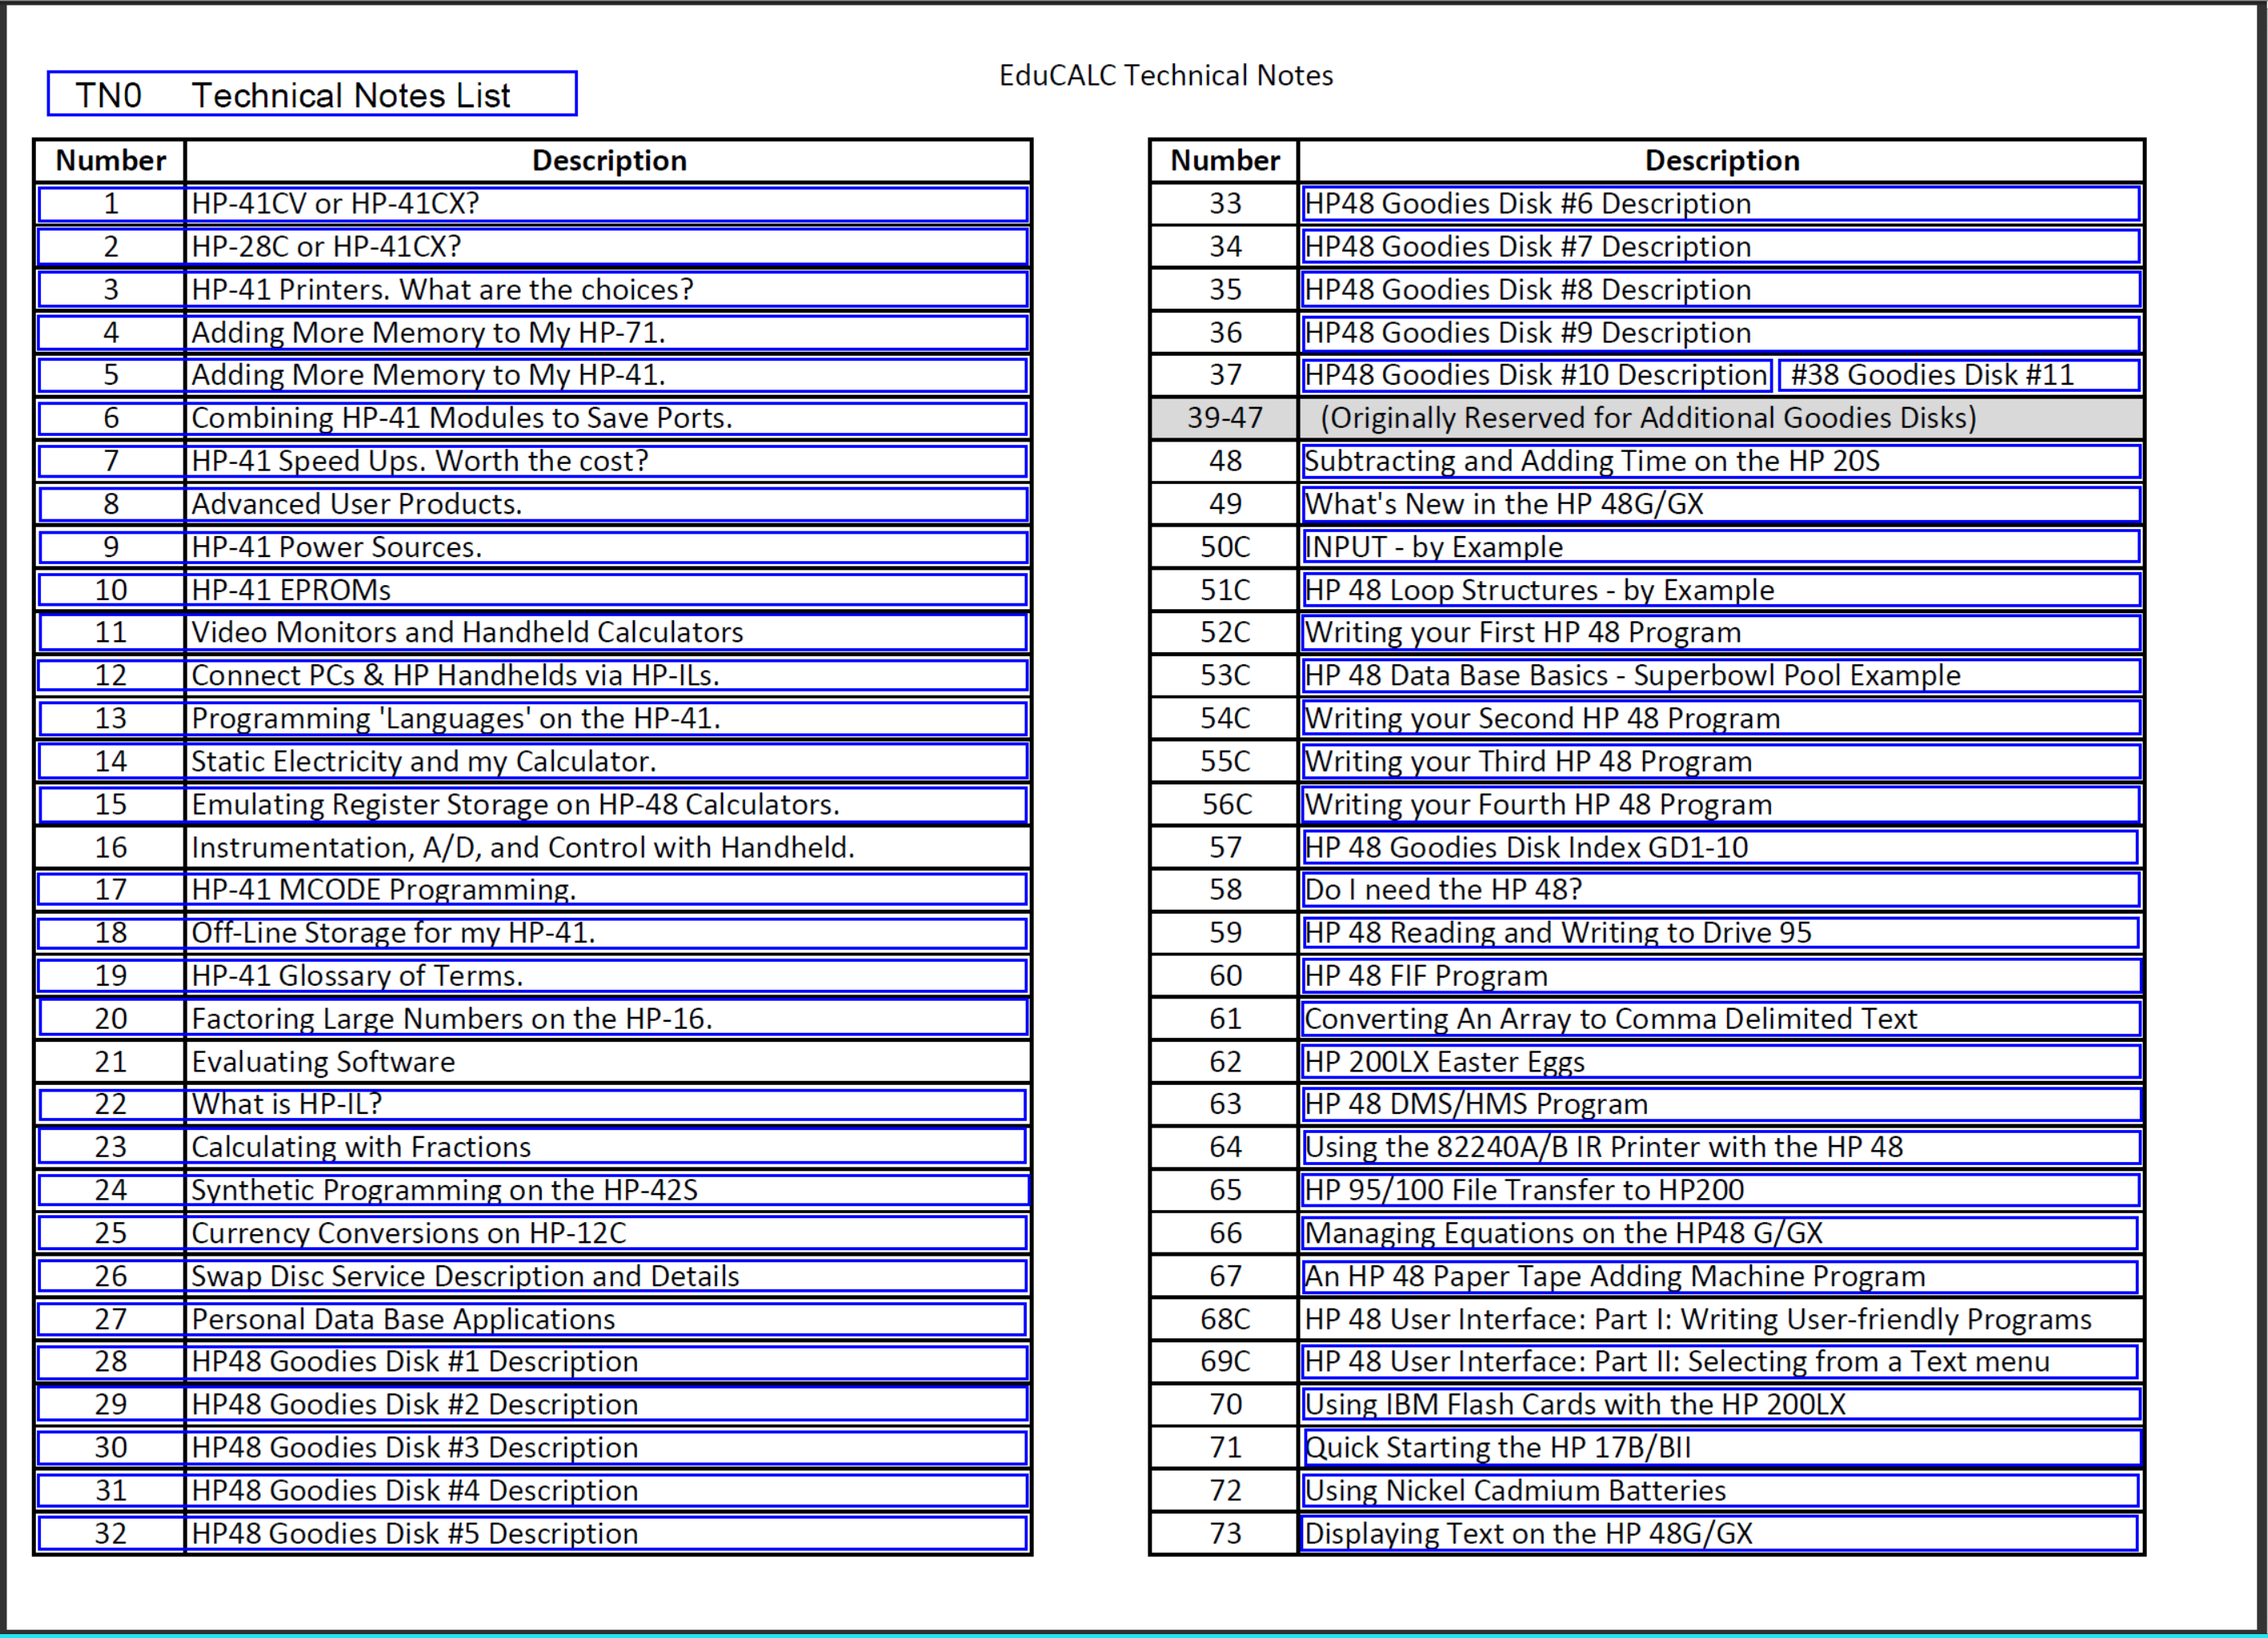
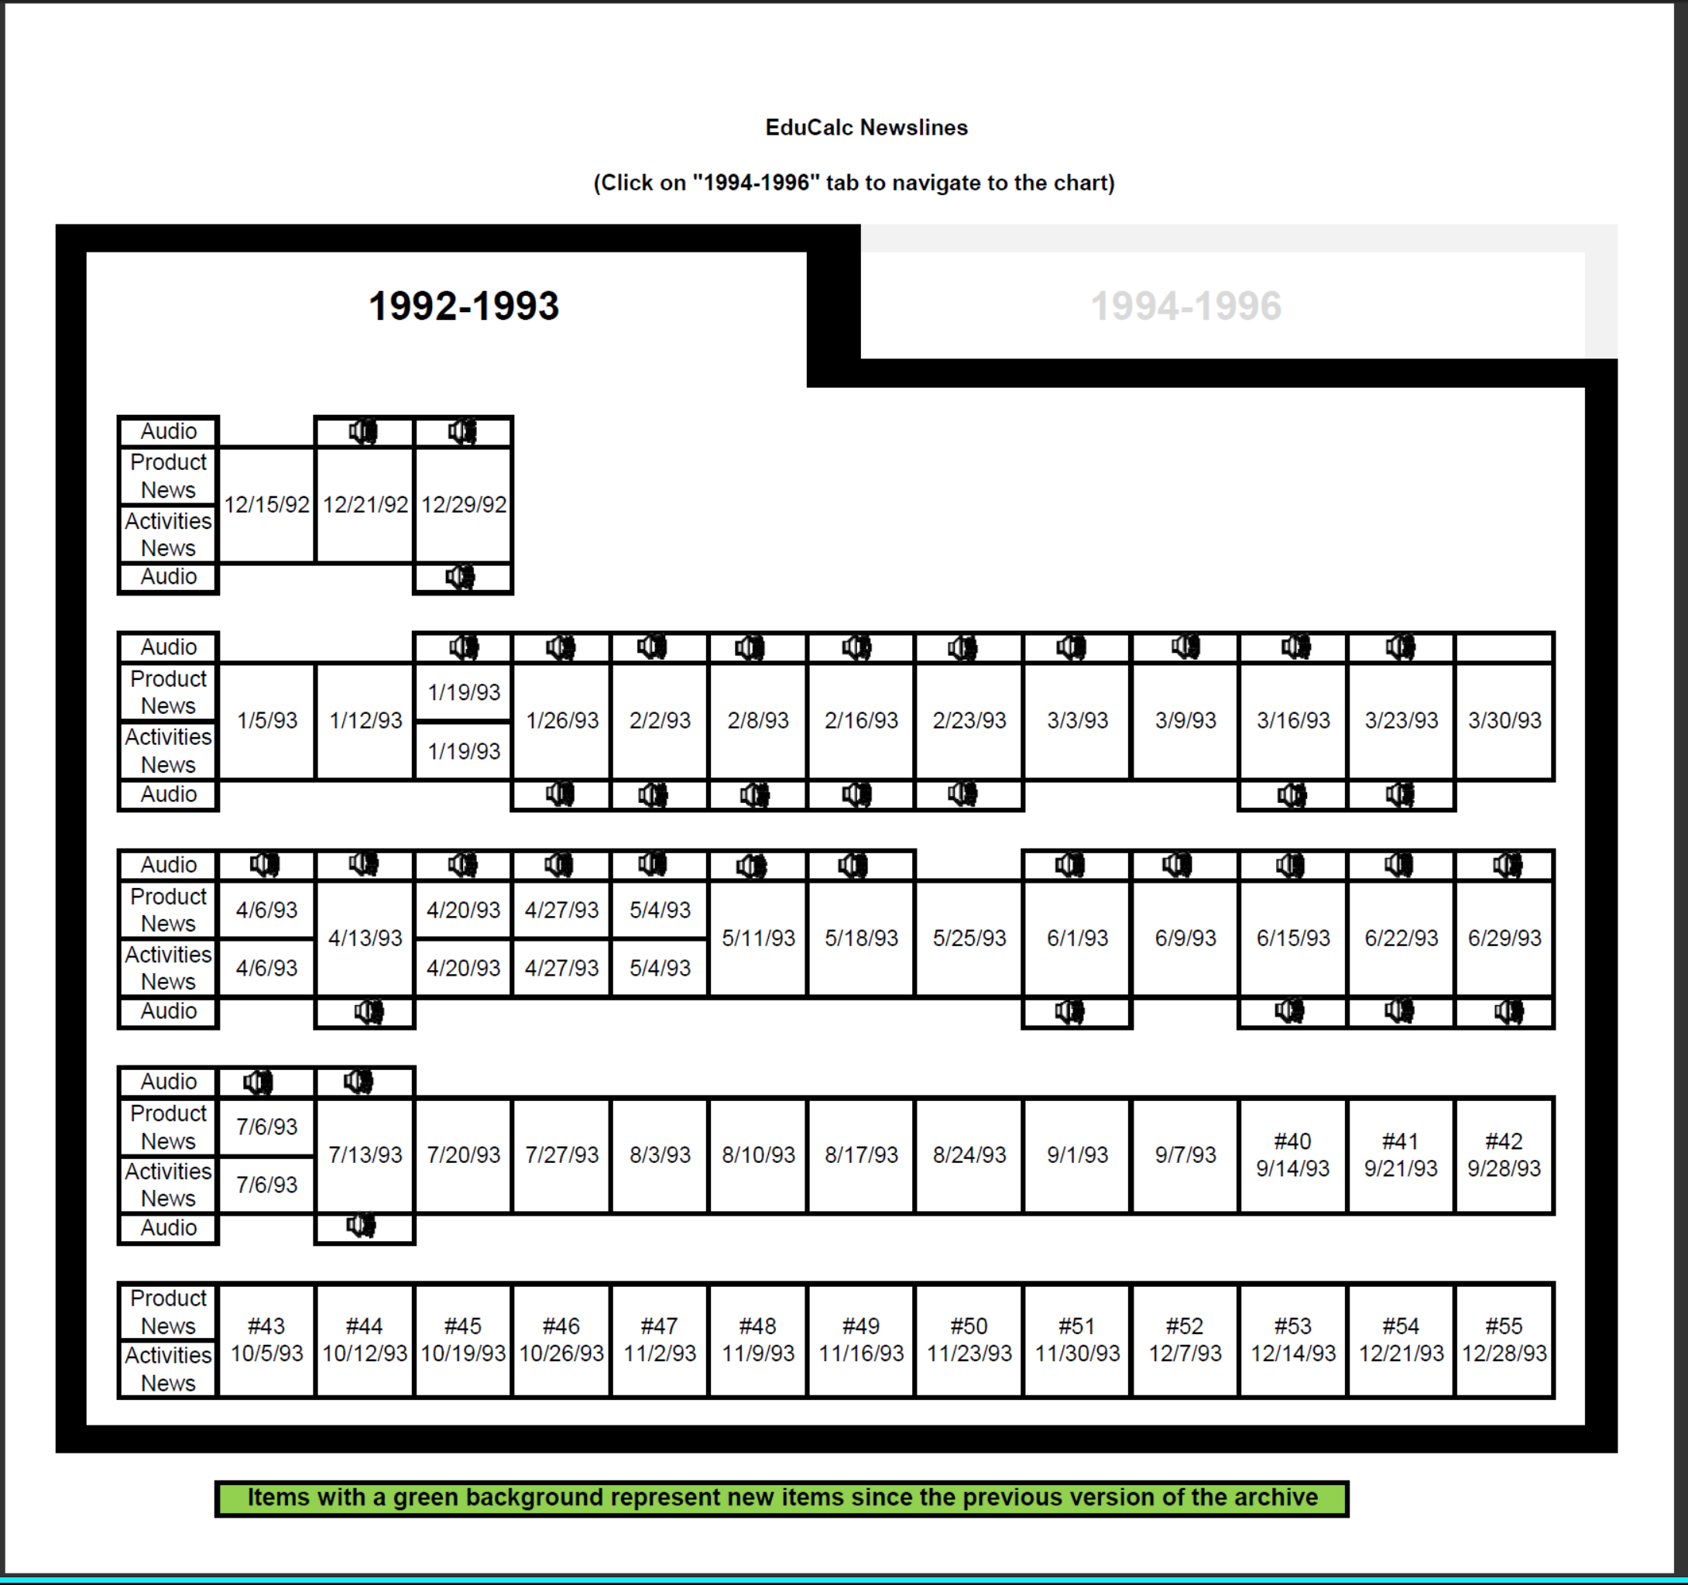
The Four EduCALC Sections (Current Status)
Technical Notes 1 to 73
Catalogs #5 to #75
Newslines 1992-1996
Additional Materials
13

Slide 14
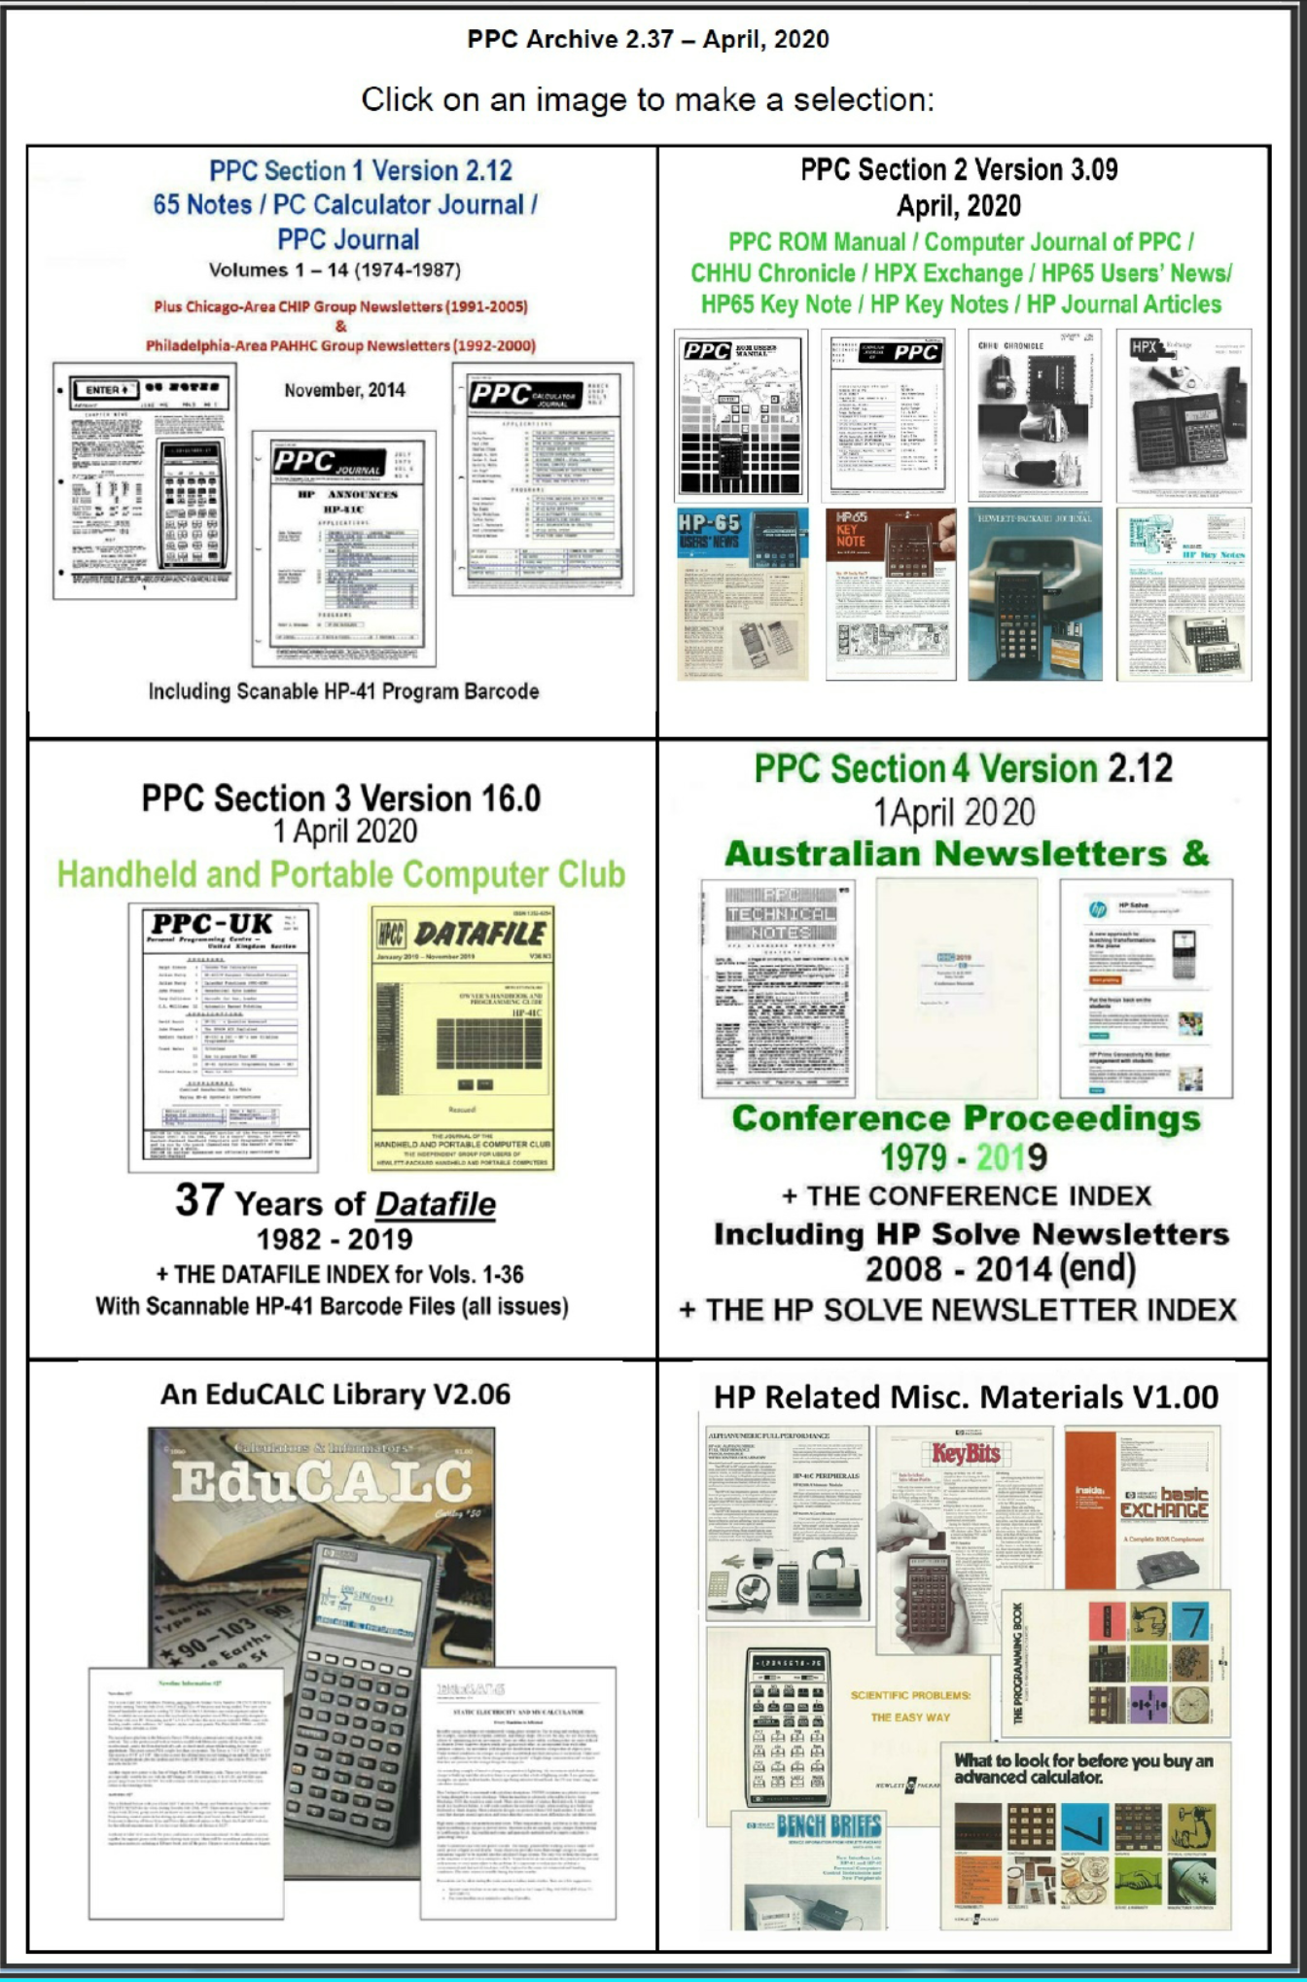
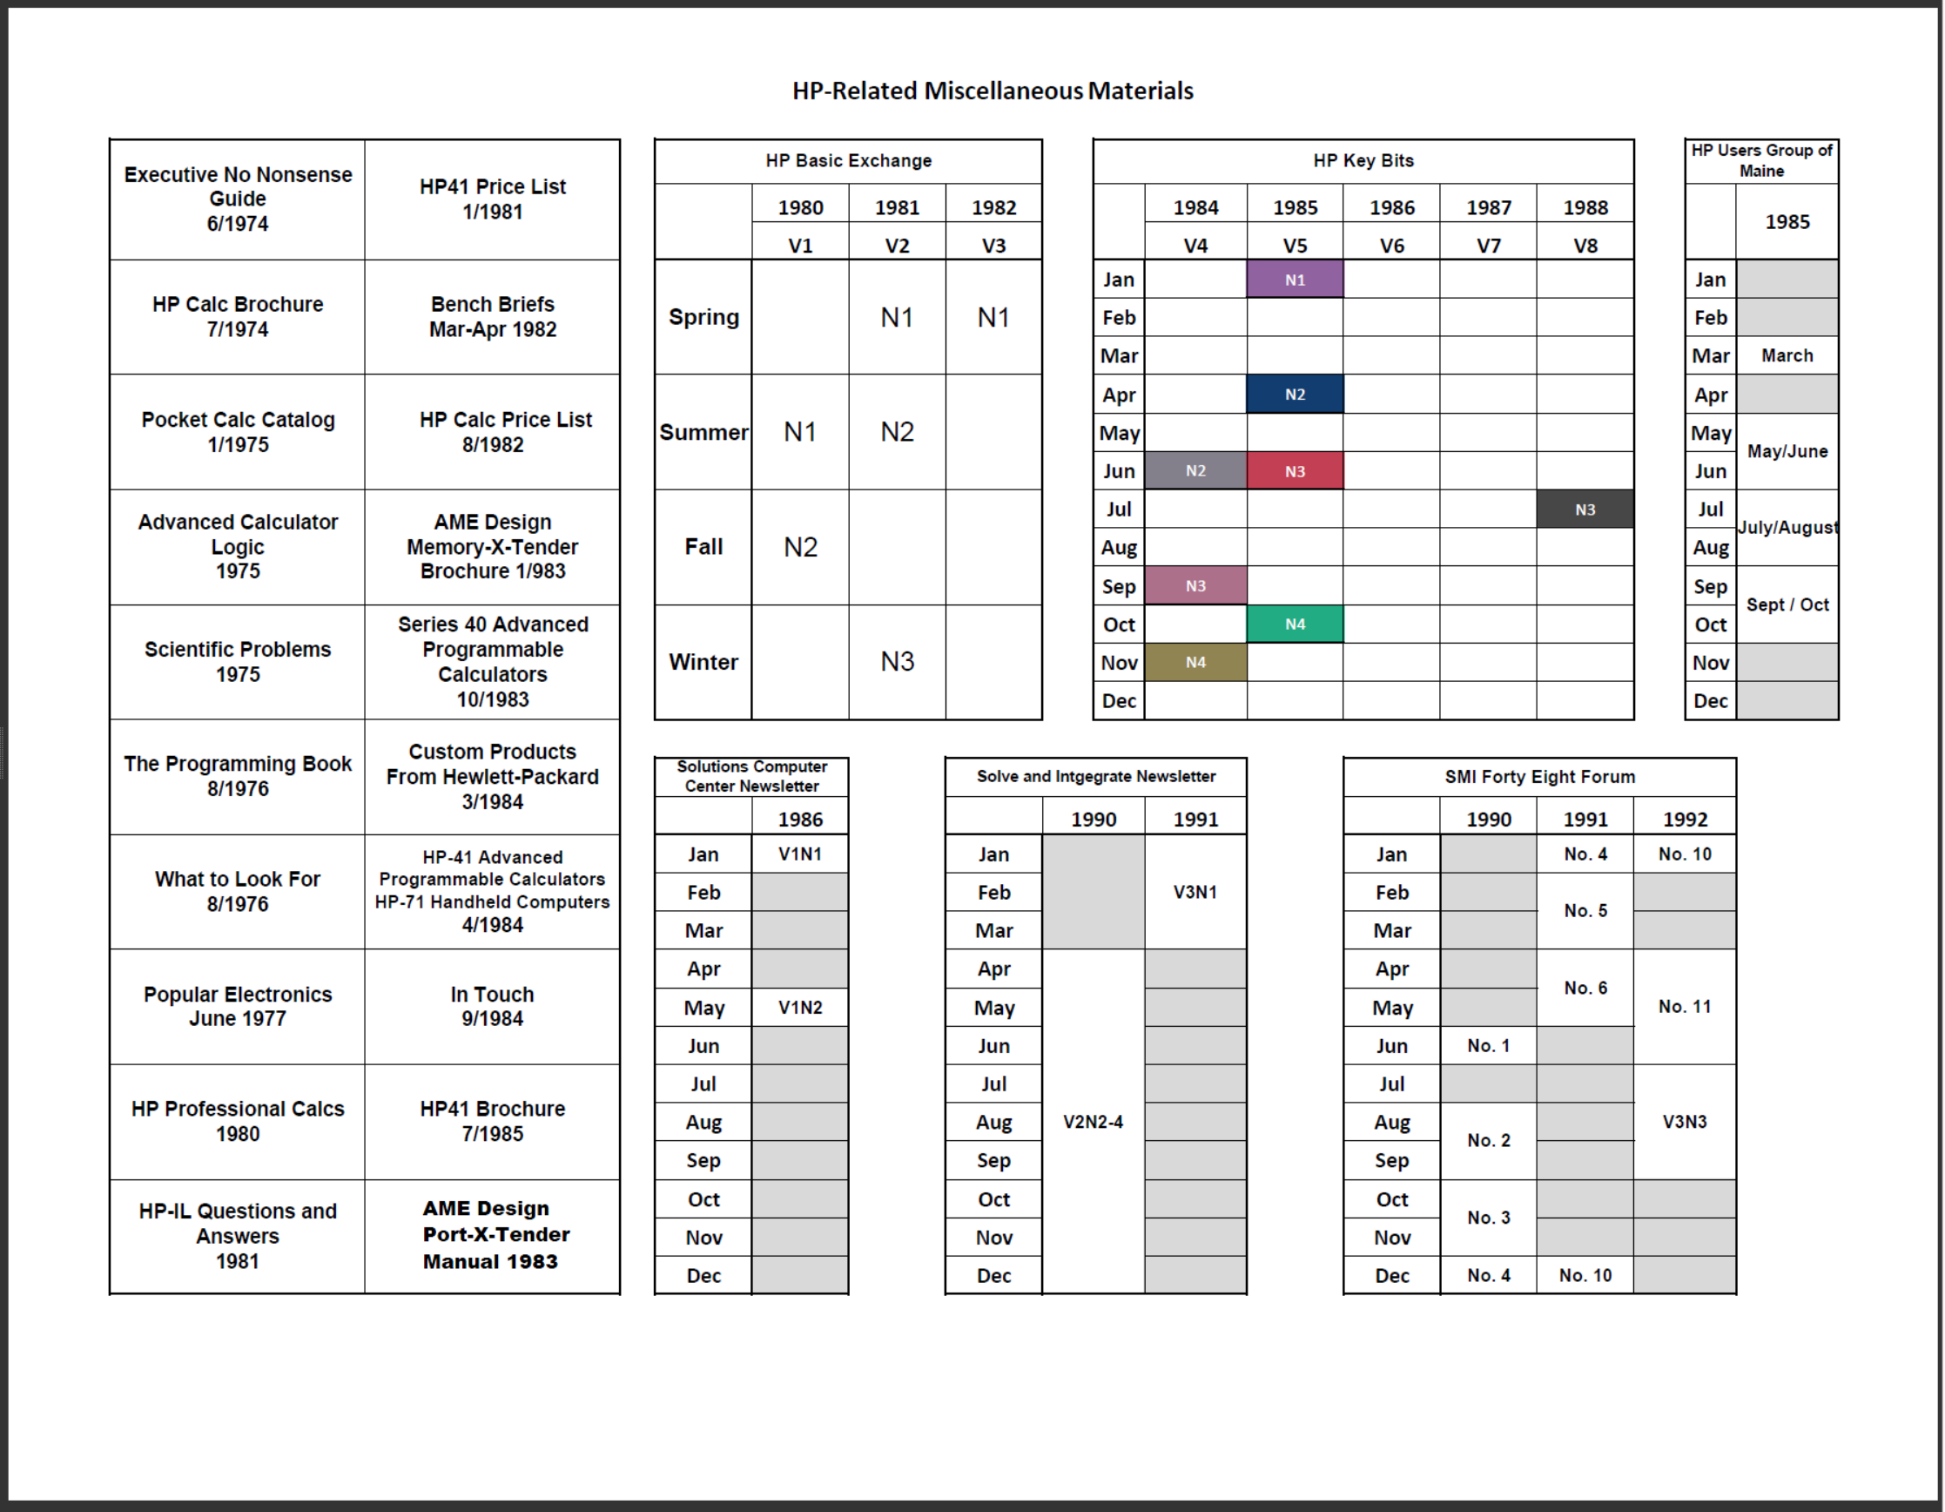
2020 – Adding Misc. HP Materials Section
Original Misc HP Materials Jump Page
14

Slide 15
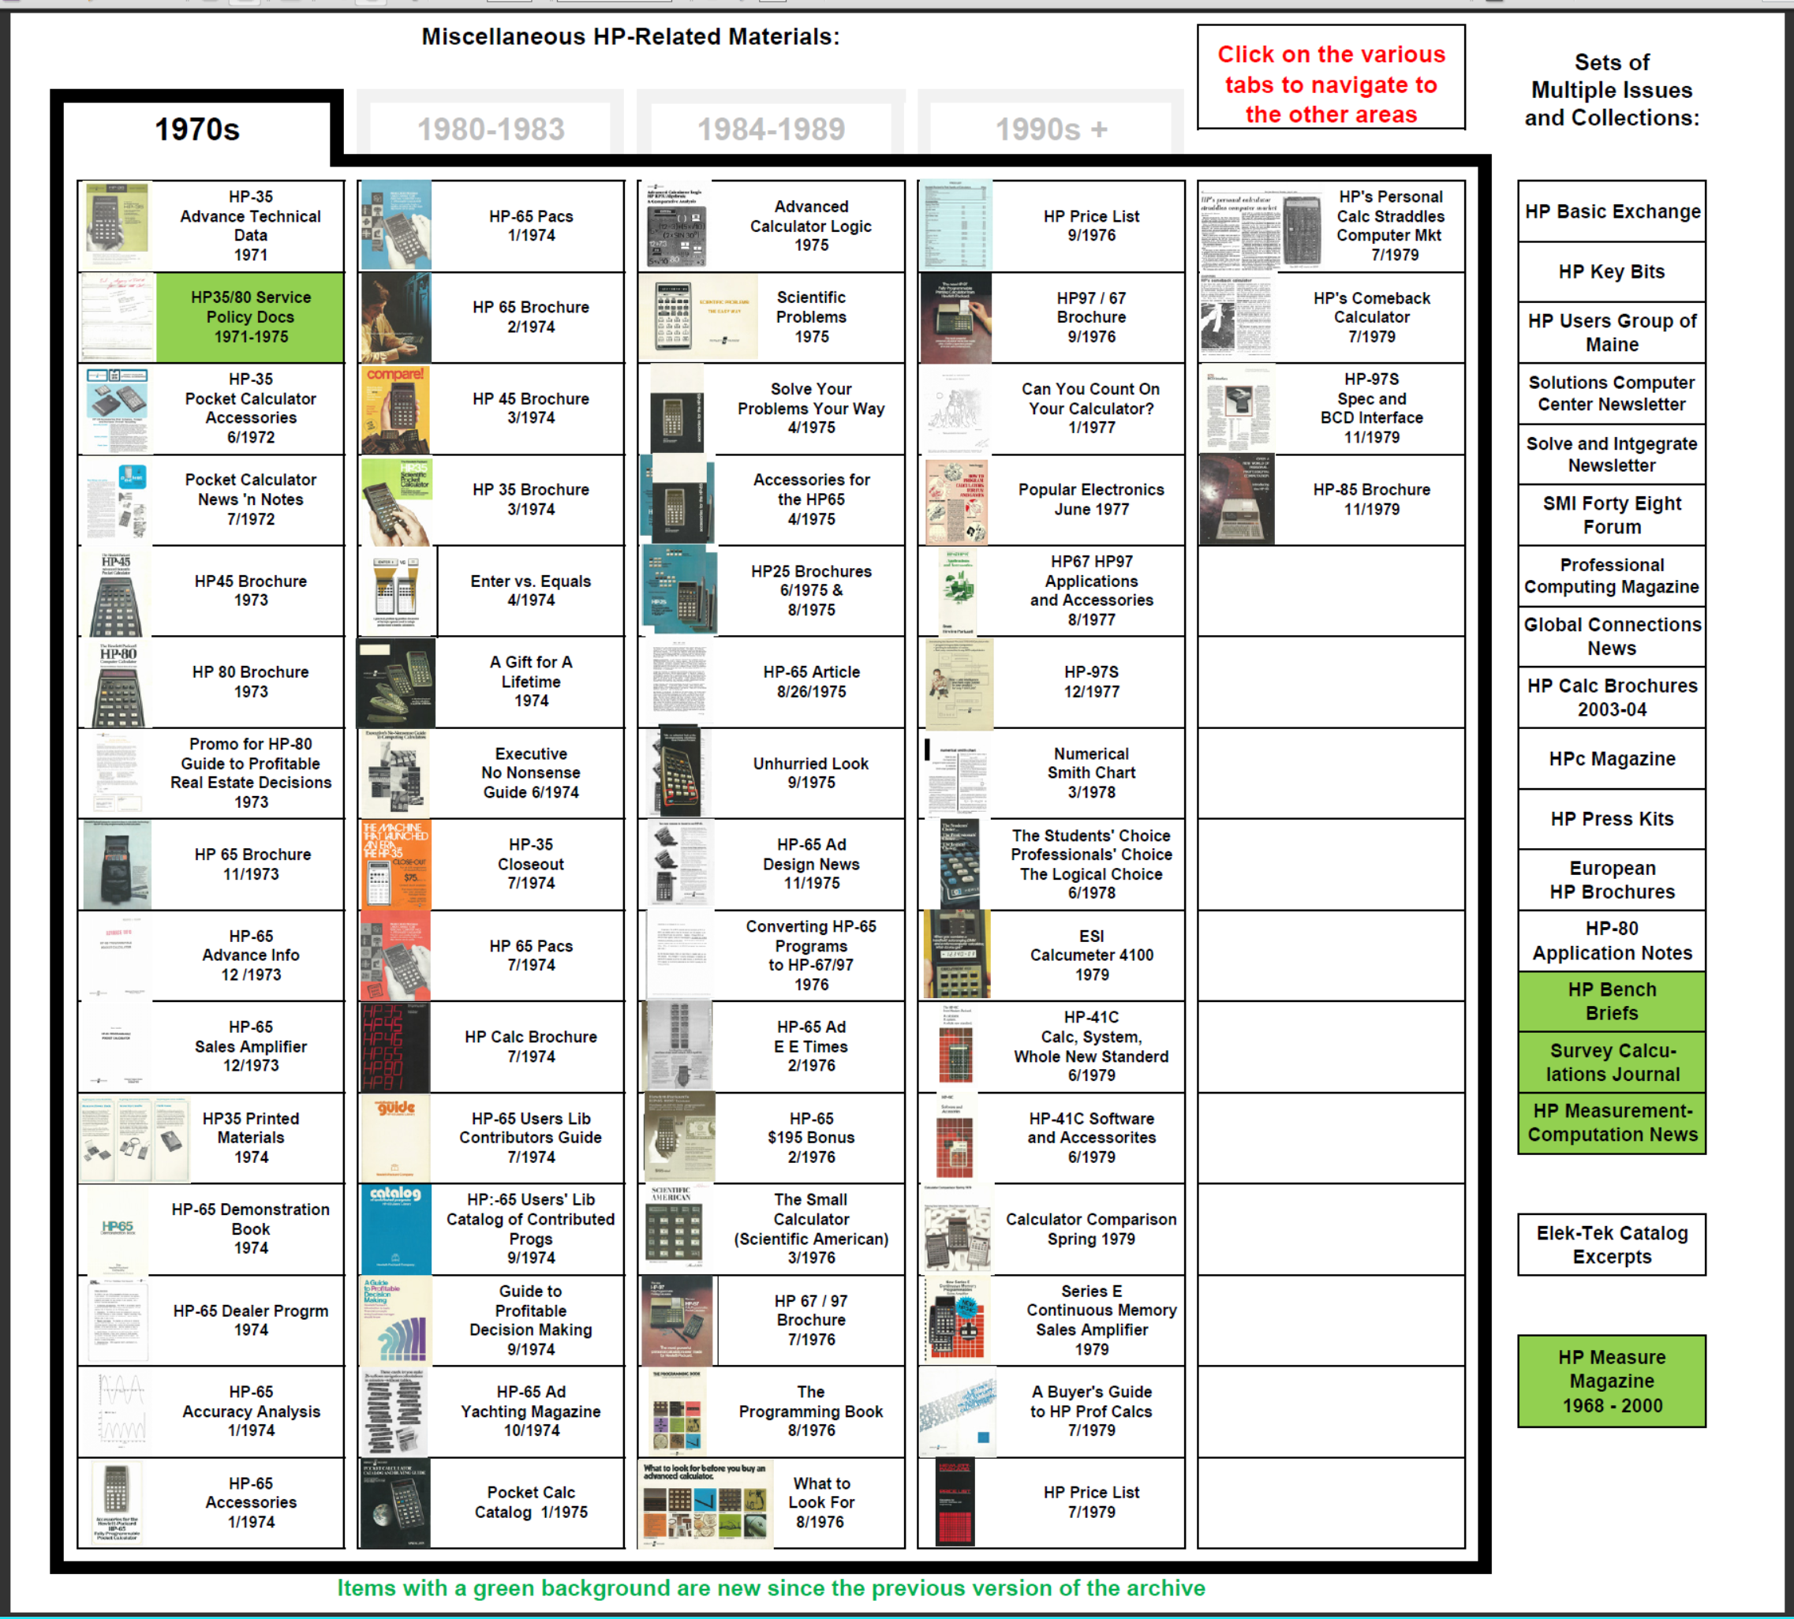
2022 – Current Miscellaneous HP Materials Section
177
Docs
136
Docs
Individual Materials
Multi-Issue Items
28
Issues
176
Issues
Elek-Tek Issues
HP Measure Issues
15

Slide 16
2022 – Current Starting Point Jump Table (V2.41)
16

Slide 17
Please enjoy the PPC Archive…
New releases still planned for November and April each year
If you have any of the missing documents, please contact me
PPC Special Issue “C” (1981)
Datafile Sample issues besides #3
Australian PPPM issues from 1998 to 1990
EduCALC catalogs #9 and #13
EduCALC Technical Notes #16, 21, 68C
EduCALC Newsline transcripts beyond 1996
Elek-Tek catalogs 1-2, 4, 8-9, 32, > 33
Email me: jakes@pahhc.org
17

