Slide 1
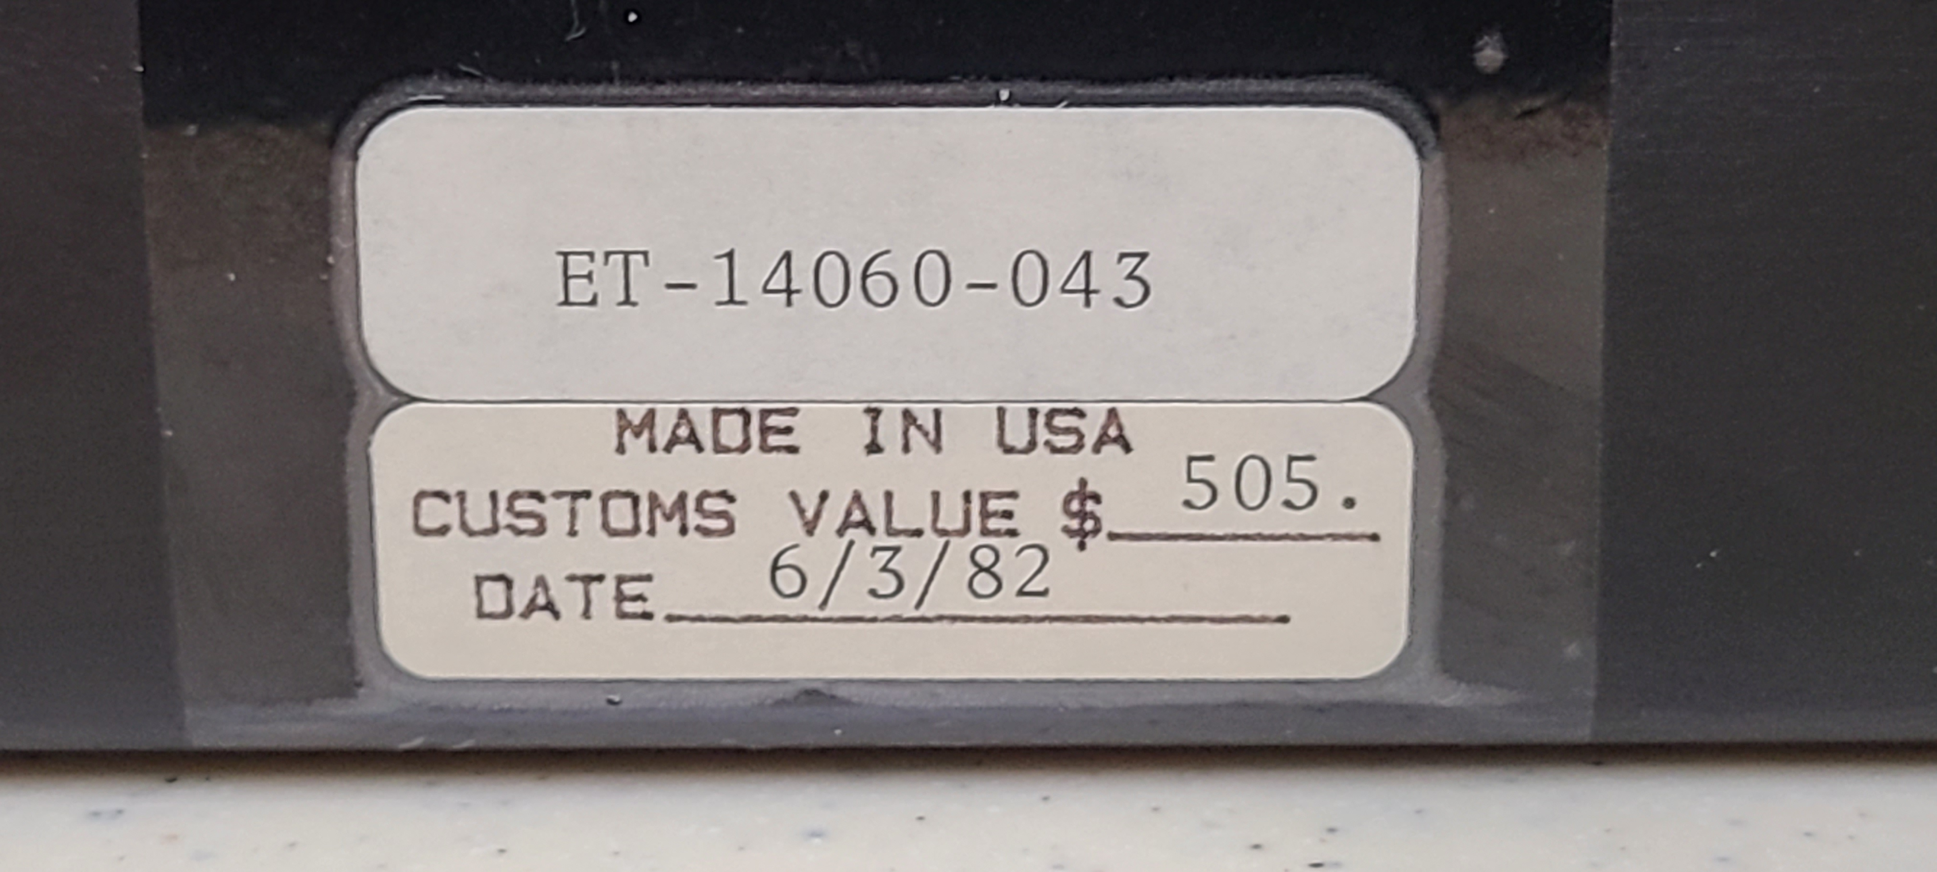
HP-75 S/W Development Prototype
Chuck McCord
Notes:
This talk provides details of the HP-75 SW Development Prototypes

Slide 2
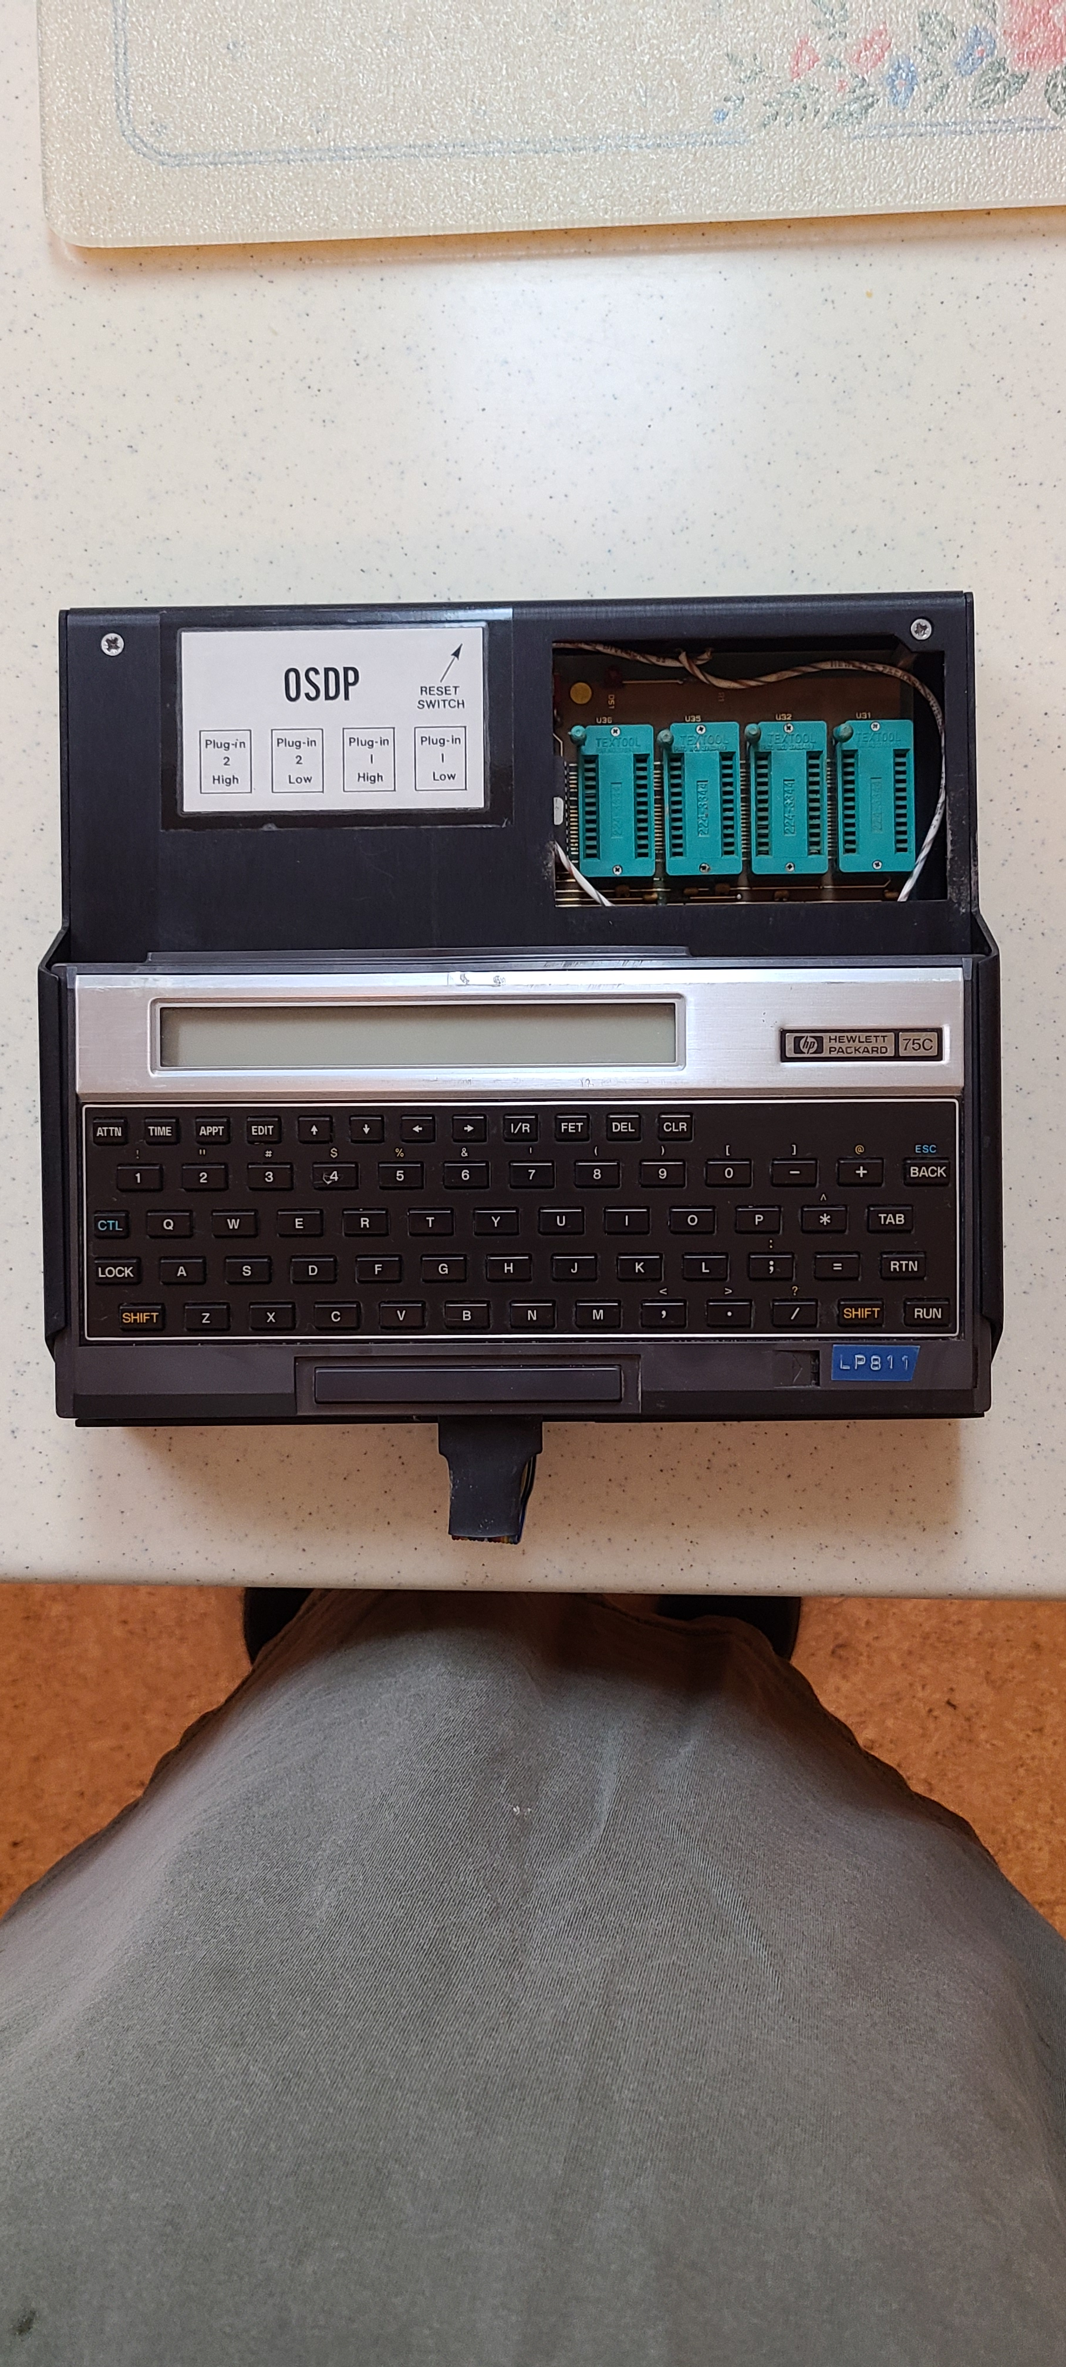
Top View

Slide 3
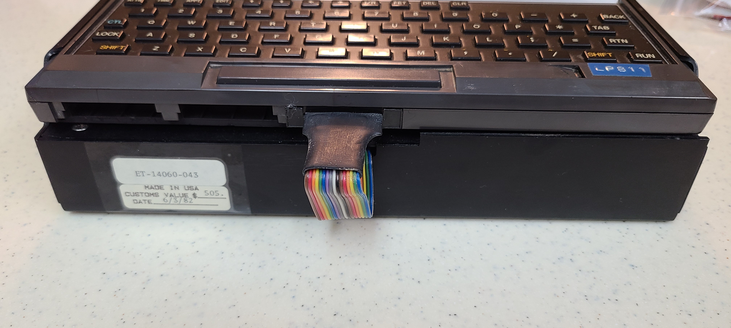
Front View

Slide 4
Unit Label
Notes:
This would indicate that at least 43 of these were in use the summer of 1982.

Slide 5
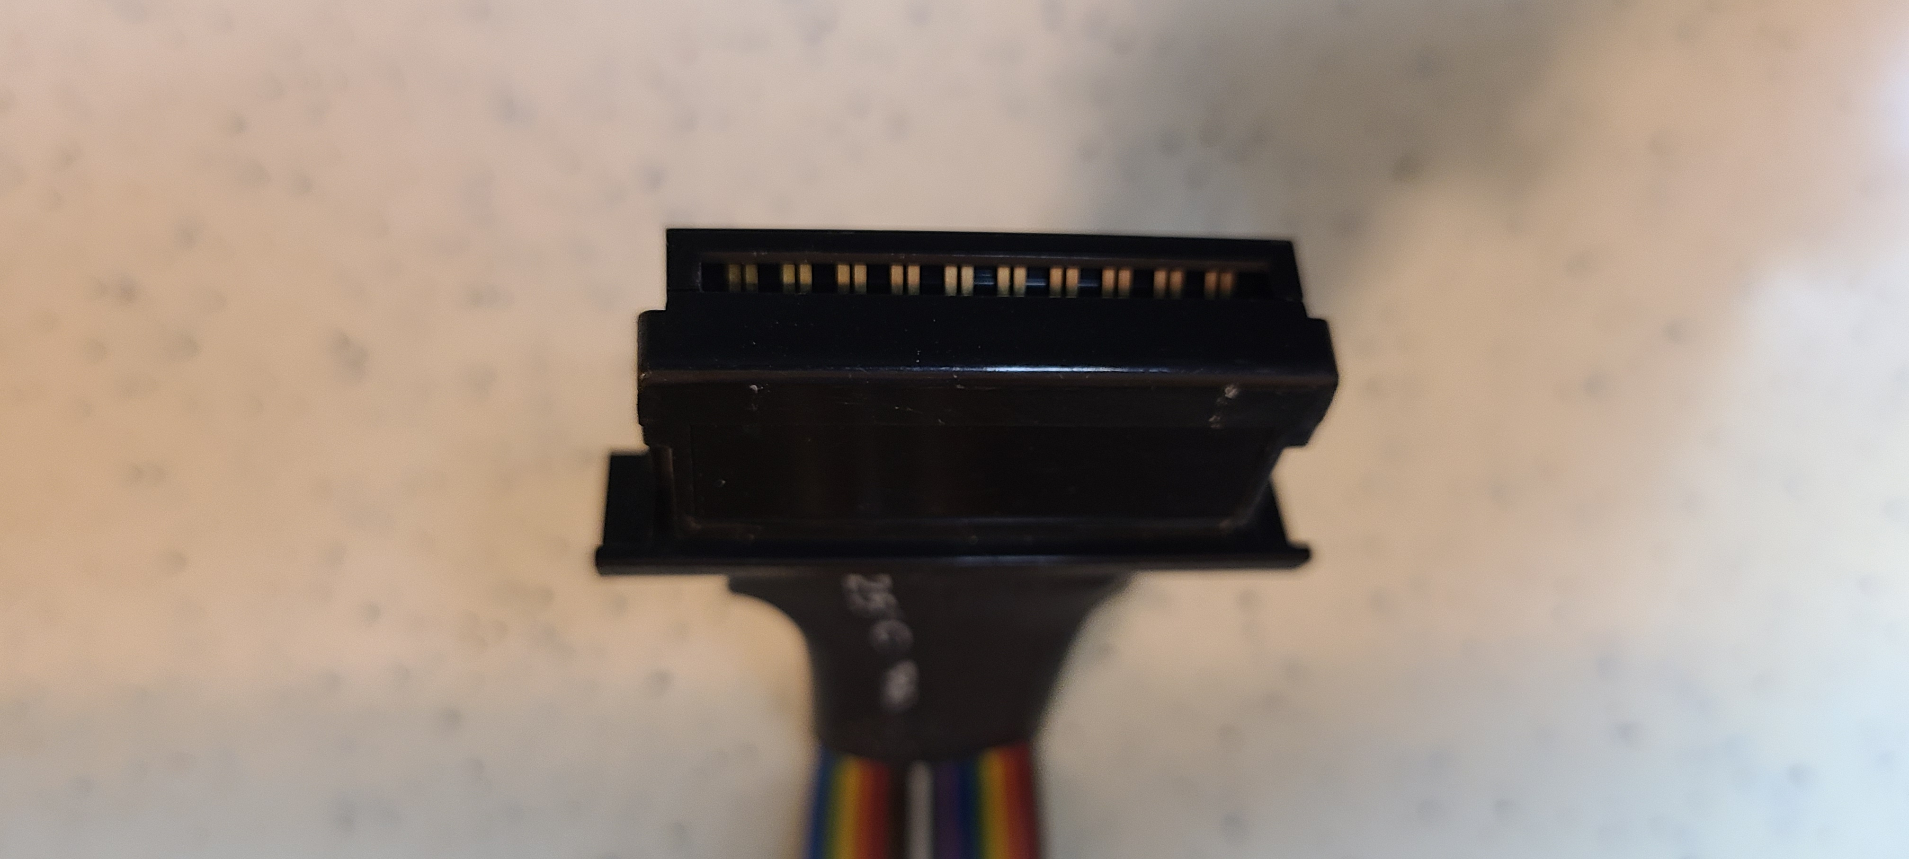
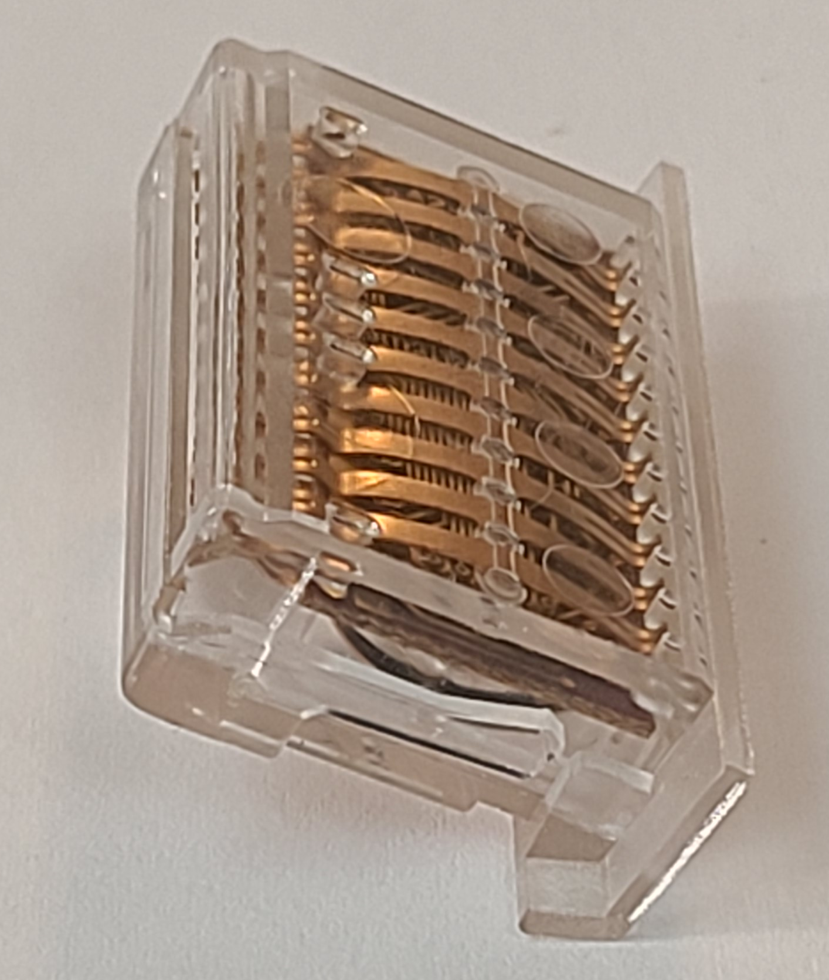
HP75 Plug-in Module
Connected to HP75 with a Plug in module with standard springs and long module PCB
Notes:
The HP75 modules were designed for a large number of insertions.
The clear module shows the gold spring structure.
The Dev system uses standard module plastic & springs with a large PCB for cable connection

Slide 6
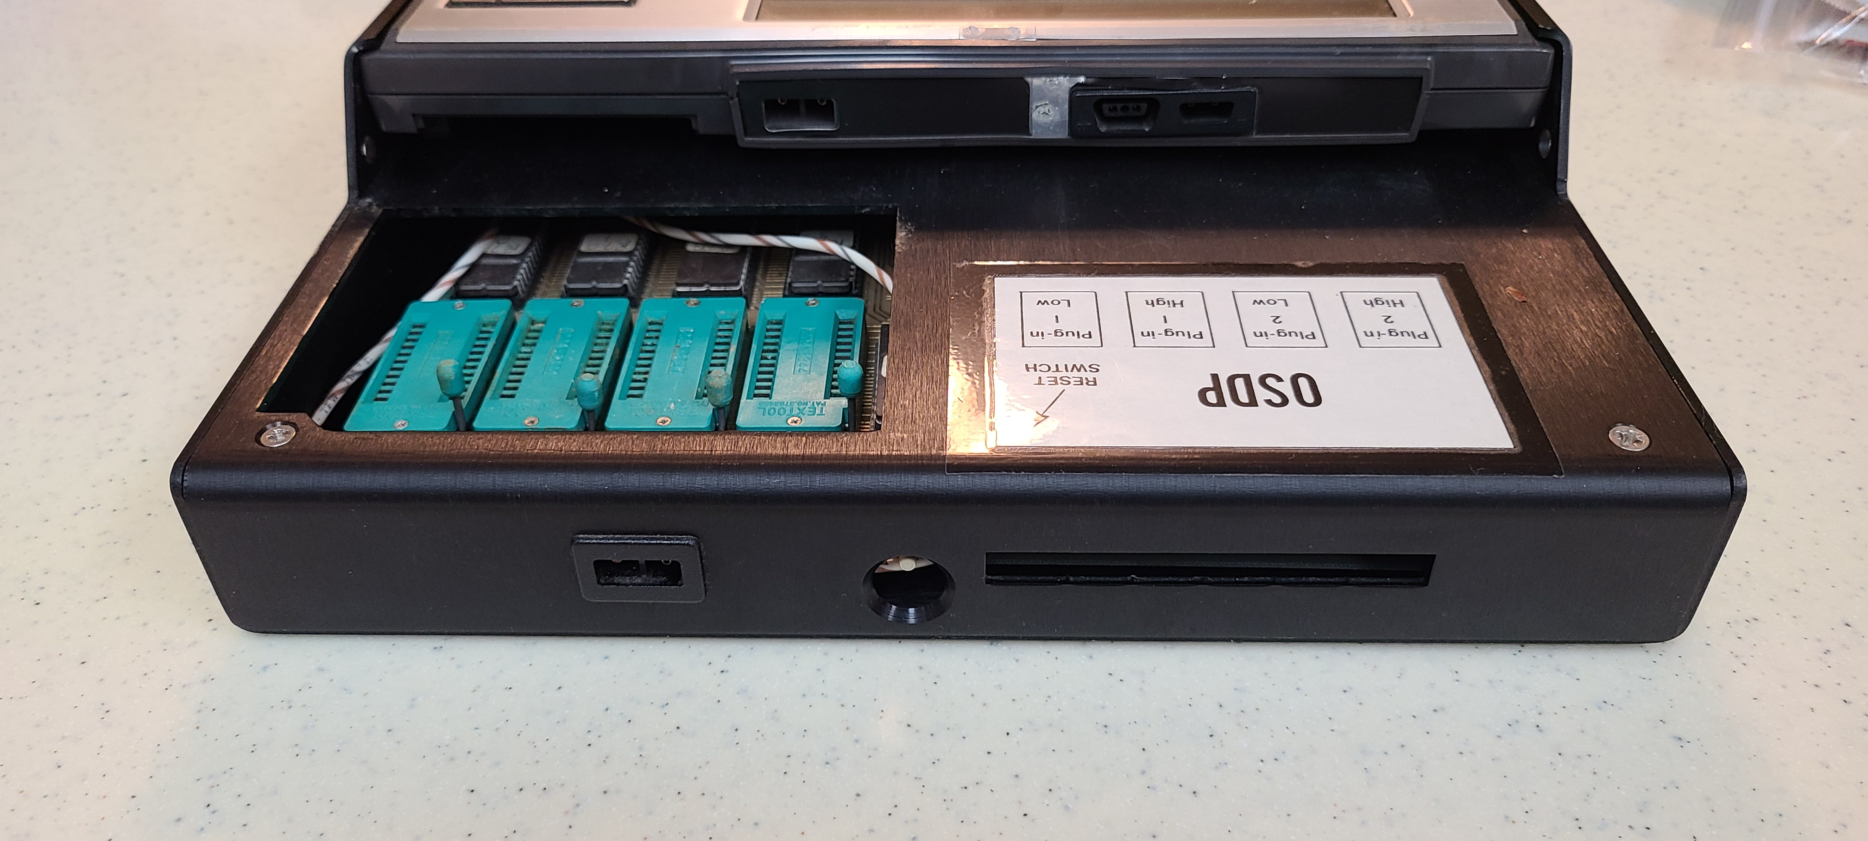
Uses standard HP 75 adapter
Unit Back view
Notes:
The Development system uses the same AC adapter used by the HP75.

Slide 7
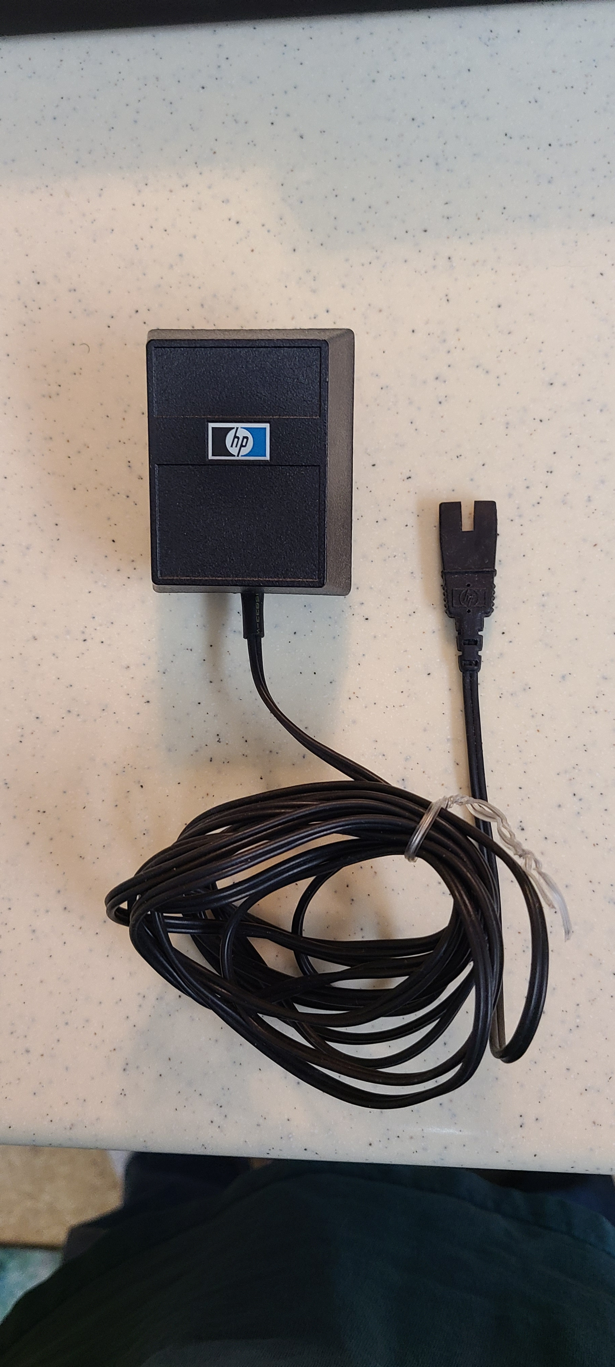
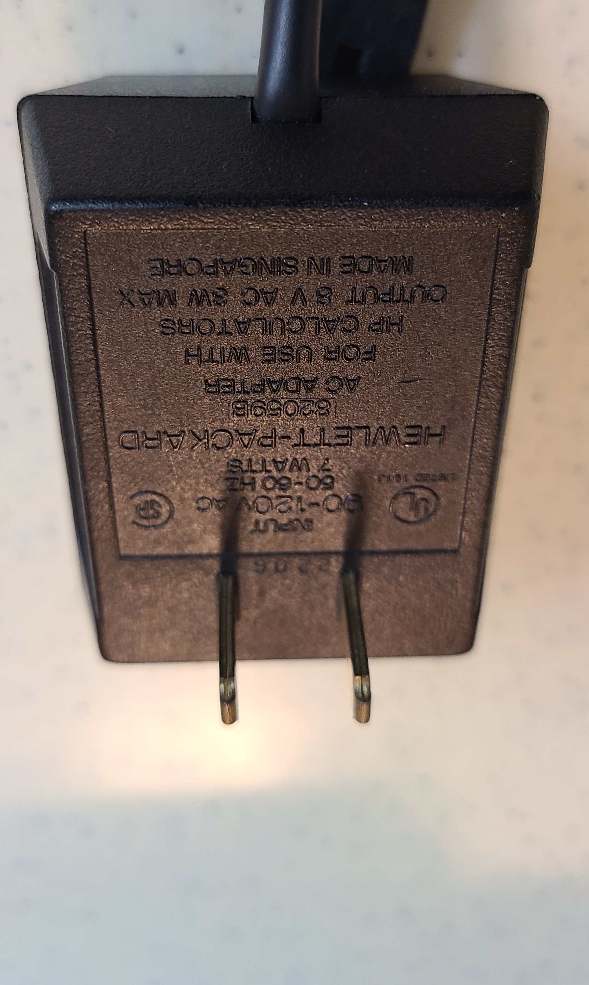
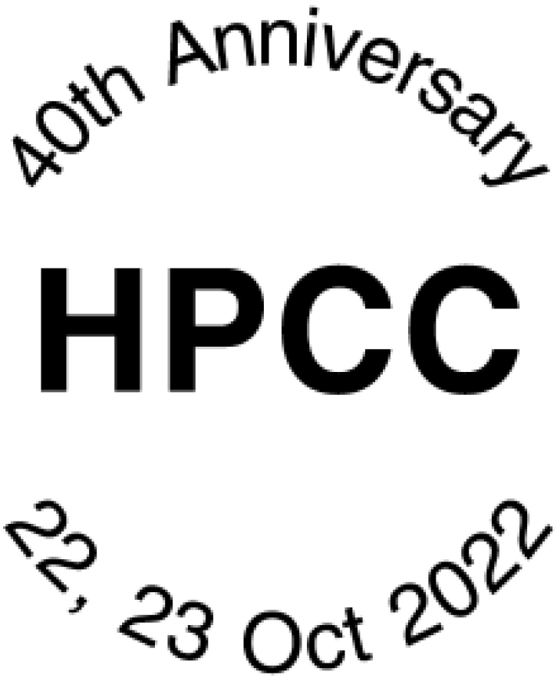
HP 82059B
AC adapter

Slide 8
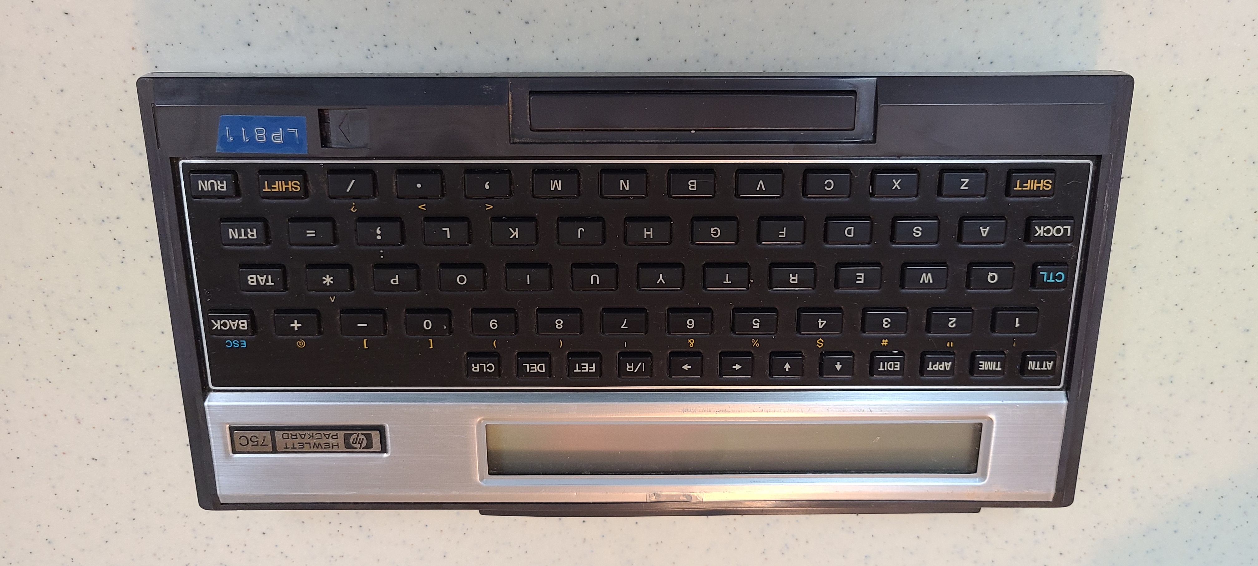
It looks like a stock HP75C ….
… but it’s not …

Slide 9
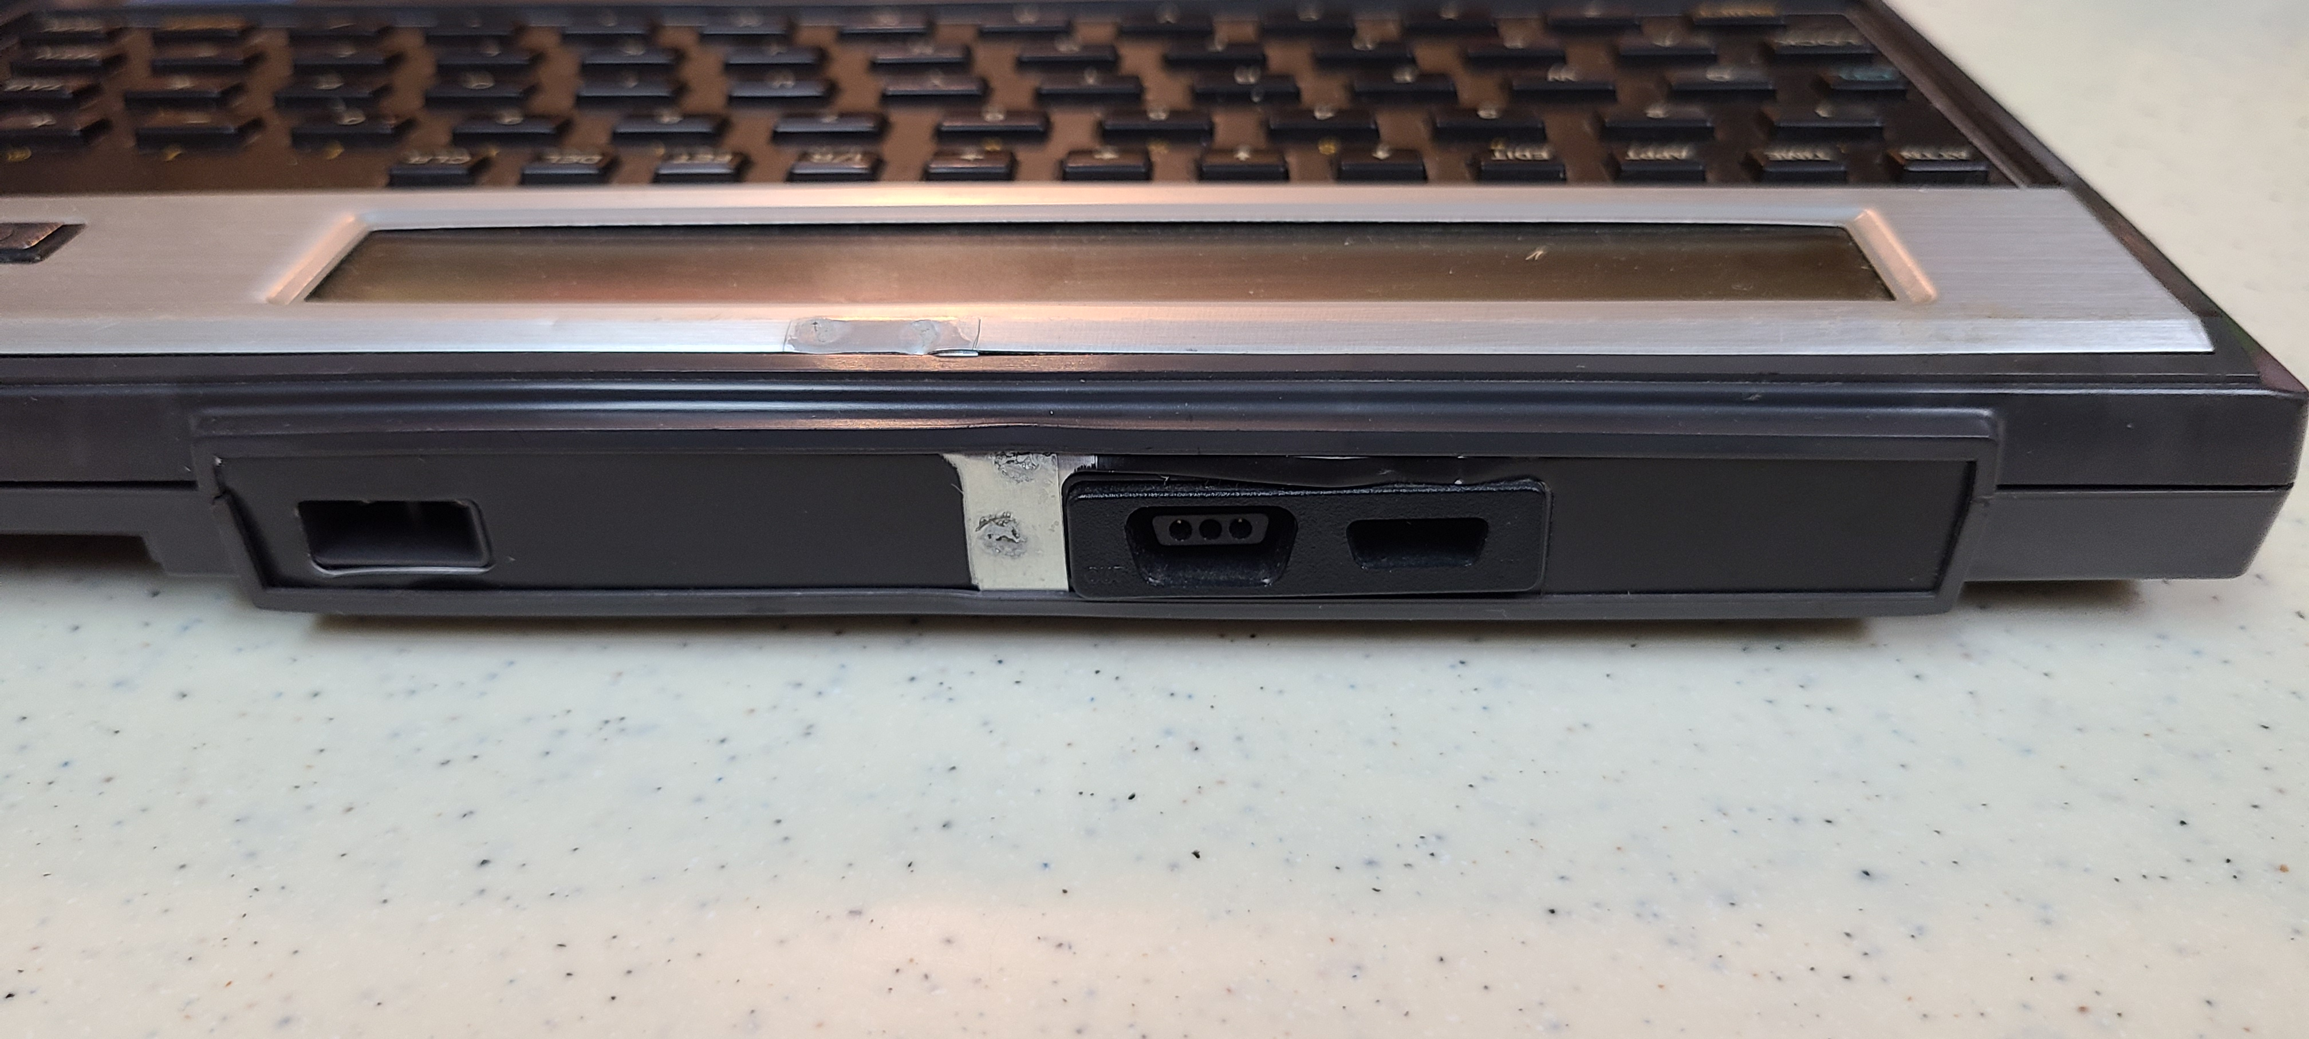
ESD test point
HP75 Back View

Slide 10
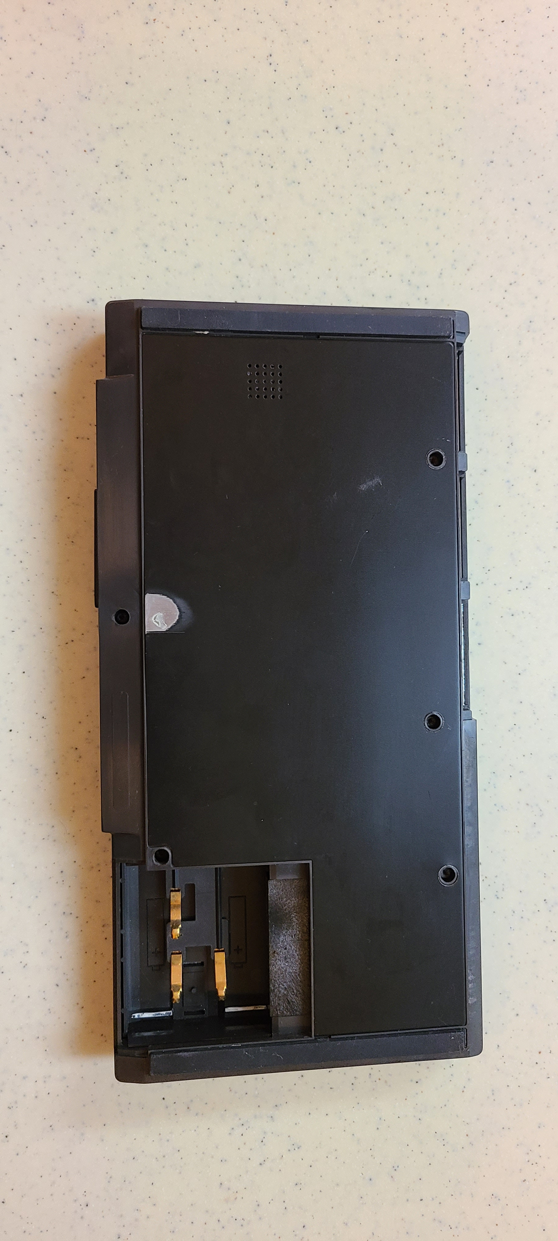
HP75 bottom view
Notes:
Another ESD test point.
The Development system HP75 has a RAM module and no Battery.

Slide 11
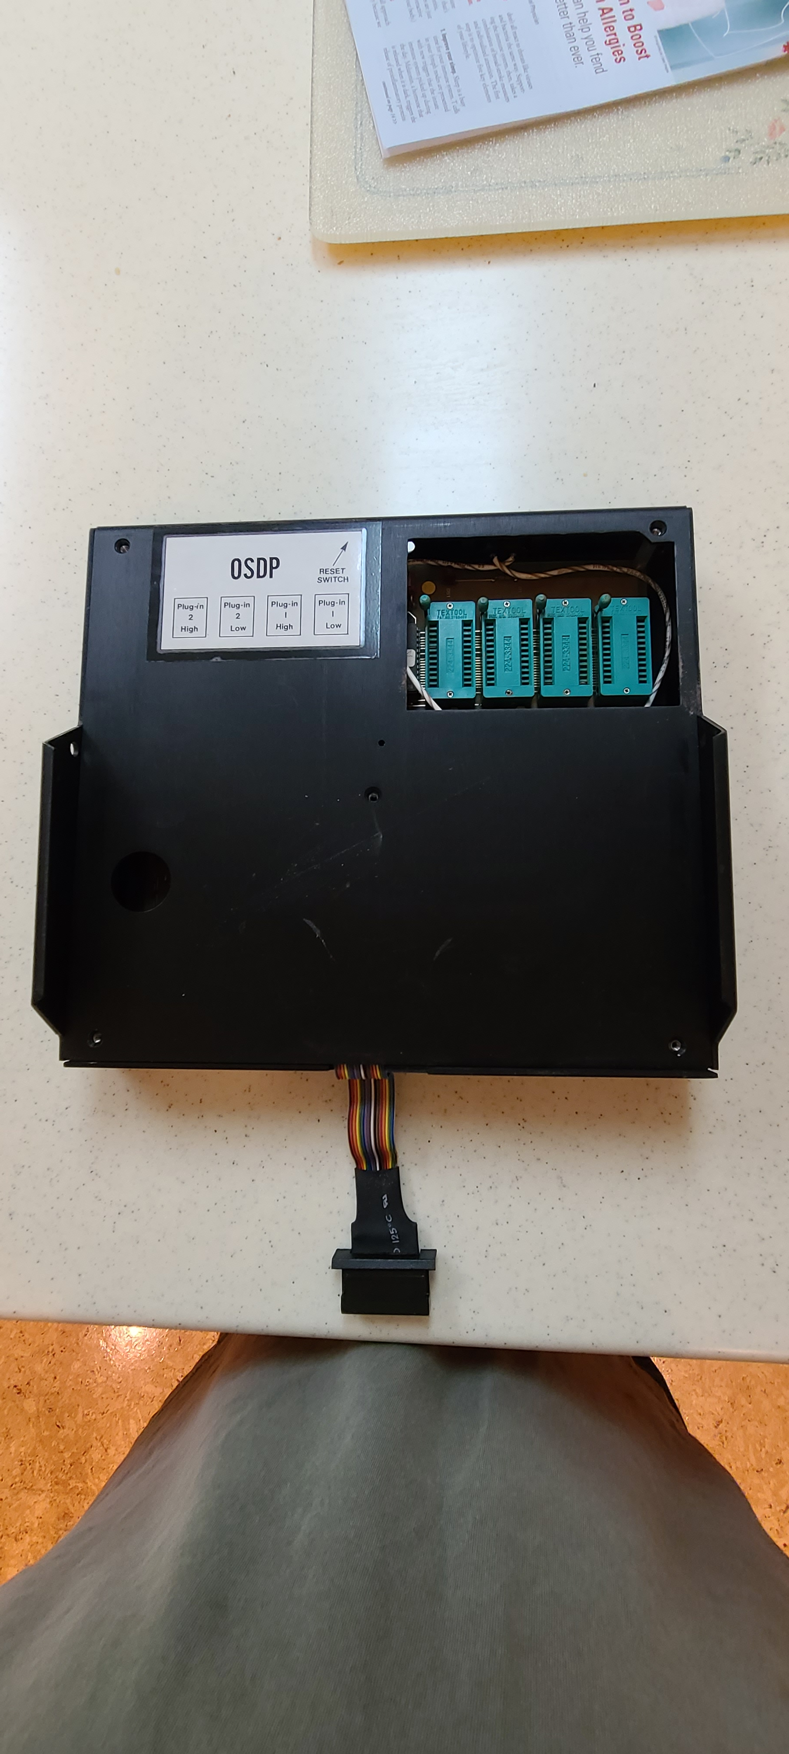
Top View
After HP75 is removed

Slide 12
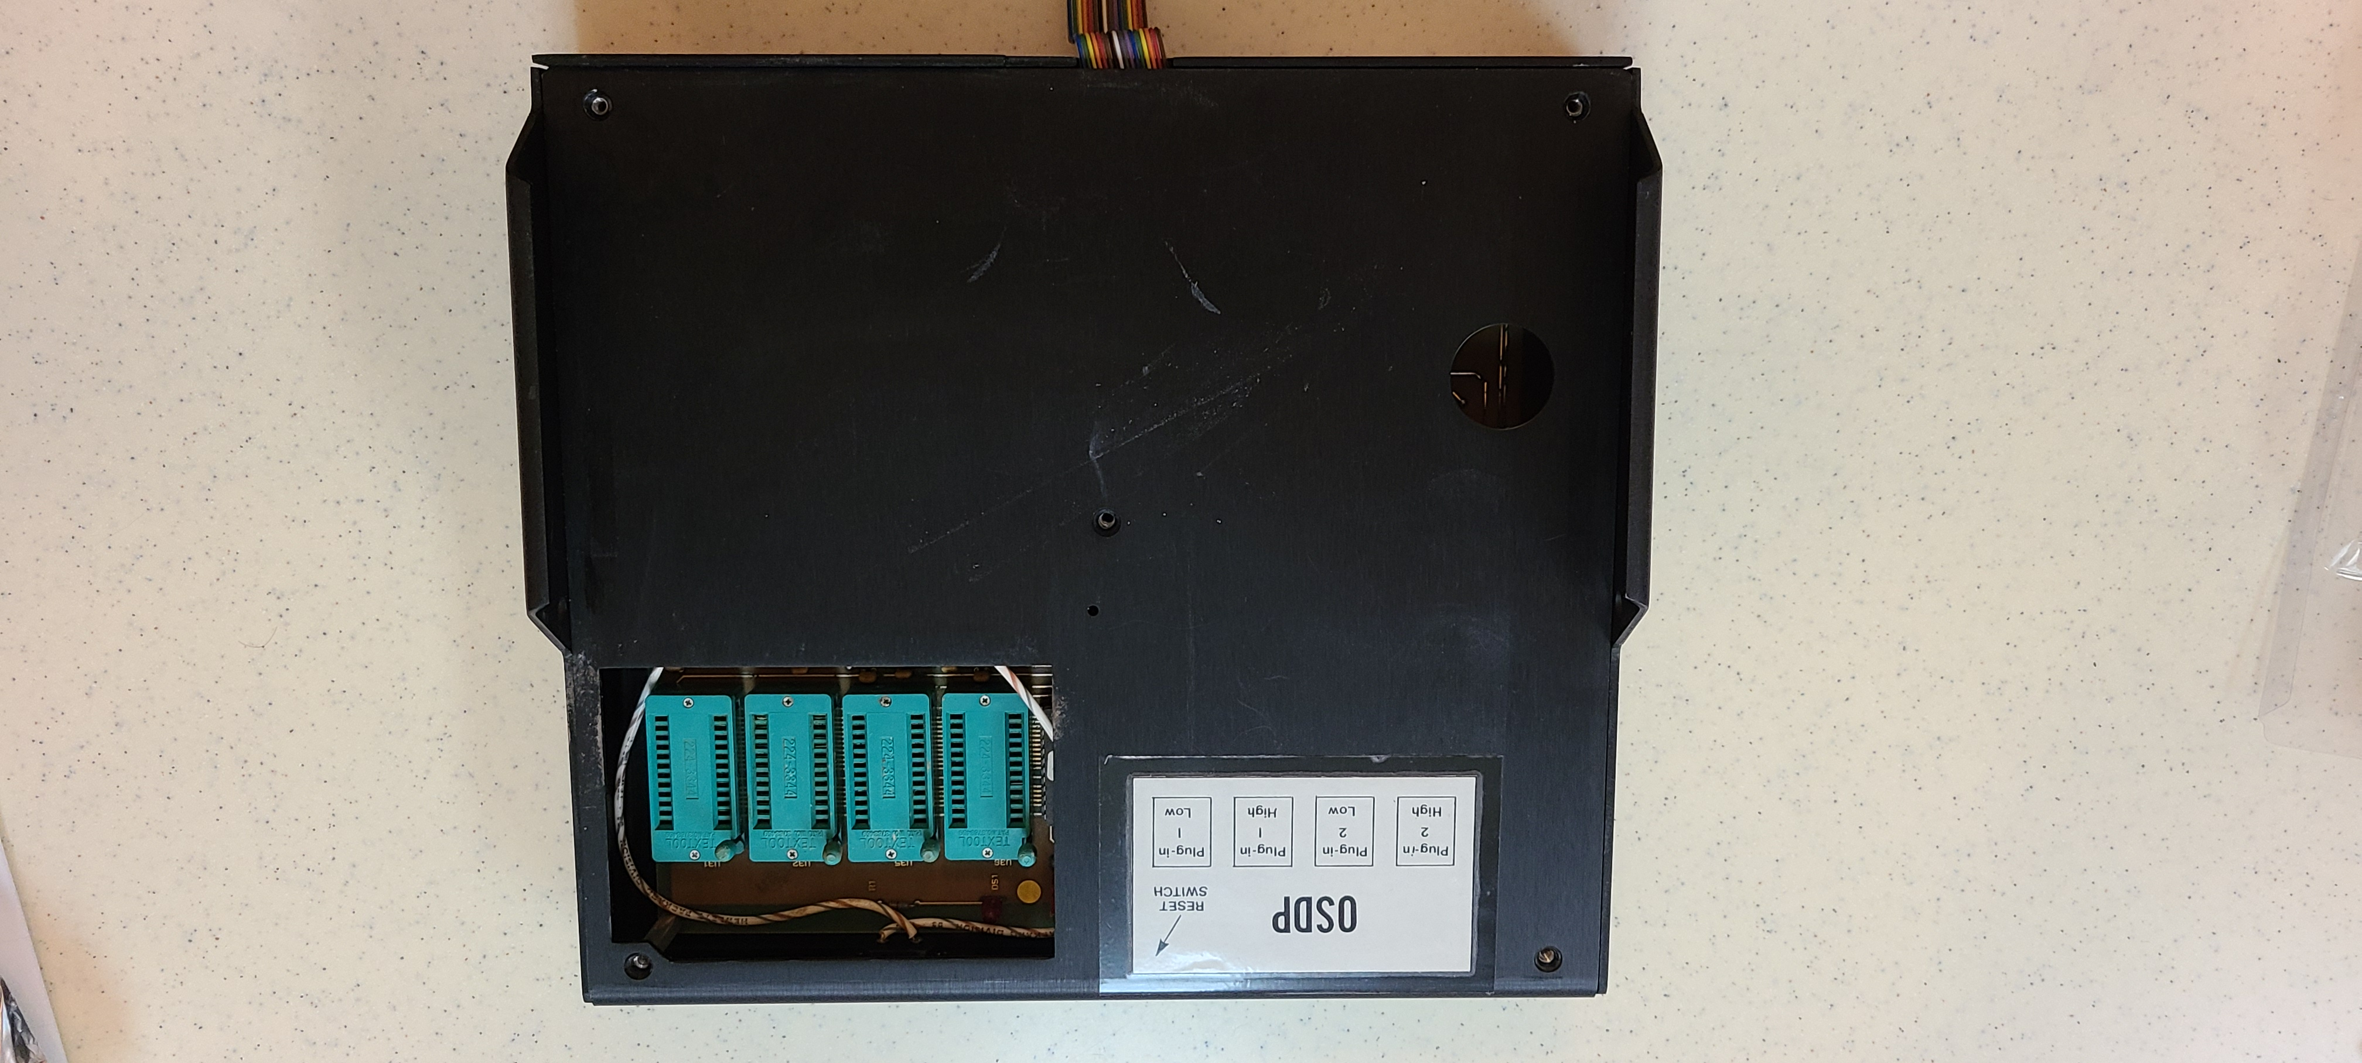
Enlarged View

Slide 13
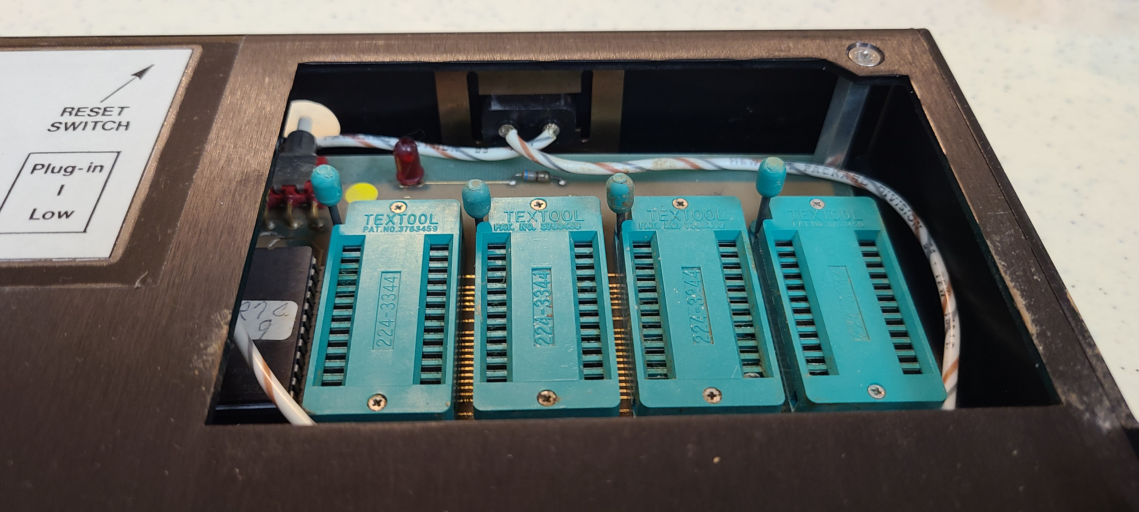
Unit is built with 5 stacked stand-offs

Slide 14
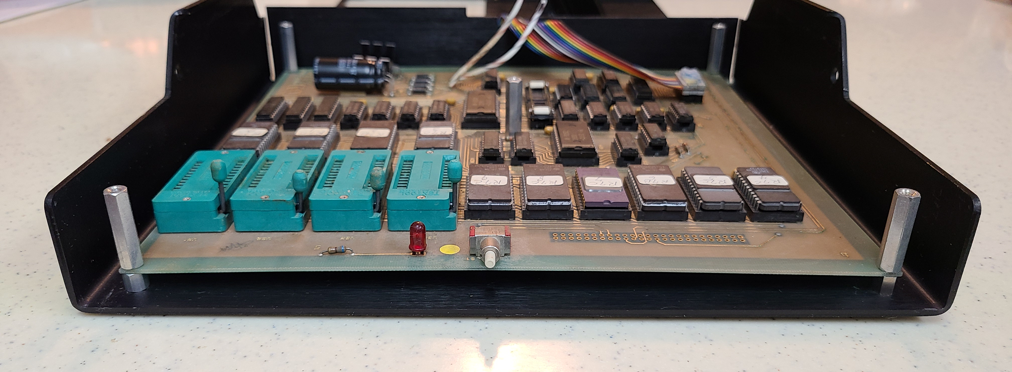
Front
Back
Notes:
Stacked stand-offs in the 4 corners of the PCB and one at its center.
Unit’s thick sheet metal is very rugged- build like a tank.

Slide 15
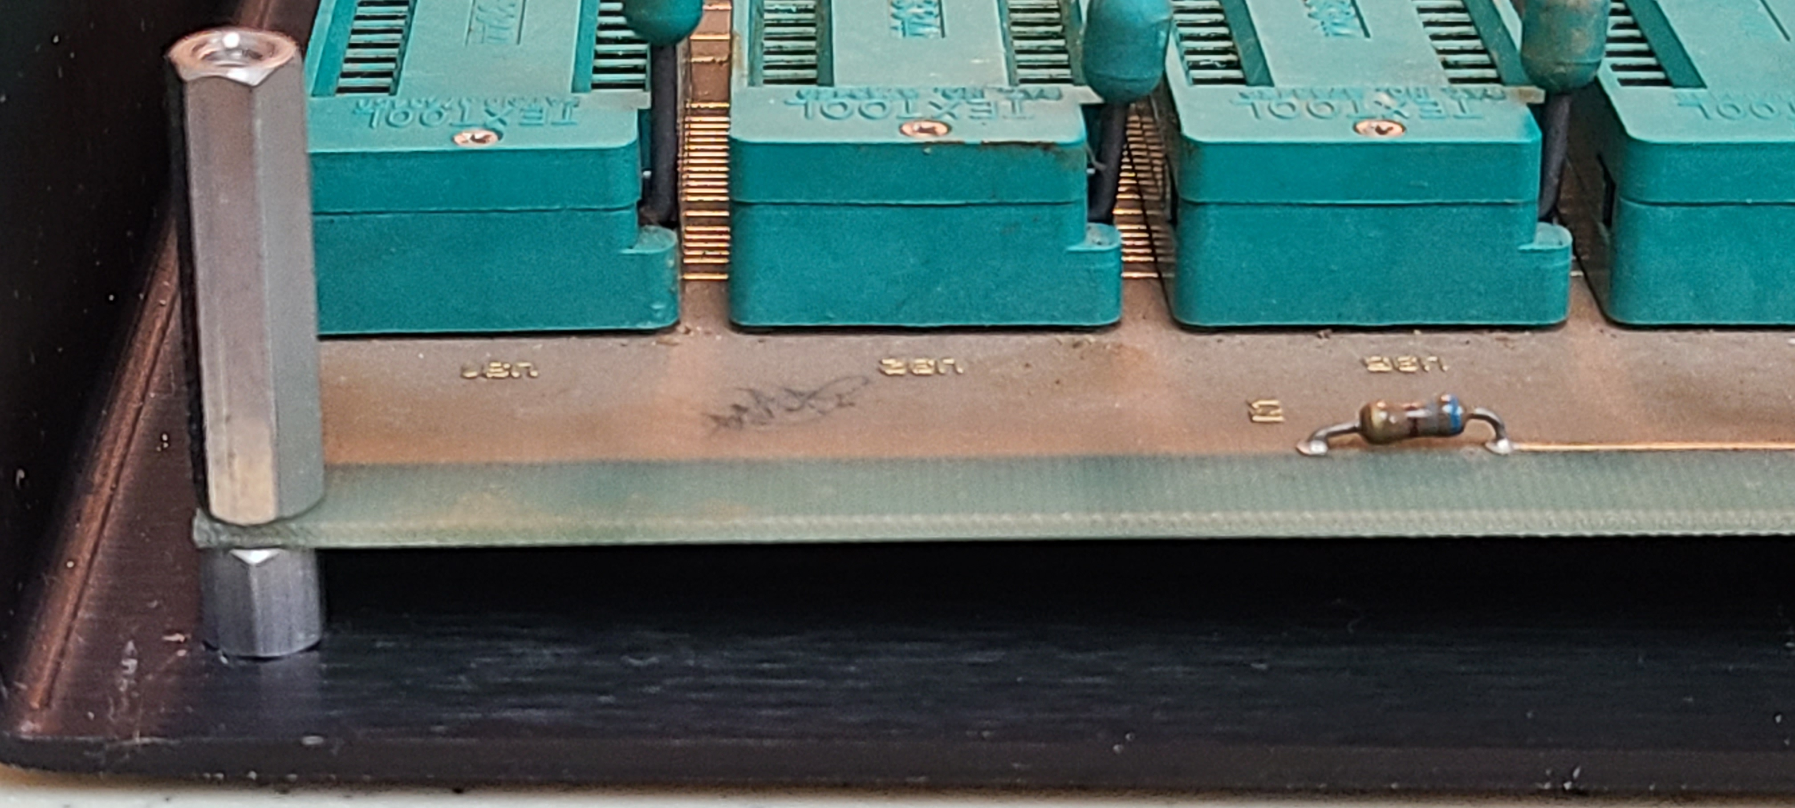
Bottom stand-off to elevate board above bottom case
Top stand-off to support top case

Slide 16
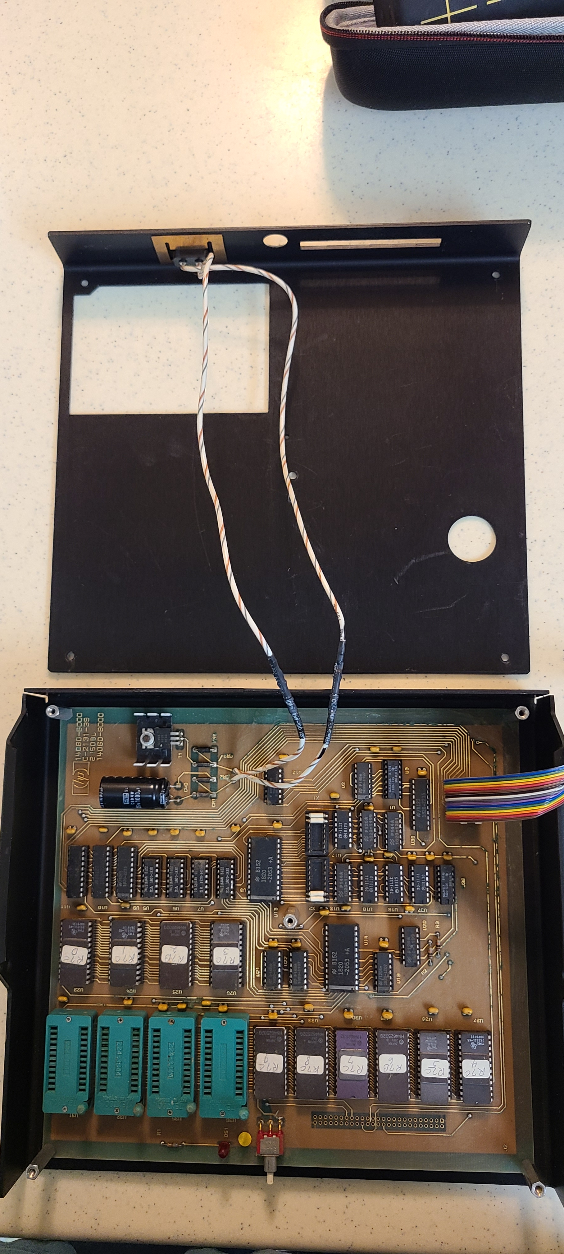
Front
Back
Bottom
Top
Unit folded open
Notes:
Top case unfolded from bottom.
2 power wires run from back panel to front of PCB
Power wires are long enough to stay connected with unit folded open

Slide 17
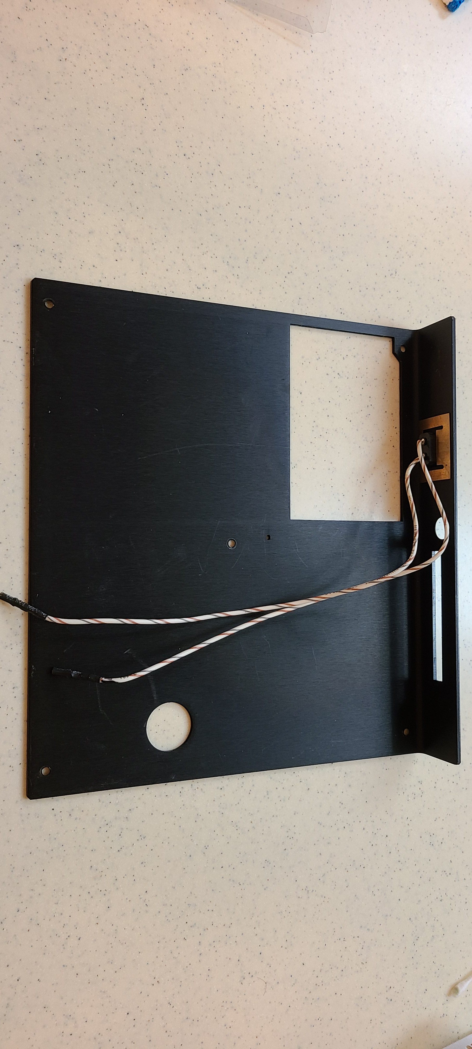
Top Case
Notes:
Power wires can also be disconnected

Slide 18
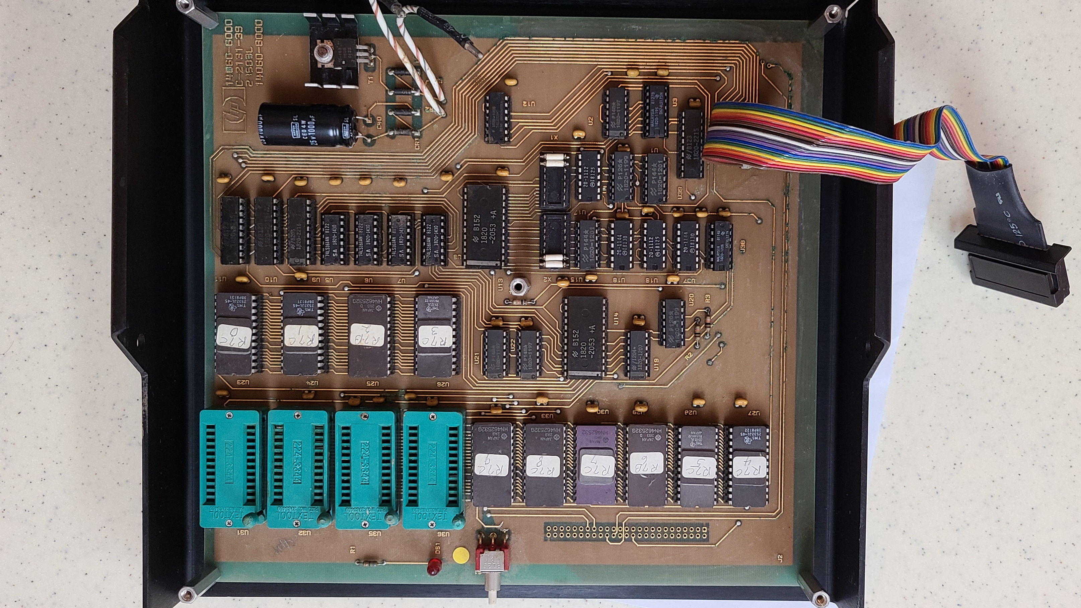
Back
Bottom Case
Front
Notes:
I have lots of pictures of the PCB to document this for others

Slide 19
Back
Enlarged view
of Full PCB
Front

Slide 20
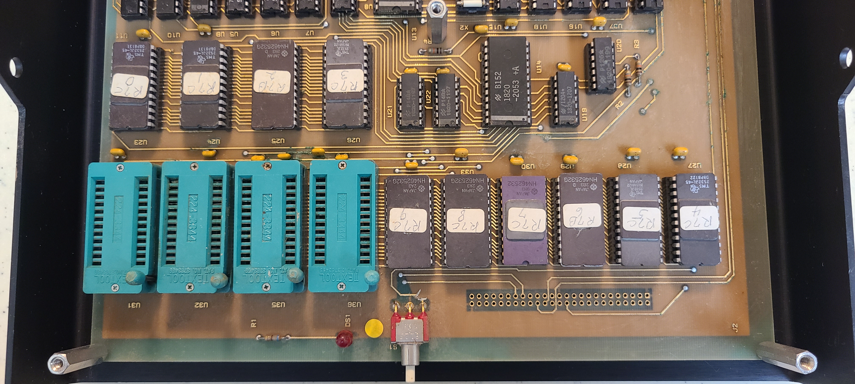
Zooming in on back of PCB…
Back
ZIF sockets for plug-in ROM Eproms and …
Front
System ROM EPROMS in sockets–
the HP75 does not have ROMS inside
Notes:
Zero-insertion sockets for plug-in ROMs easily accessible when unit is buttoned up.

Slide 21
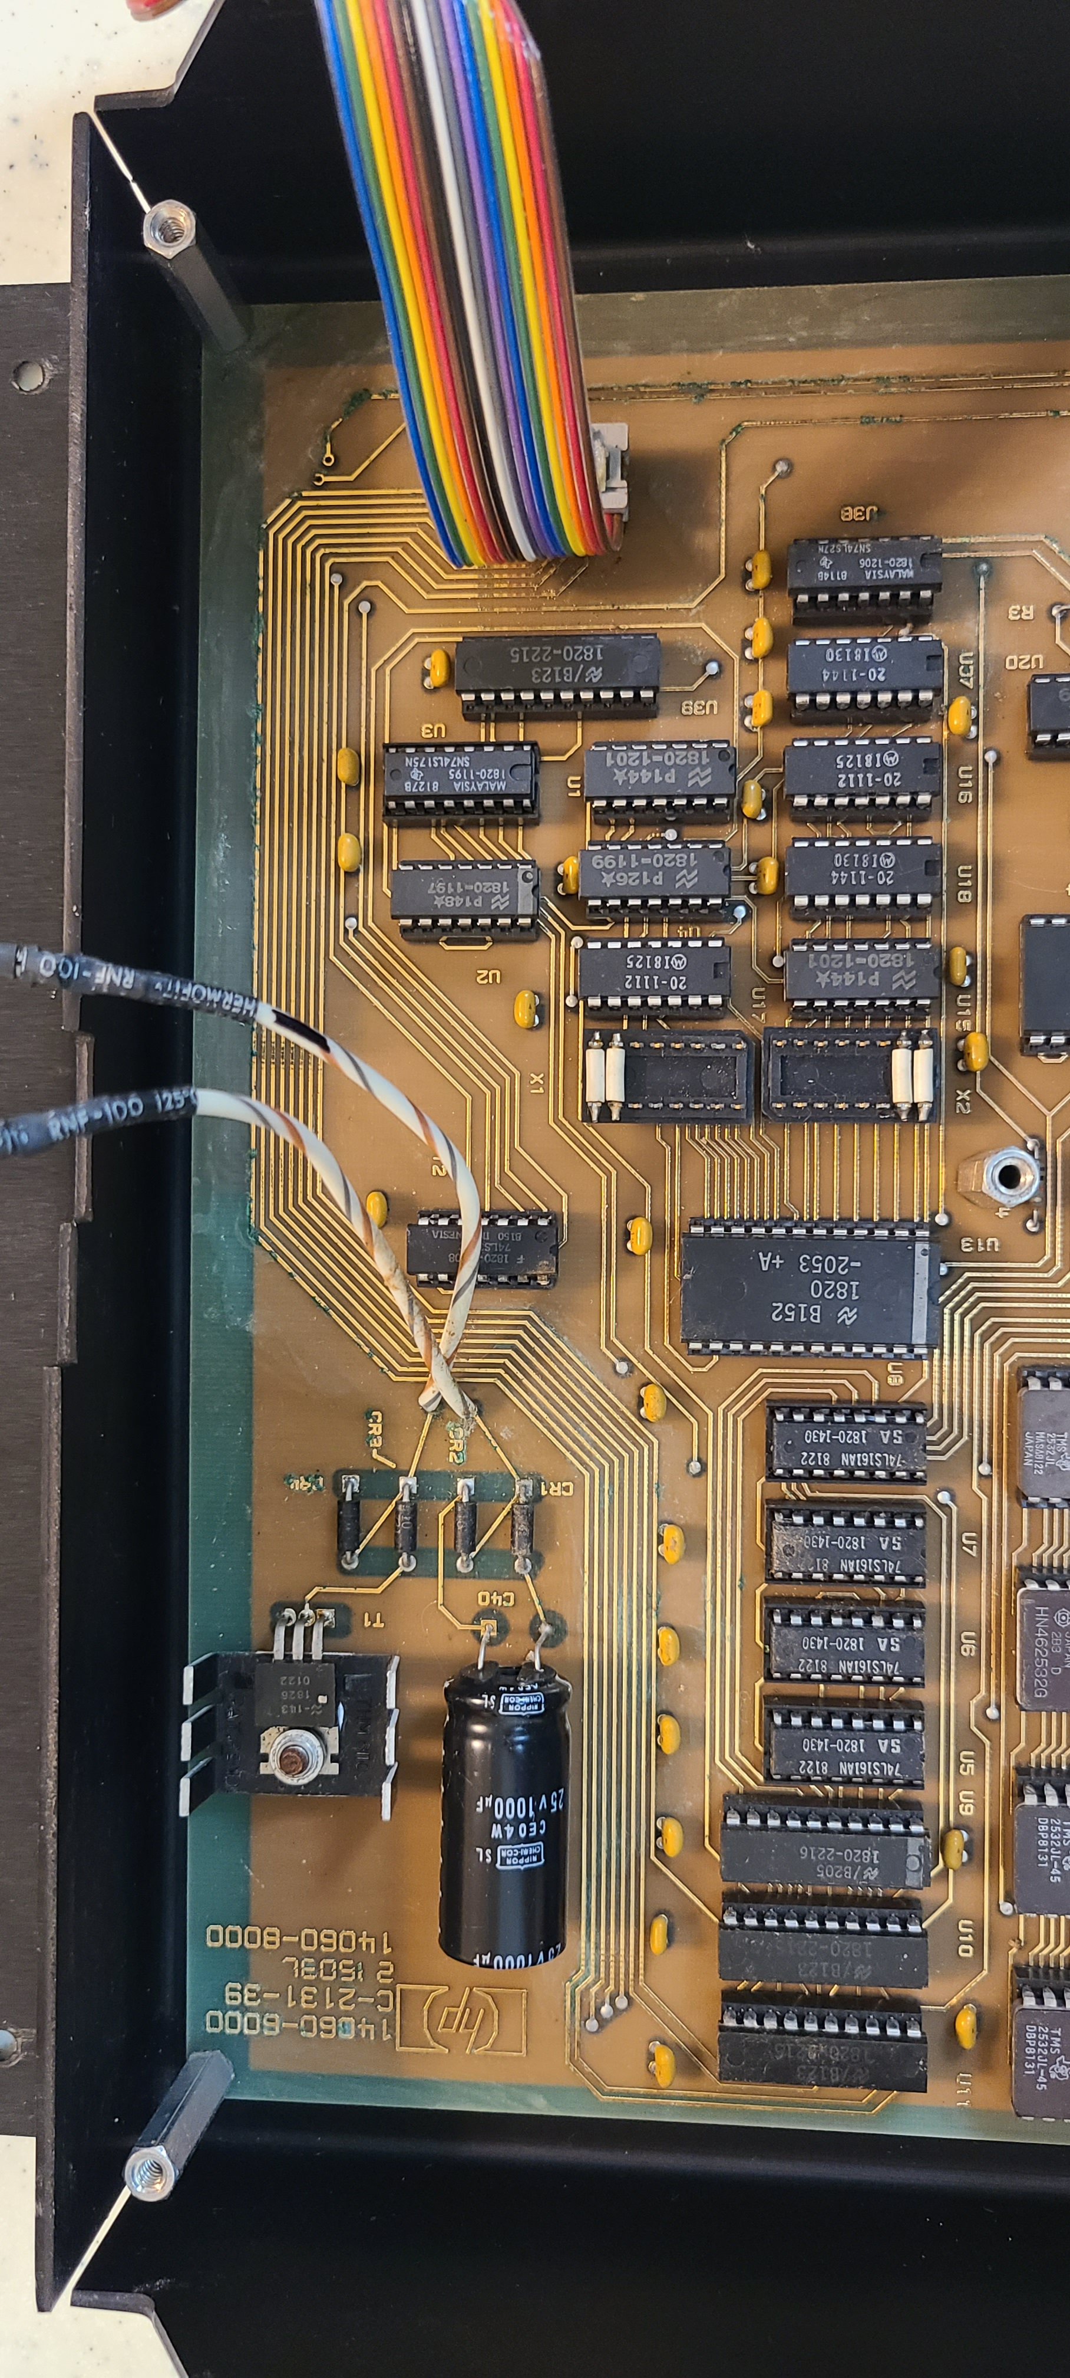
Back
Front
Notes:
Front half of the PCB. Address decode logic and power supply.

Slide 22
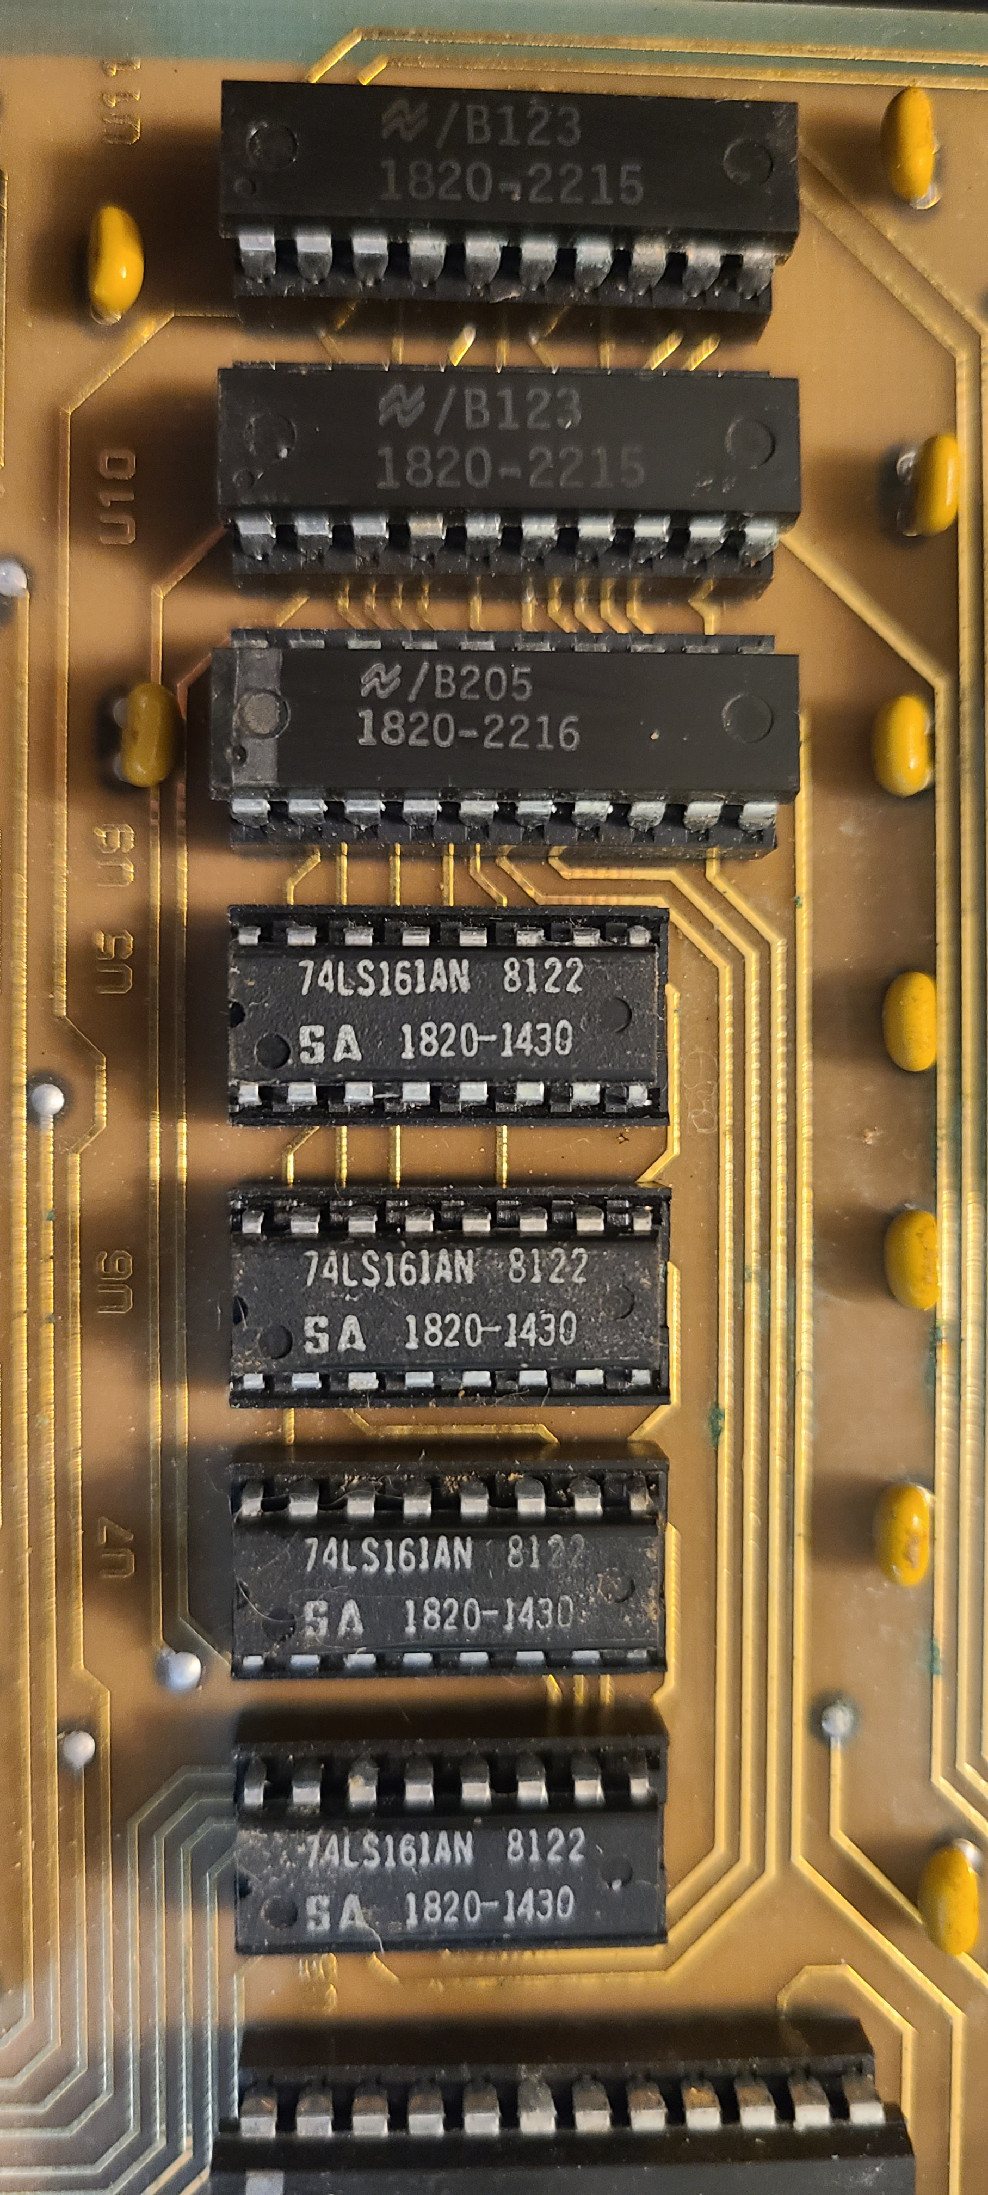
Back
Front
Notes:
Close up of ICs & their part numbers

Slide 23
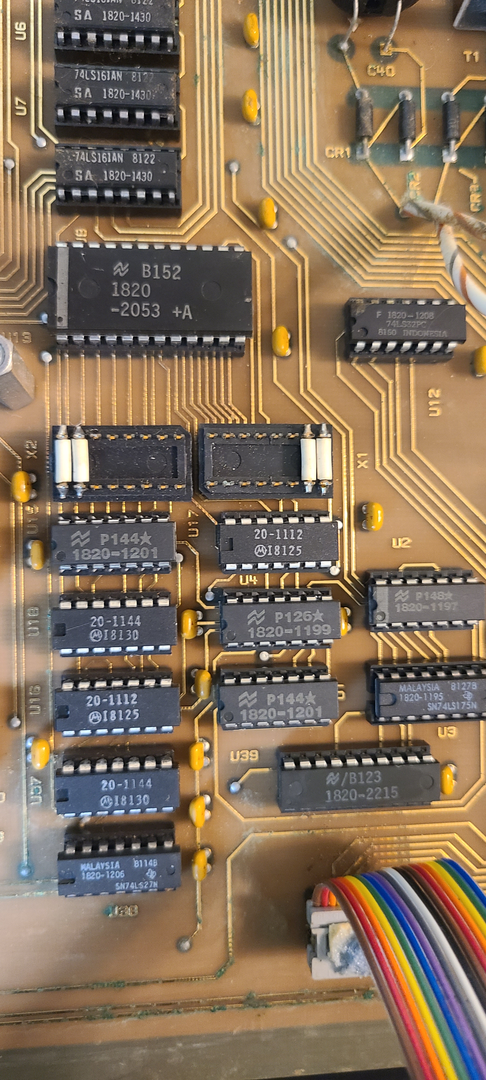
Back
Front

Slide 24
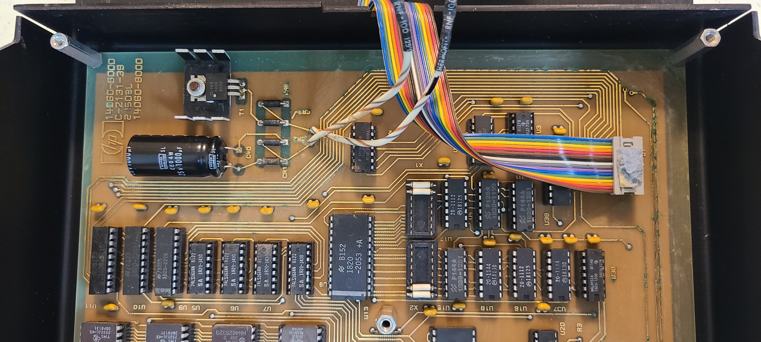
Notes:
Notice all components are labeled on the PCB

Slide 25
PCB IC Components
PCB label | HP Part # | Part Label | Look-up
U1 | 1820-1201 | Nat'l P144 | SN74LS08N
U2 | 1820-1197 | Nat'l P148 | SN74LSOON
U3 | 1820-1195 | 74ls175n | SN74LS175N
U4 | 1820-1199 | Nat'l P126 | SN74LSOhN
U5 | 1820-1430 | 74LS161AN | SN74LS161AN
U6 | 1820-1430 | 74LS161AN | SN74LS161AN
U7 | 1820-1430 | 74LS161AN | SN74LS161AN
U8 | 1820-1430 | 74LS161AN | SN74LS161AN
U9 | 1820-2215 | Nat'l B123 | MM74C373N
U10 | 1820-2215 | Nat'l B123 | MM74C373N
U11 | 1820-2215 | Nat'l B123 | MM74C373N
U12 | 1820-1208 | 74ls32pc | SN74LS32N
U13 | 1820-2053 | Nat'l B152 | DM74LS154N
U14 | 1820-2053 | Nat'l B152 | DM74LS154N
U15 | 1820-1201 | Nat'l P144 | SN74LS08N
U16 | 1820-1112 | MotI8125 | SN74LS74AN
U17 | 1820-1112 | MotI8125 | SN74LS74AN
U18 | 1820-1144 | MotI8130 | SN74LS02N
U19 | 1820-1207 | Nat'l I204 | SN74LS30N
U20 | 1820-1199 | Nat'l P126 | SN74LSOhN
PCB label | HP Part # | Part Label | Look-up
U21 | 1820-1197 | Nat'l P148 | SN74LSOON
U22 | 1820-1197 | Nat'l P148 | SN74LSOON
U23 | PROM | HN462532G | tms 2532jl-45
U24 | PROM | HN462532G
U25 | PROM | HN462532G
U26 | PROM | HN462532G
U27 | PROM | HN462532G
U28 | PROM | HN462532G
U29 | PROM | HN462532G
U30 | PROM | HN462532G
U31 | Prom socket
U32 | Prom socket
U33 | PROM | HN462532G
U34 | PROM | HN462532G
U35 | Prom socket
U36 | Prom socket
U37 | 1820-1144 | MotI8130 | SN74LS02N
U38 | 1820-1206 | 74ls27N | SN74LS27N
U39 | 1820-2215 | Nat'l B123 | MM74C373N
HP part number reference list:
http://hparchive.com/Bench_Briefs/HP-Bench-Briefs-1987-10-12.pdf
Notes:
Complete IC Component List
No custom ICs!
You could build your own system. Module connector and PCB hardest parts to duplicate.
To decode the HP 1820- IC numbers I used reference….

Slide 26
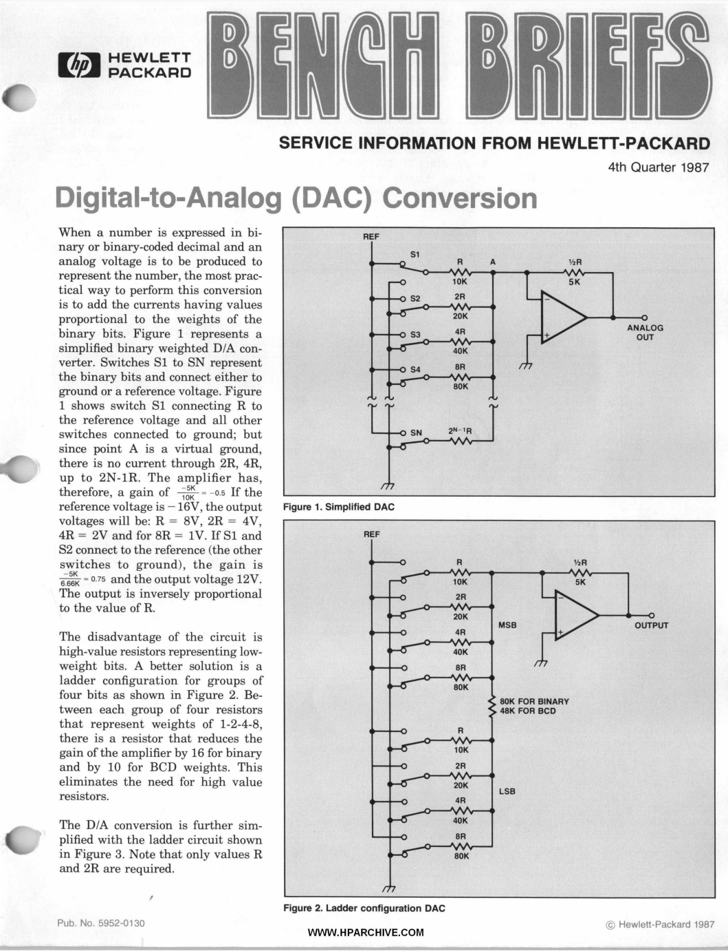
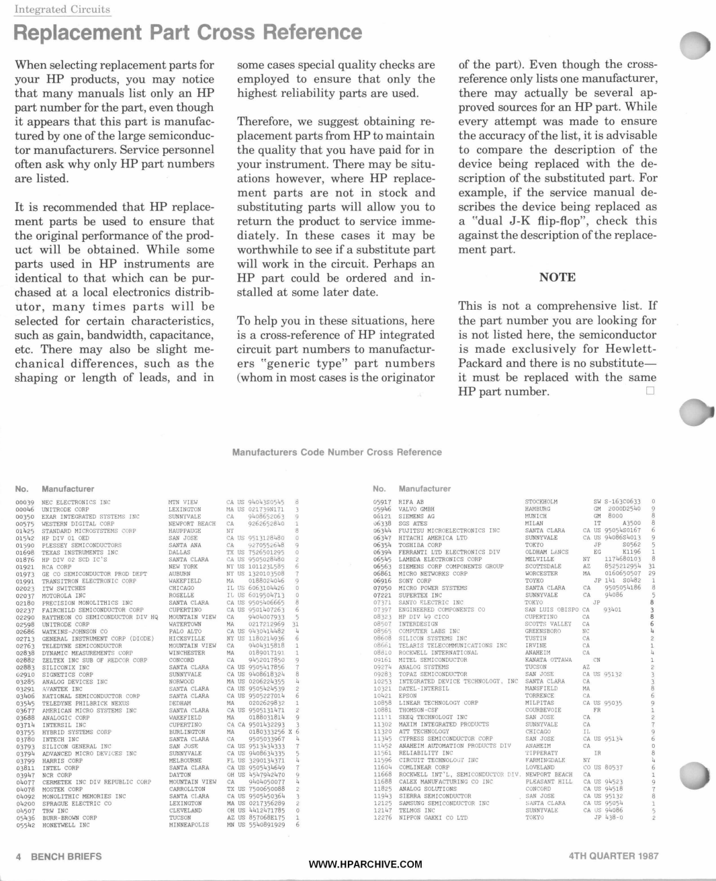
HP Part Cross Reference
Notes:
This HP Bench Briefs issue has a very hand HP Part Cross reference to map from 1820- to commercial part number. This is on Eric’s archive drive.

Slide 27
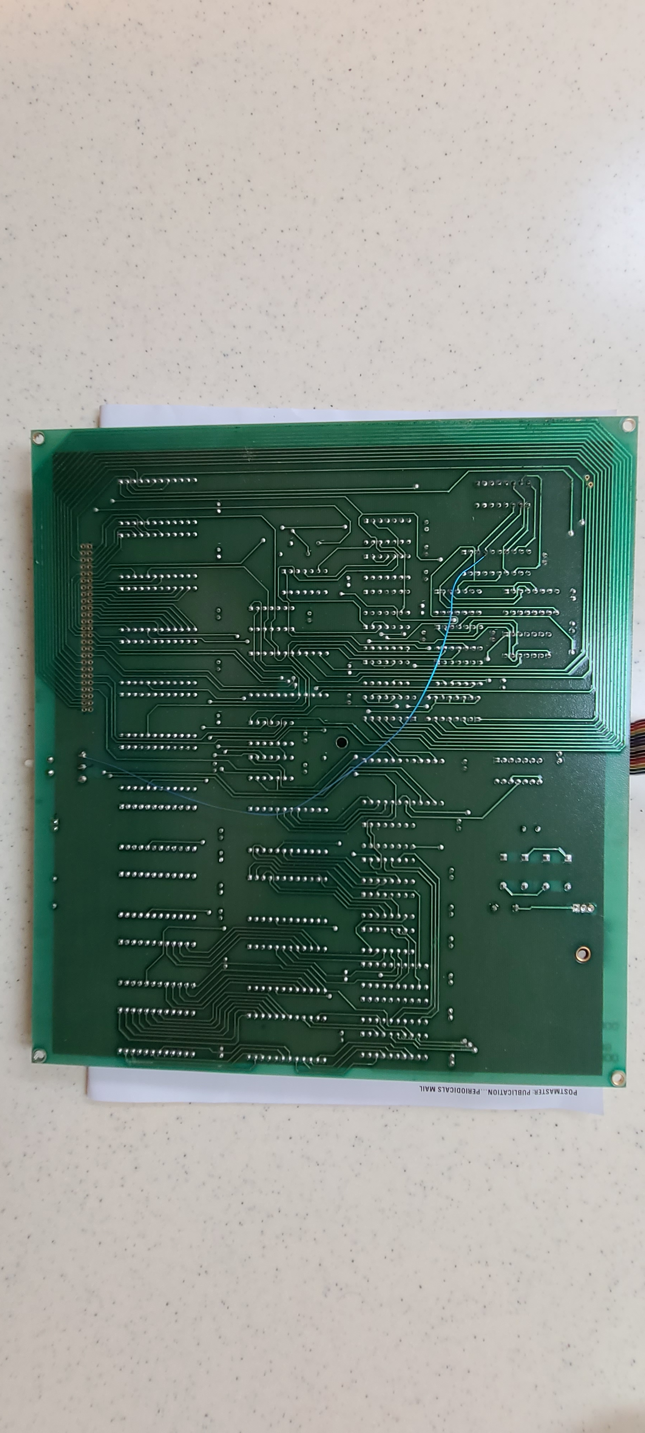
PCB
Back-side
Front
Notes:
Back side of the 2 layer PCB.

Slide 28
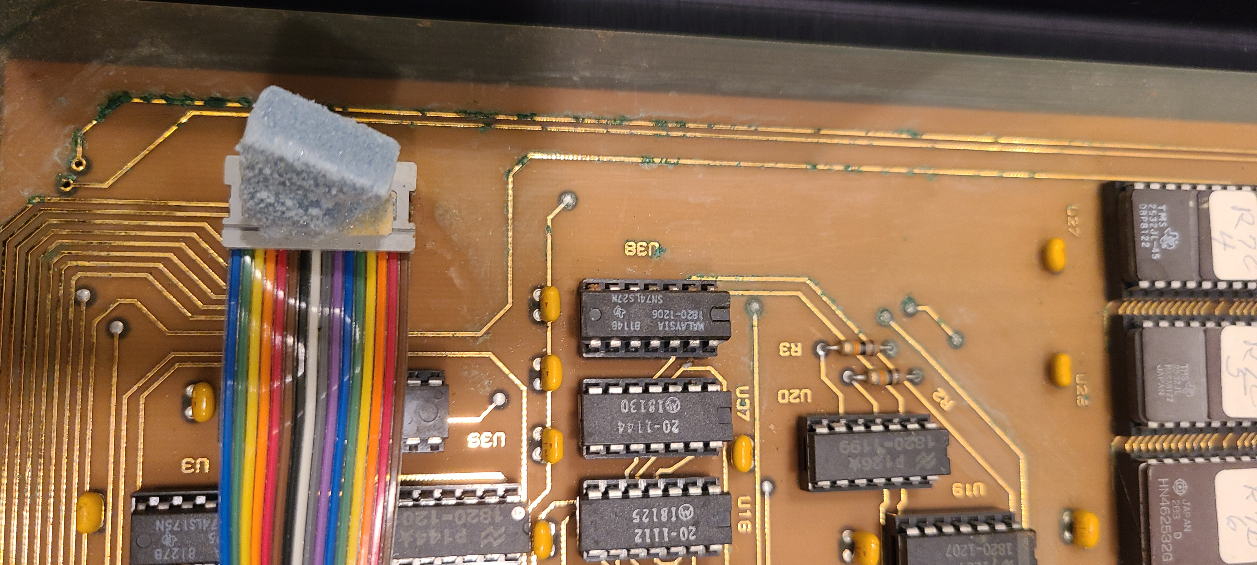
PCB Corrosion
Notes:
This unit was stored in a garage and time was not kind. The PCB has corrosion in multiple places.

Slide 29
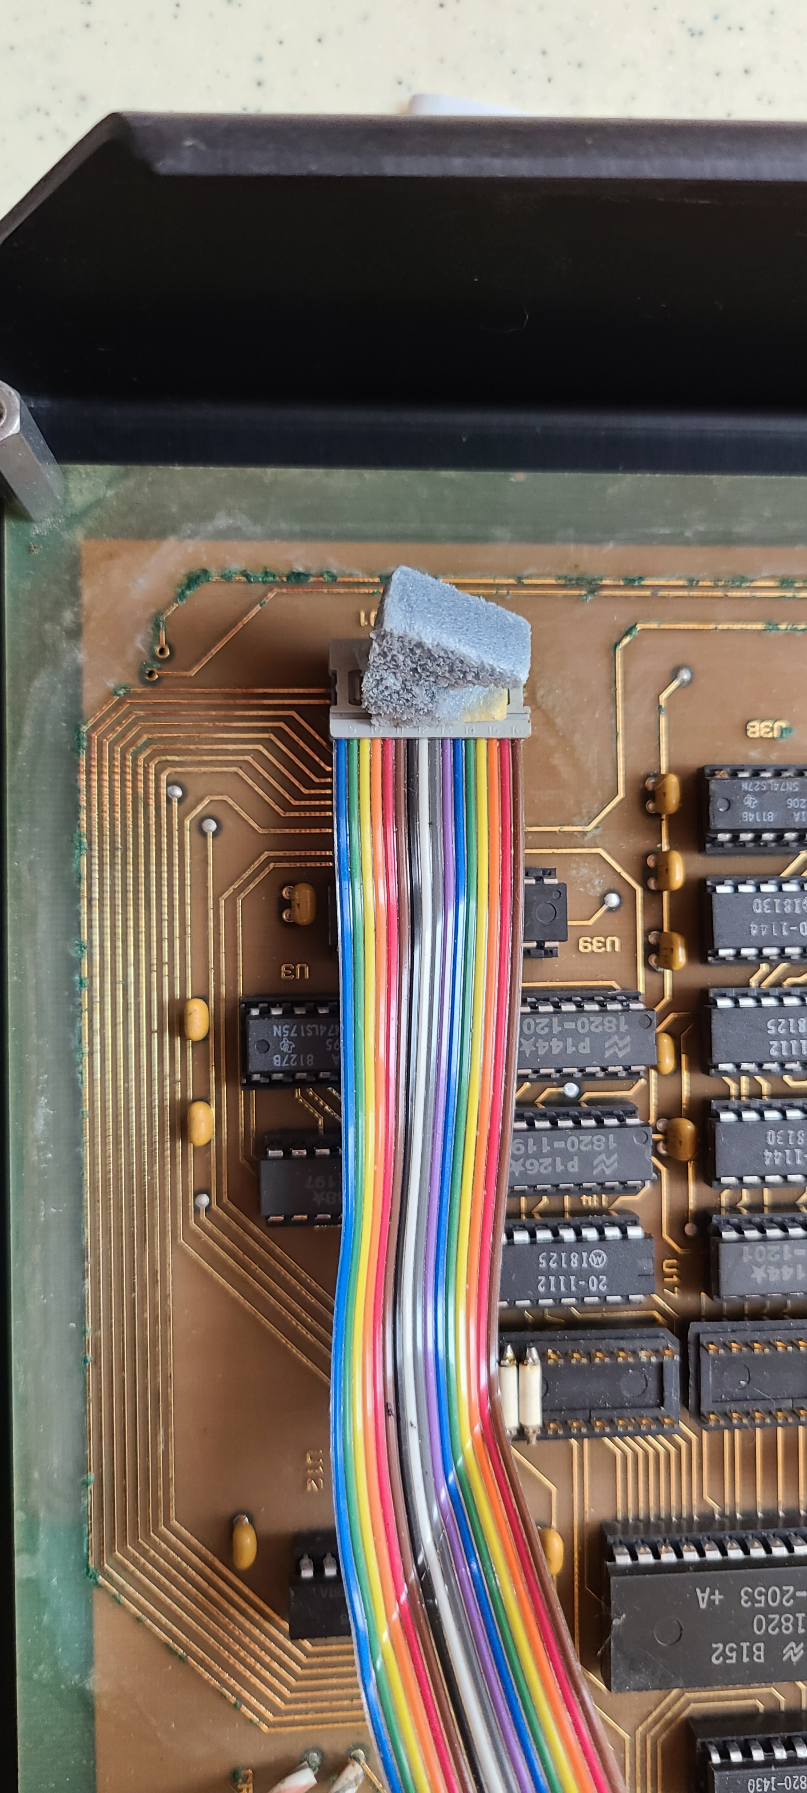
PCB Corrosion

Slide 30
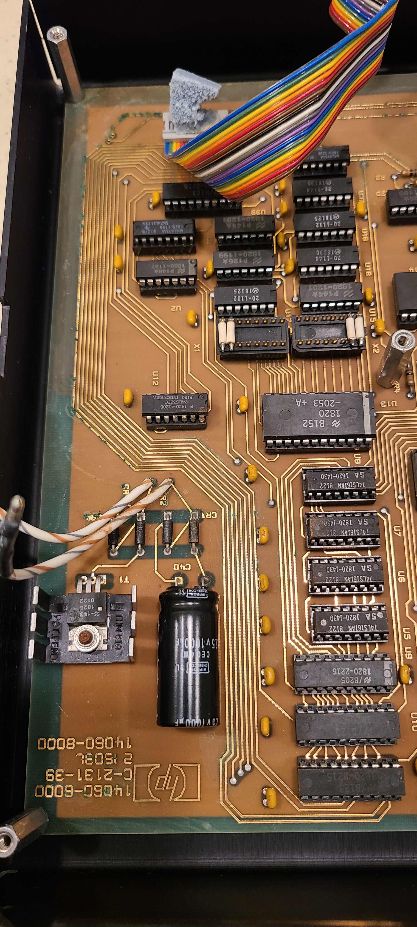
PCB Corrosion

Slide 31
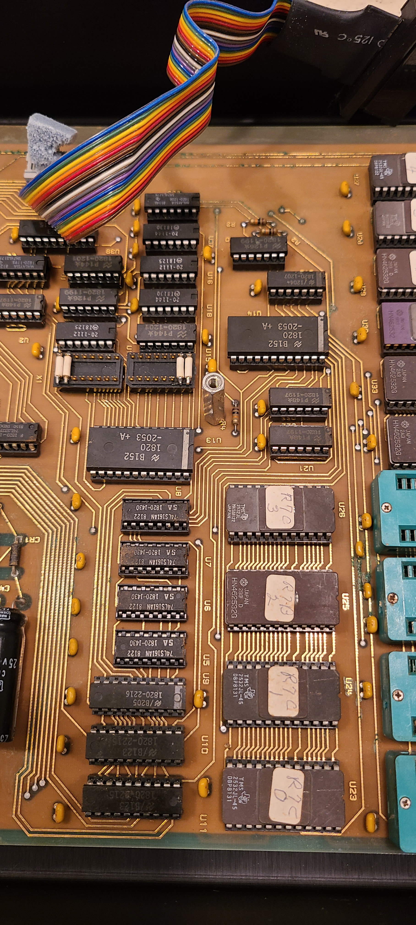
PCB Corrosion

Slide 32
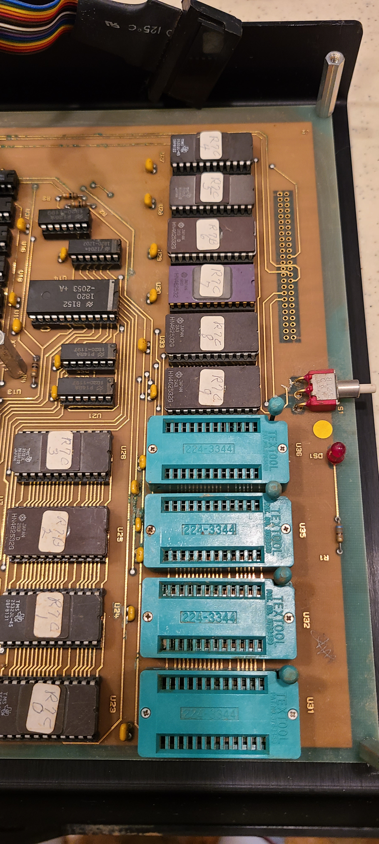
PCB Corrosion

Slide 33
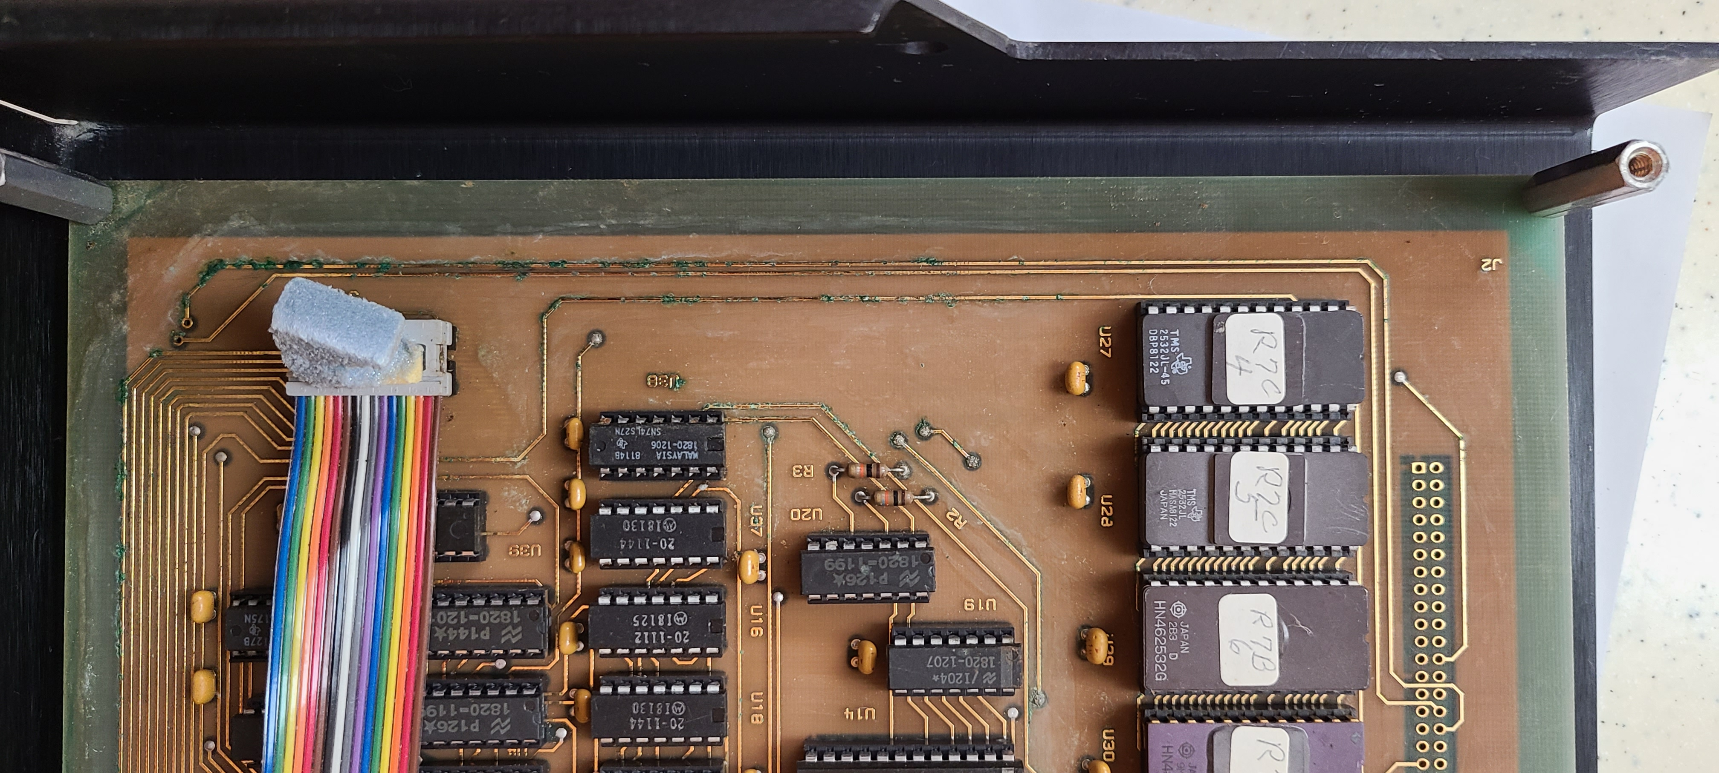
PCB Corrosion

Slide 34
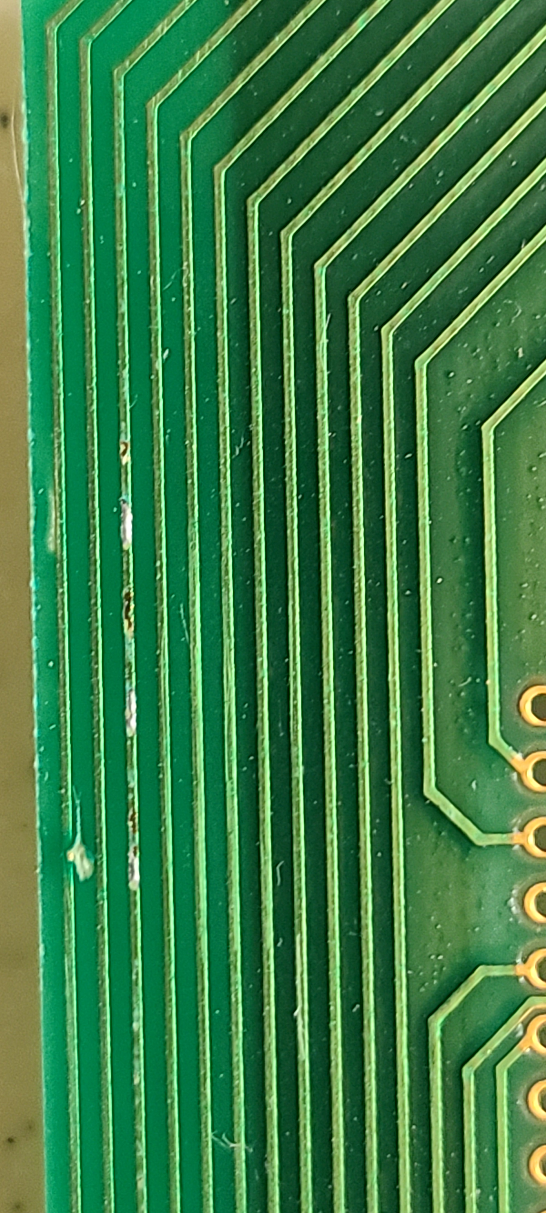
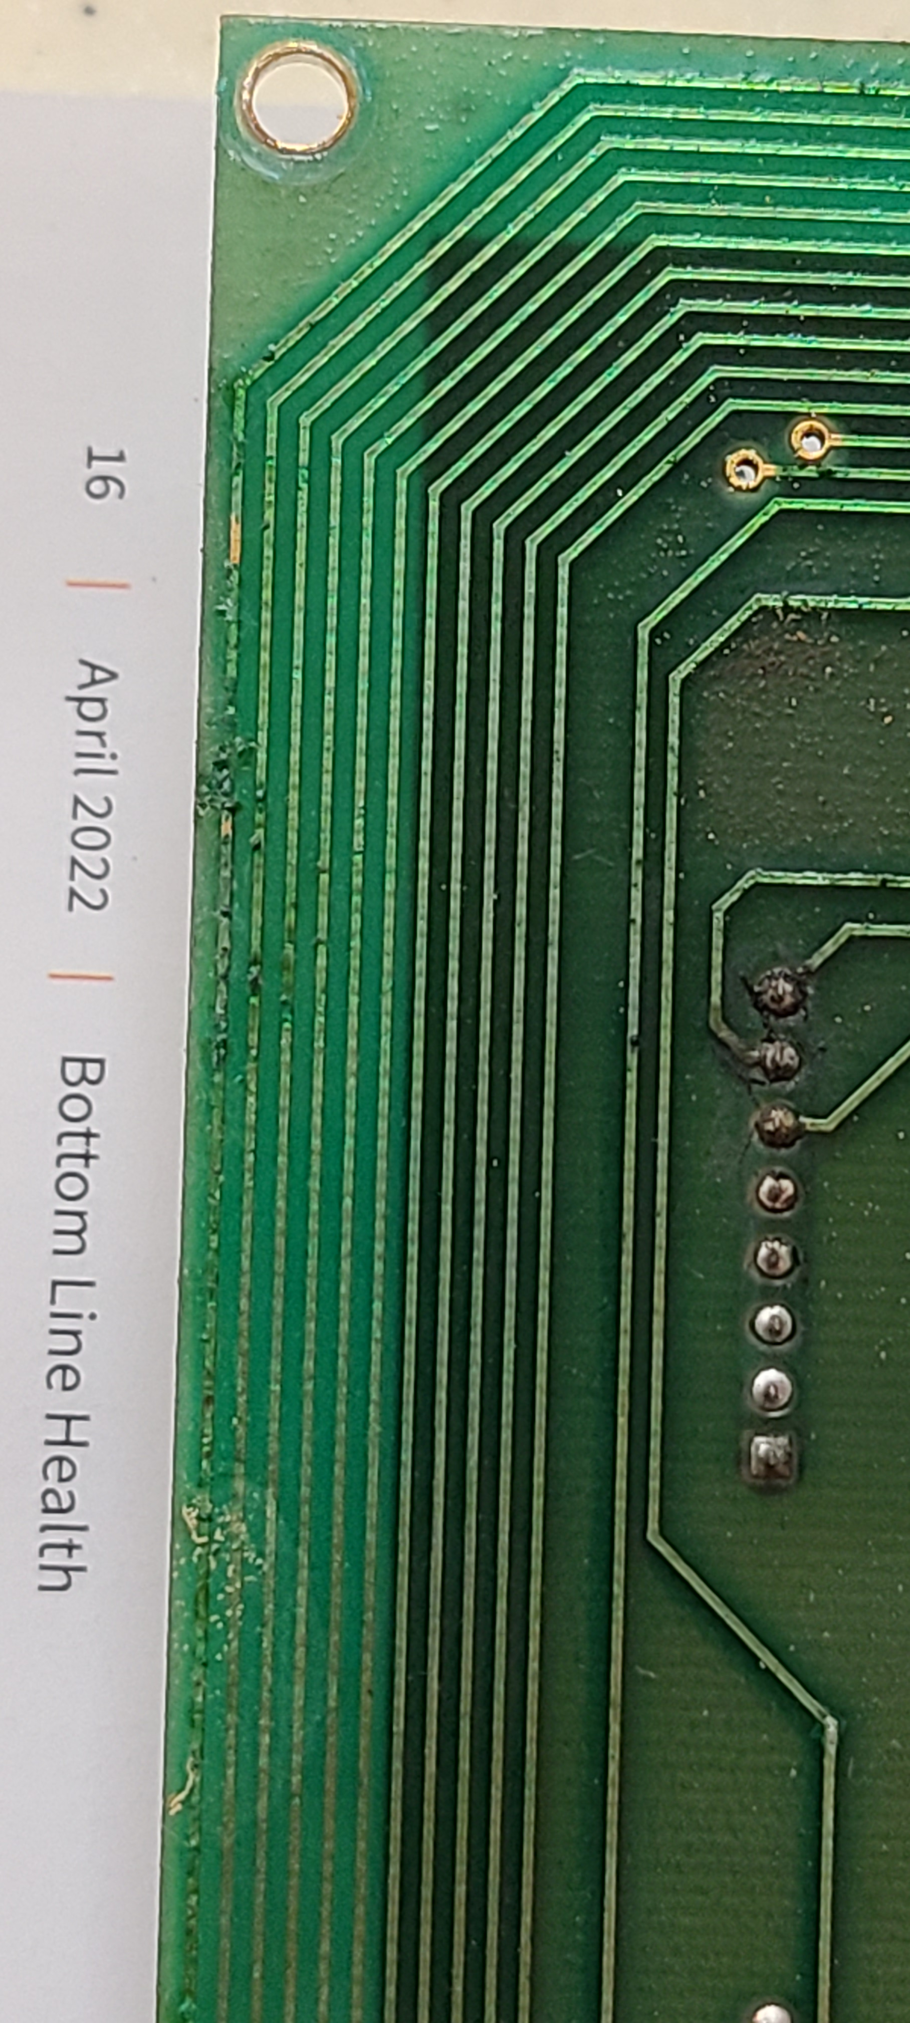
PCB
Corrosion
Notes:
So Far I have
Fiber cleaned traces
Reseated most of the socketed ICs
Multimeter checked adjacent traces- no shorts
Multimeter checked corroded traces- still have end to end continuity
Next steps will require a scope

Slide 35
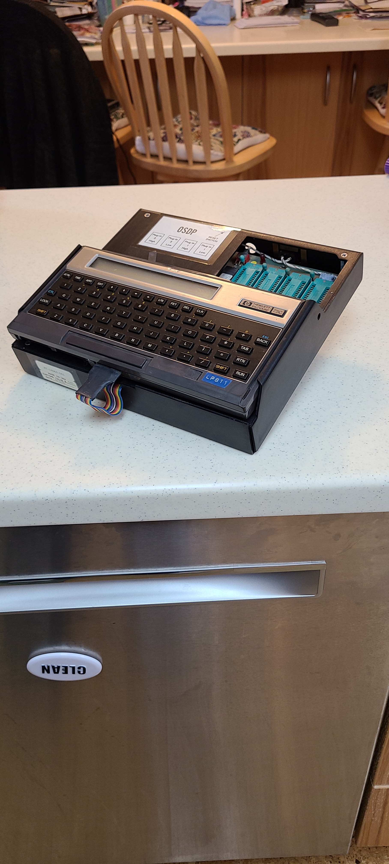
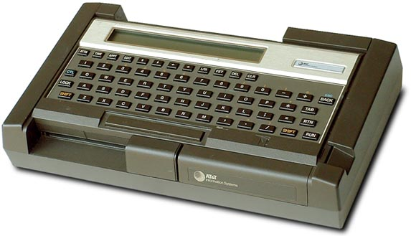
…. Similar …
Thank you!

