Slide 1
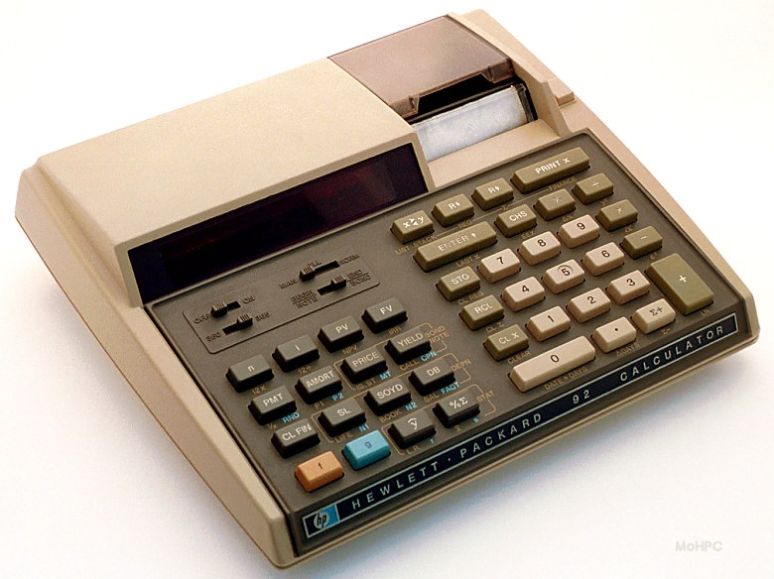
When HP was designing
the HP-92…
Pictures: hpmuseum.org

Slide 2
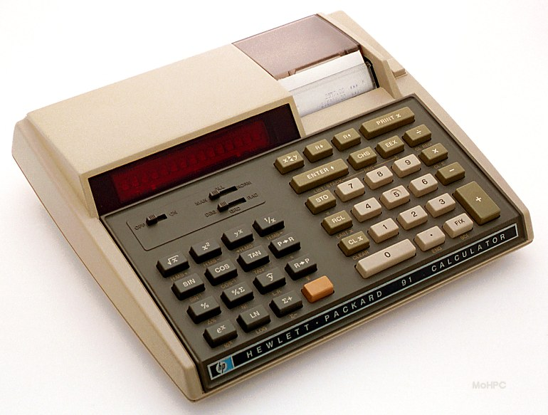
HP-91s were used to build HP-92 development systems…
Notes:
Plastic injection molding tooling was a longer lead time so HP91s were used to build development systems

Slide 3
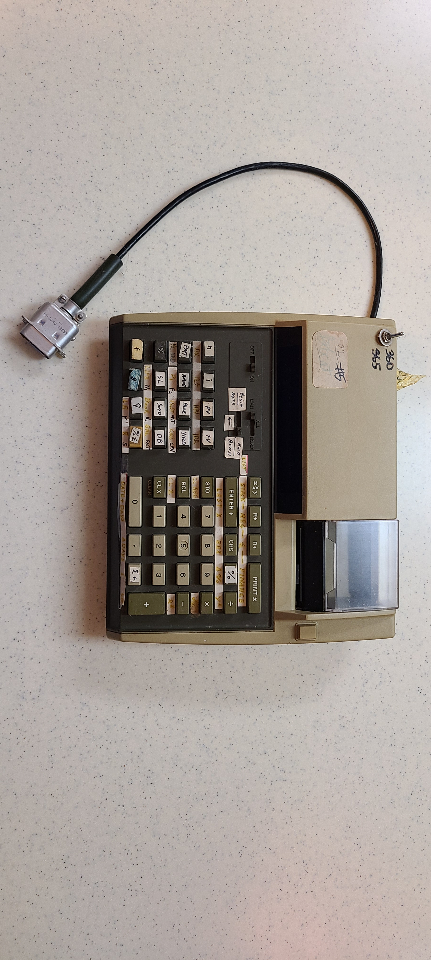
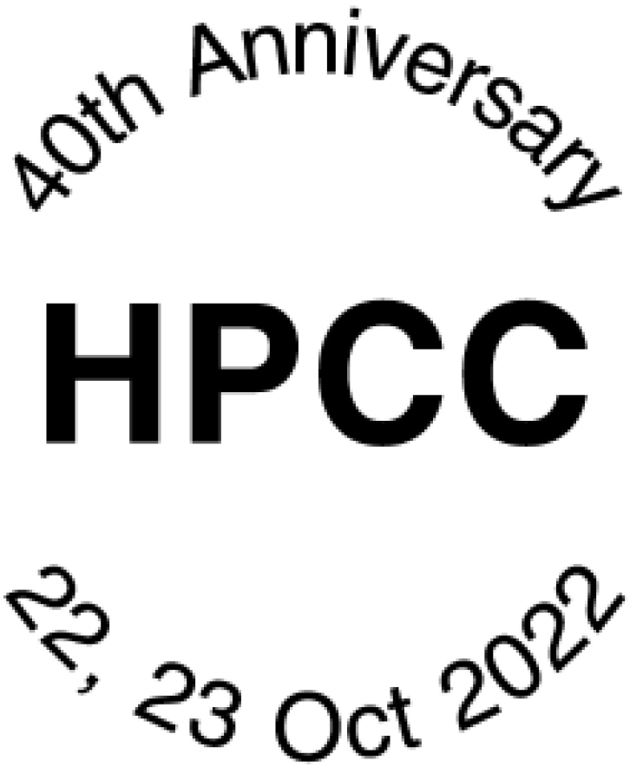
An HP-92
Development
System
Notes:
This is one of those development systems

Slide 4
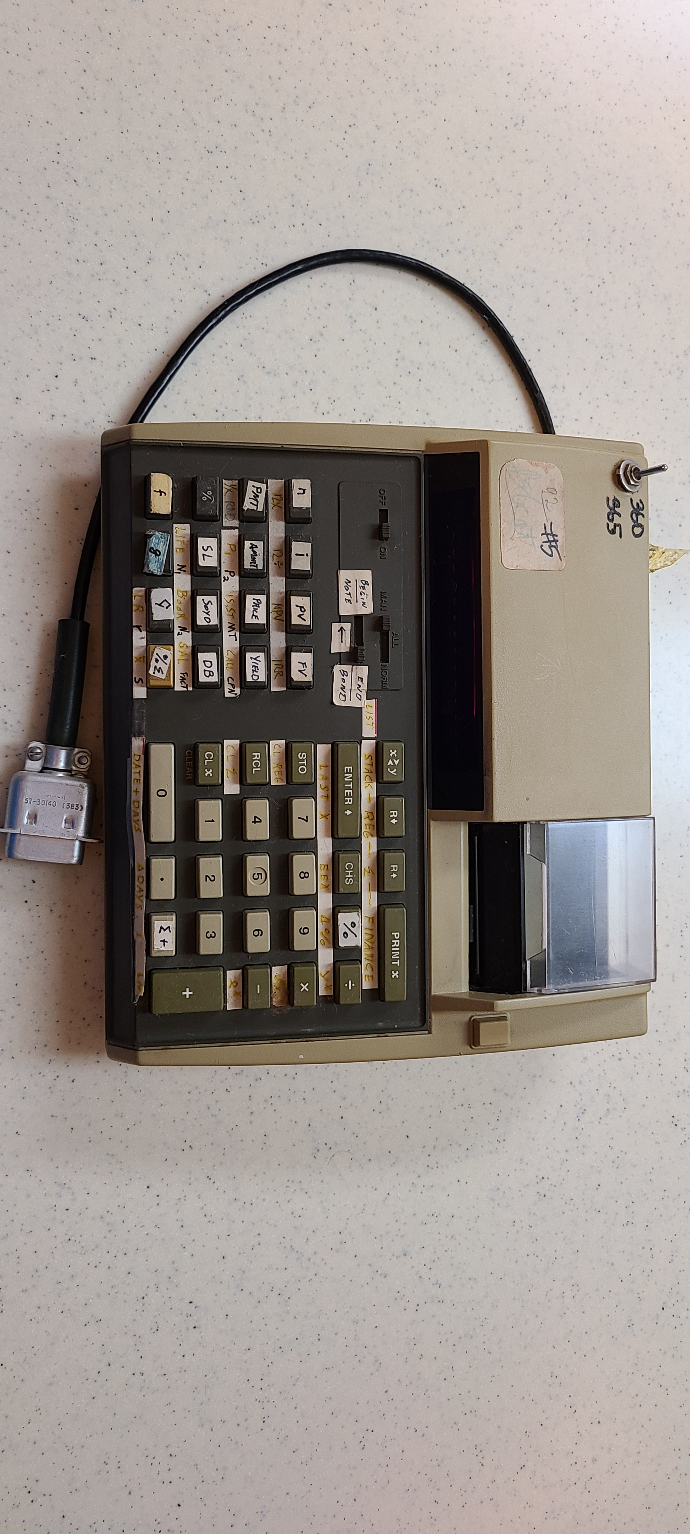
Zooming in
on the label…
Notes:
If we zoom in on it label….

Slide 5
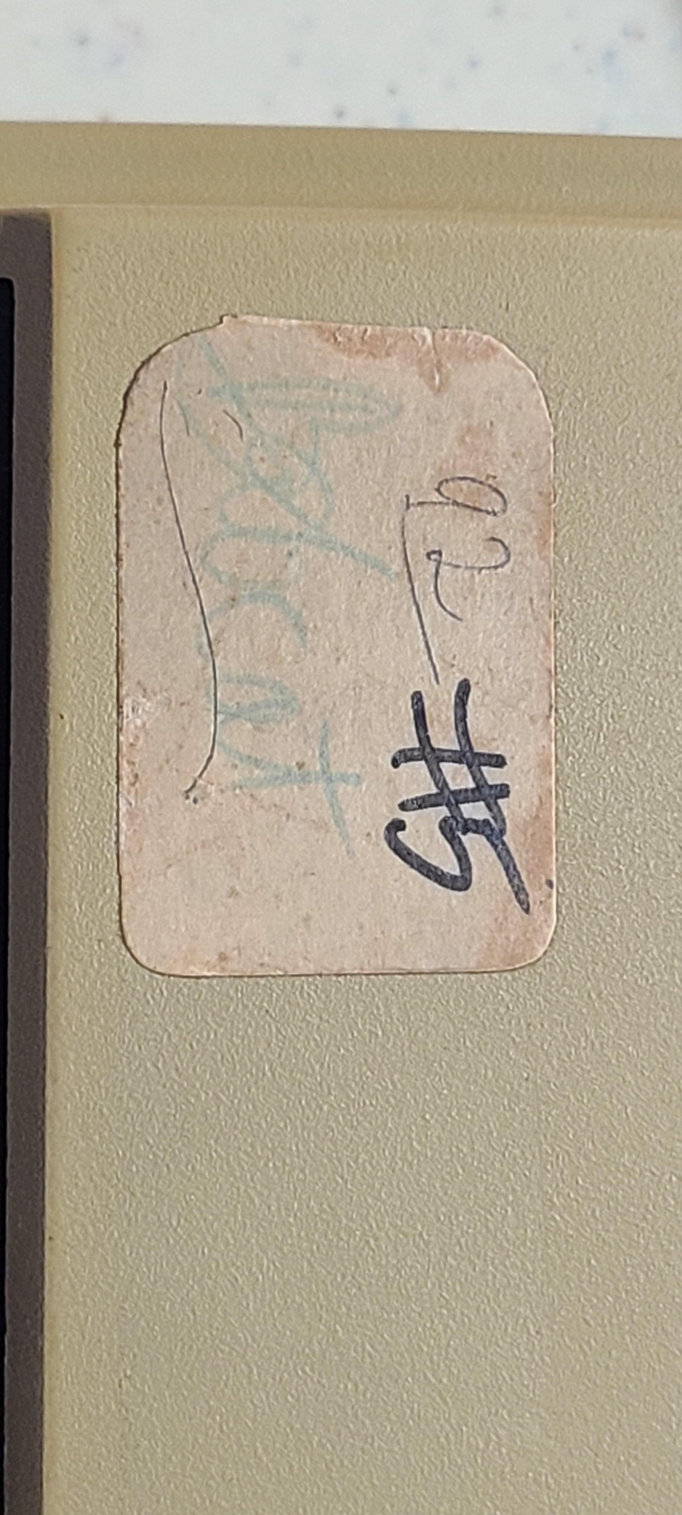
Code Names
Many HP calculators had internal code names during their development. The following code names are known:
HP-91—Felix
HP-92—Bobcat
HP-97—Kittyhawk
HP-97S—Ricochet
Xpander—Endeavor
- Museum of HP Calculators
Notes:
This is Bobcat (HP92) development system #5 so at least 5 of these units existed. Bobcat was the project’s code name. Someone added the 92 product number later.

Slide 6
Remember the
development system
switch?

Slide 7
“Like the HP-80, the HP-92 included bond price and yield, but it added call price, coupon amount, and issue, settlement and maturity dates. Also new were Internal Rate of Return calculations, and switches to select 365- or 360-day year calculations and begin/end of period payments.”
https://www.hpmuseum.org/hp92.htm
The HP-91 had 3 slide switches, the HP-92 has 4 slide switches with 2 new slide switch functions. The Bobcat development systems used a toggle switch for one of these switches (360/365).
For the Begin/End switch…
Notes:
The 92 added 2 switch functions.
The 91 had 3 switches, the 92 had 4 switches.
The development system implements 360/365 with the toggle.
(91) 3 + 2 = 5 but 92 had 4…
For the begin/end…

Slide 8
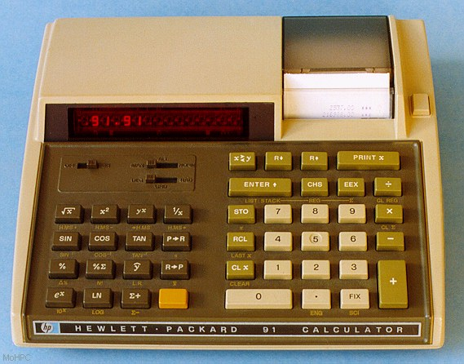
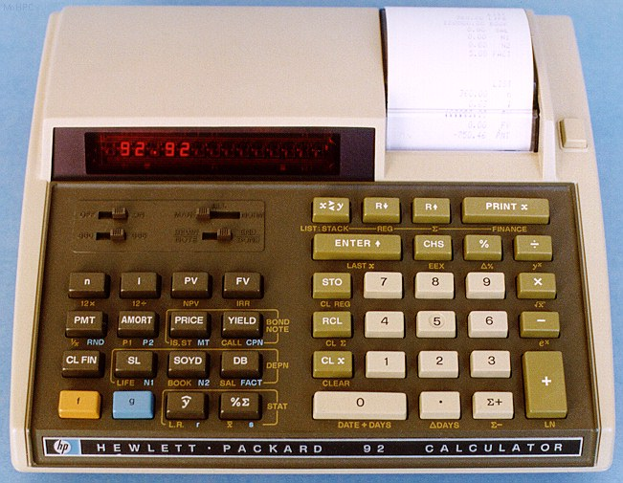
The HP-91 had trig functions and a Deg-Grd-Rad switch.
The HP-92 had no trig and repurposed the Deg-Grd-Rad switch to Begin/Note-End/Bond.
Pictures: hpmuseum.org

Slide 9
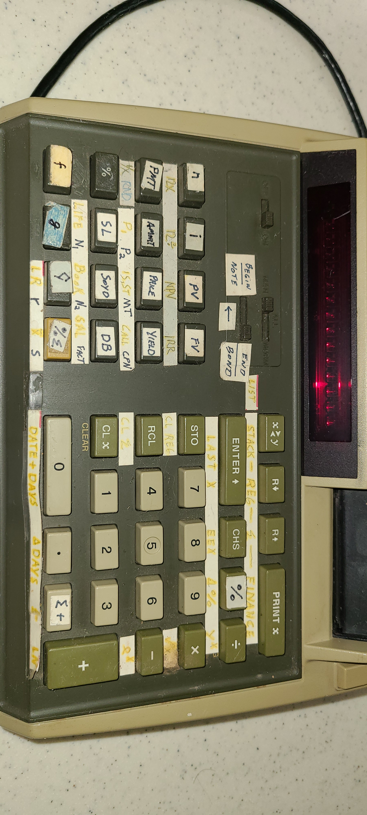
The Bobcat development system keyboard & display…

Slide 10
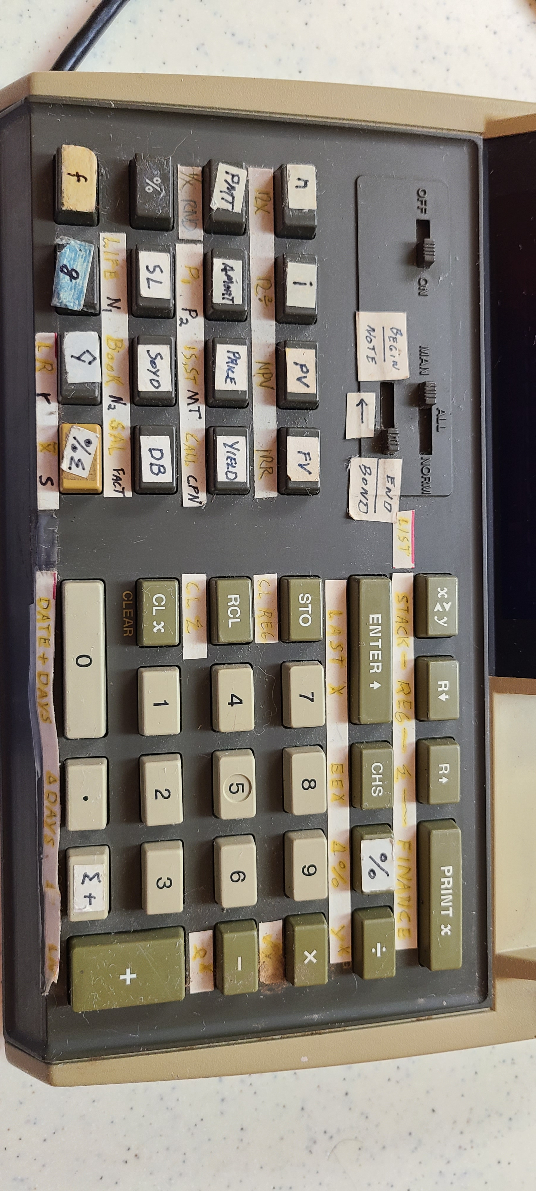
Larger view of keyboard…

Slide 11
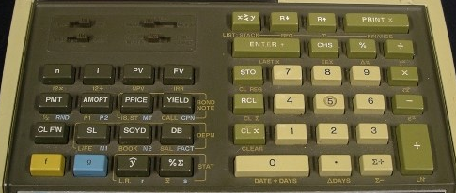
Comparing the
development system
and
production HP-92
keyboards
Notes:
Paper labels match the final product keyboard

Slide 12
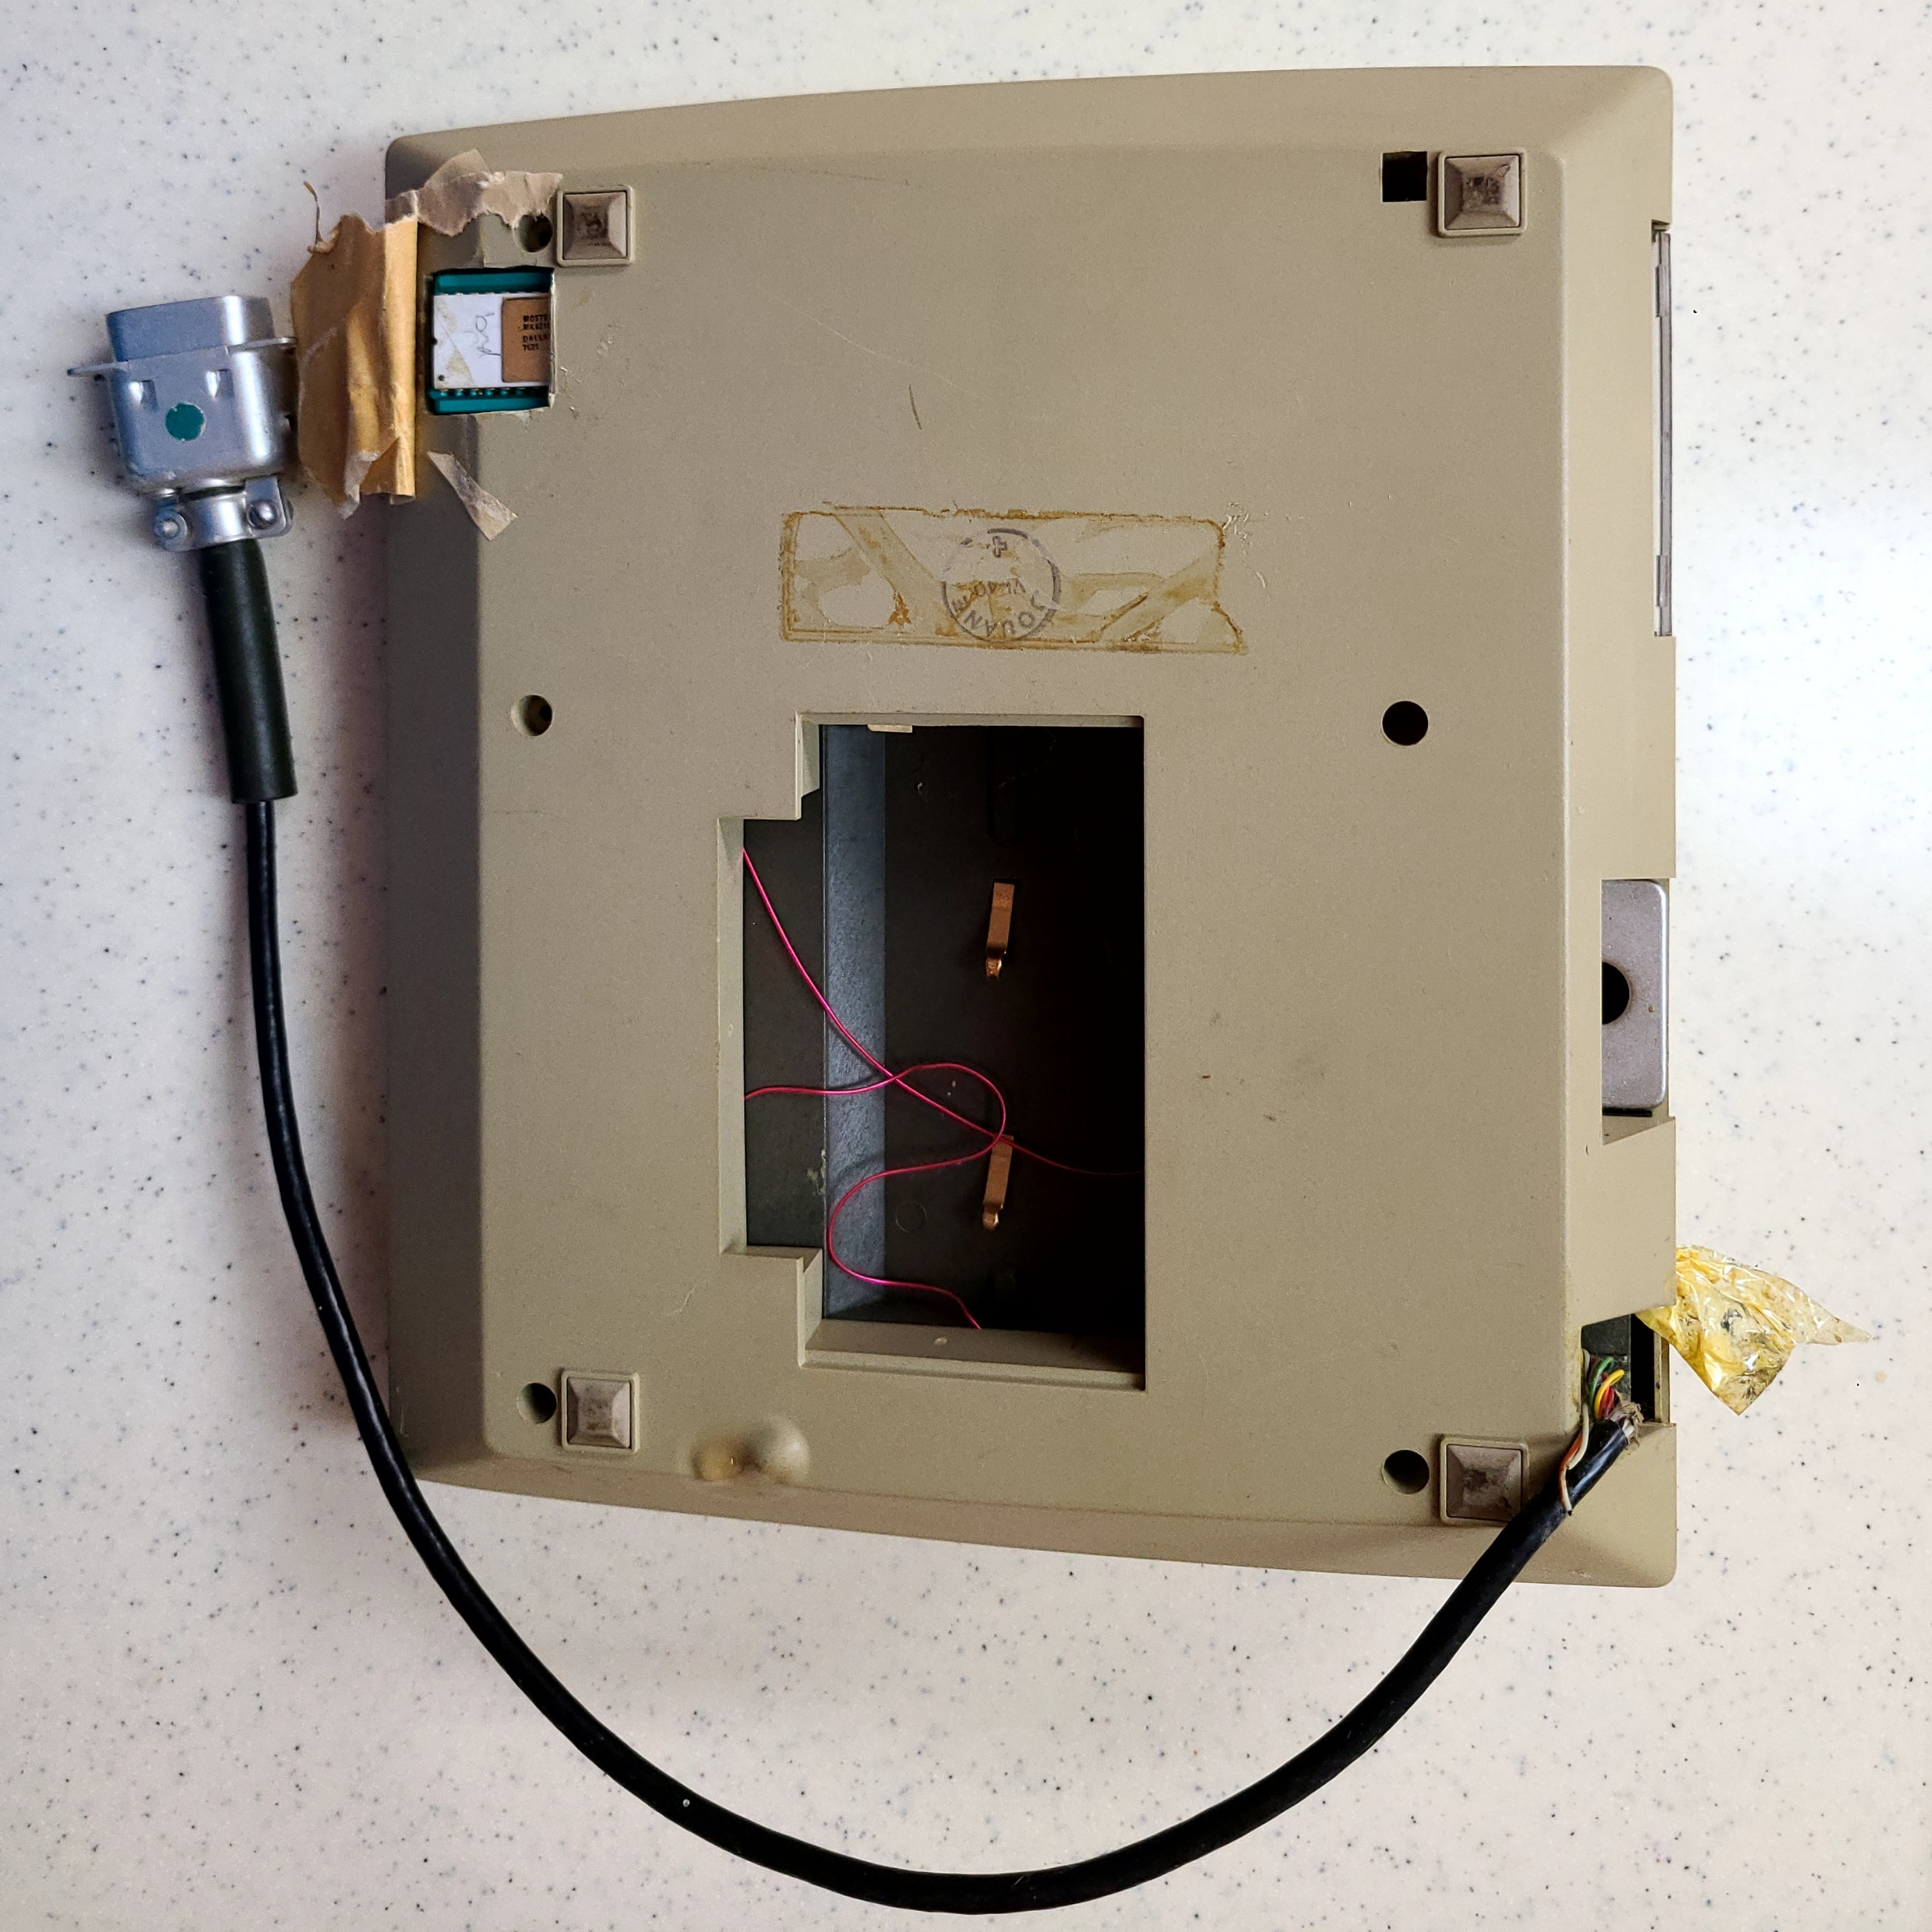
Looking at the bottom of the unit…

Slide 13
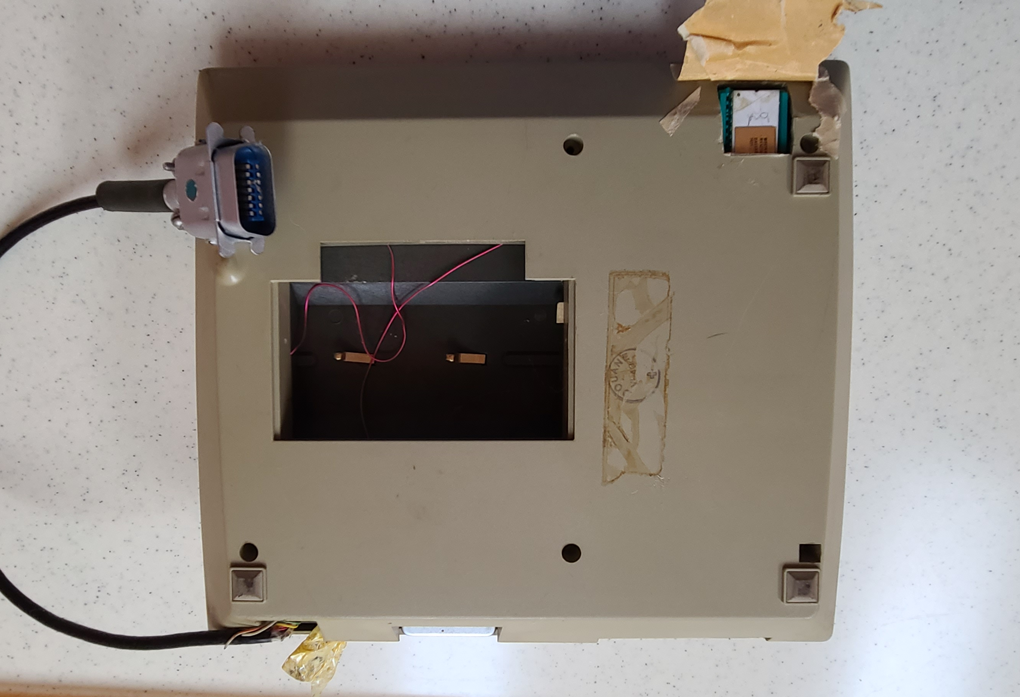
We’ll see that the connector is for both power and data. I have no pinout documentation…
Notes:
The connector comes out of where power connector would normally be.
We’ll see the cable = power + data
1 of the development system’s ICs is socketed, clearance required cut out

Slide 14
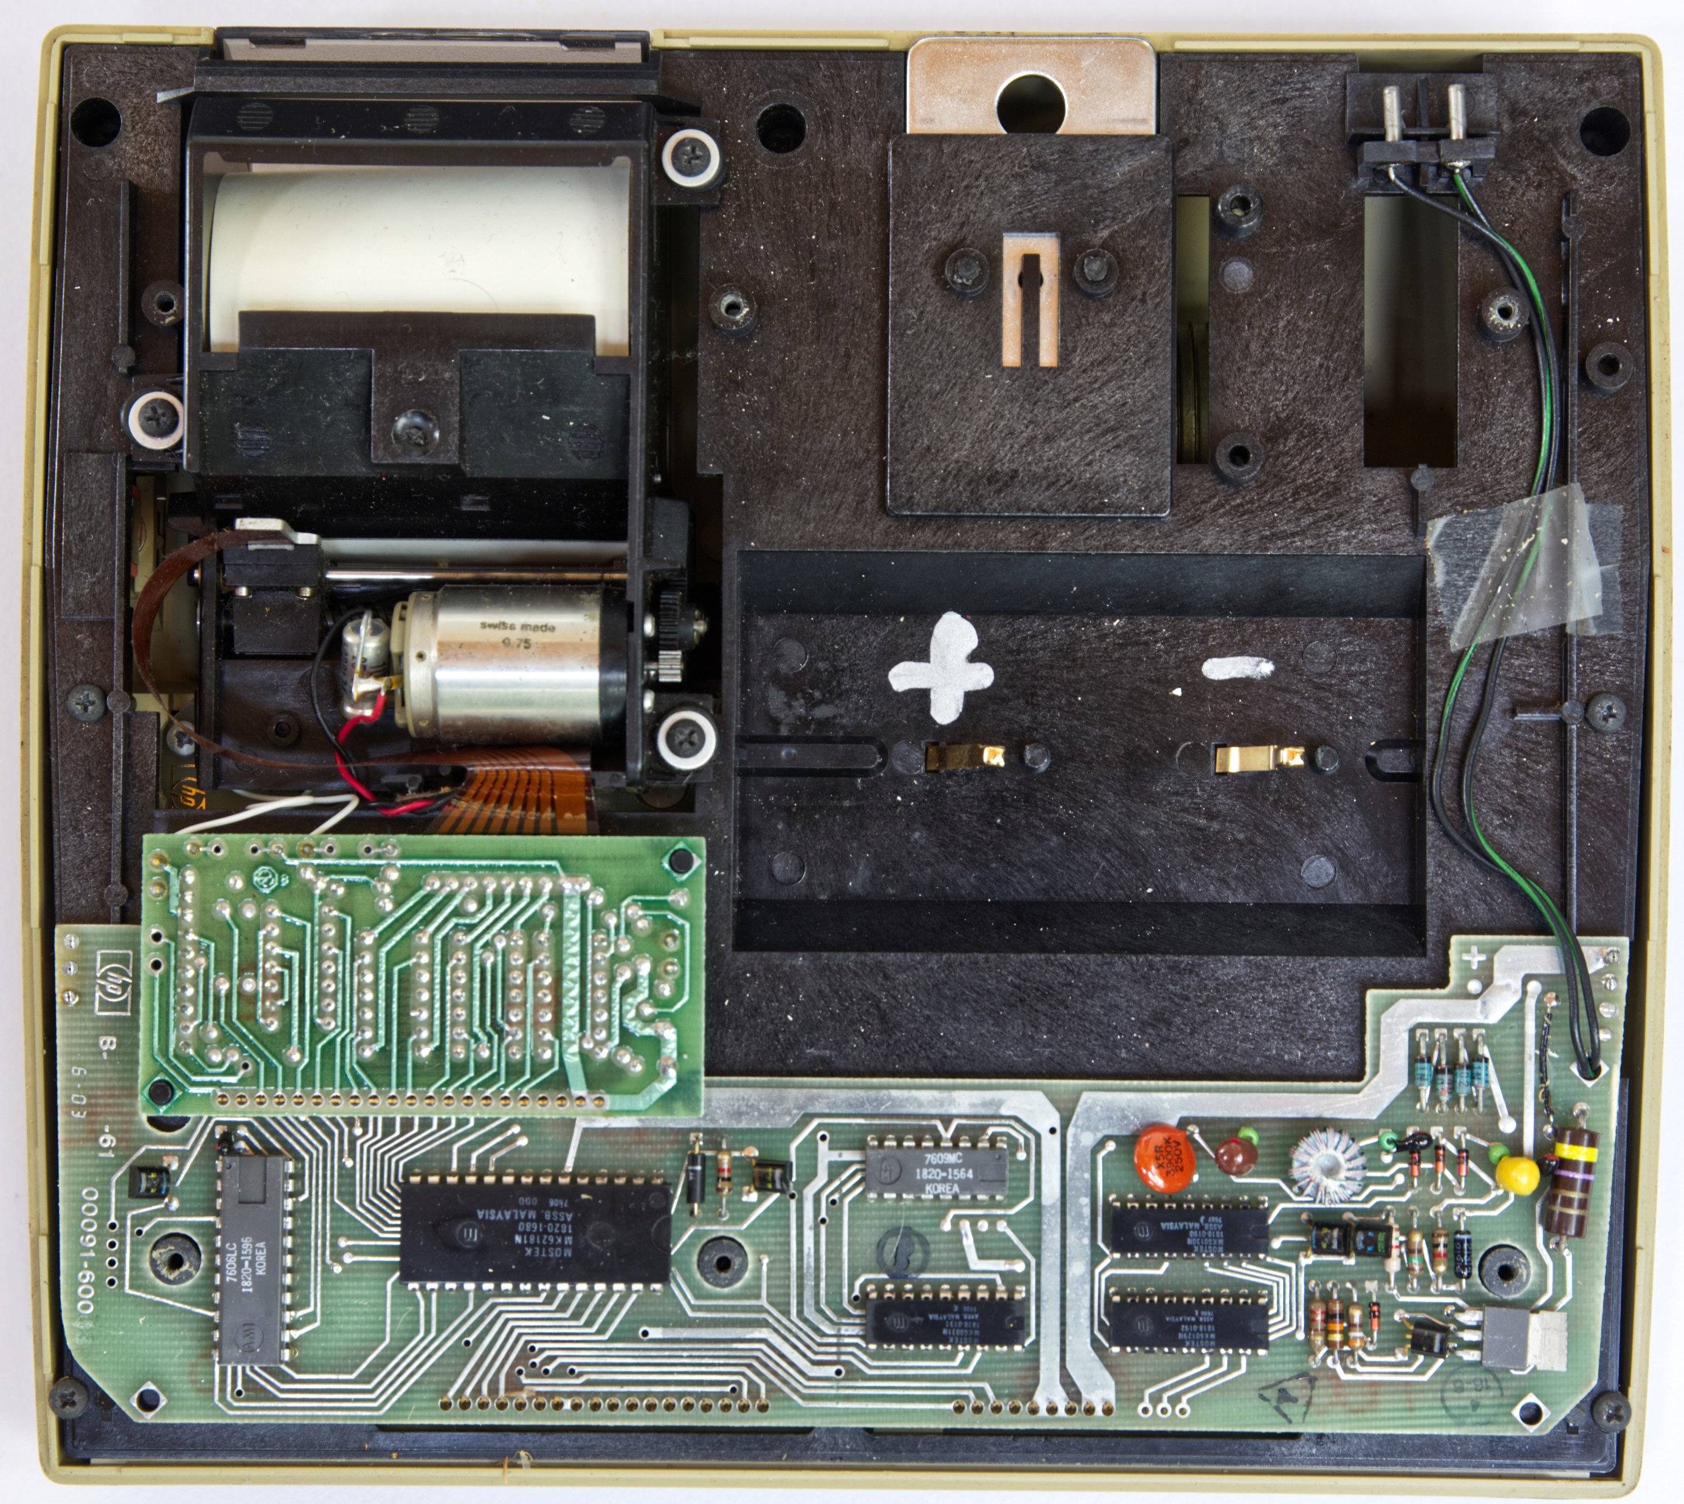
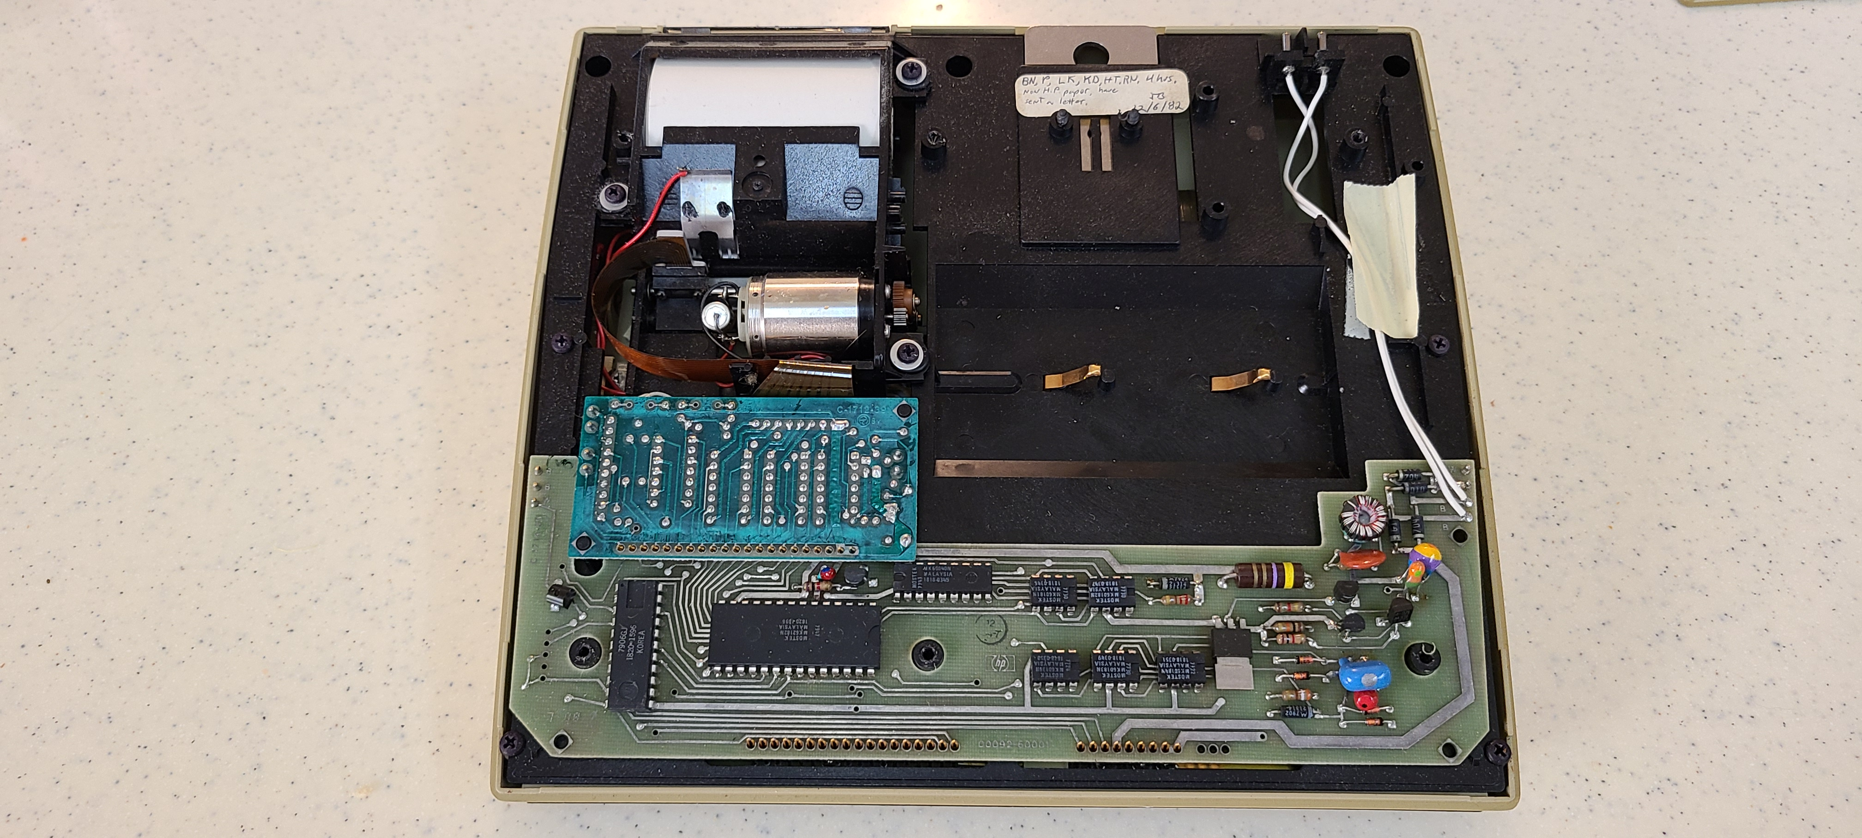
HP-91
HP-92
An inside look at the HP-91, HP-92 for reference
Notes:
The HP91 and 92 internals look very similar

Slide 15
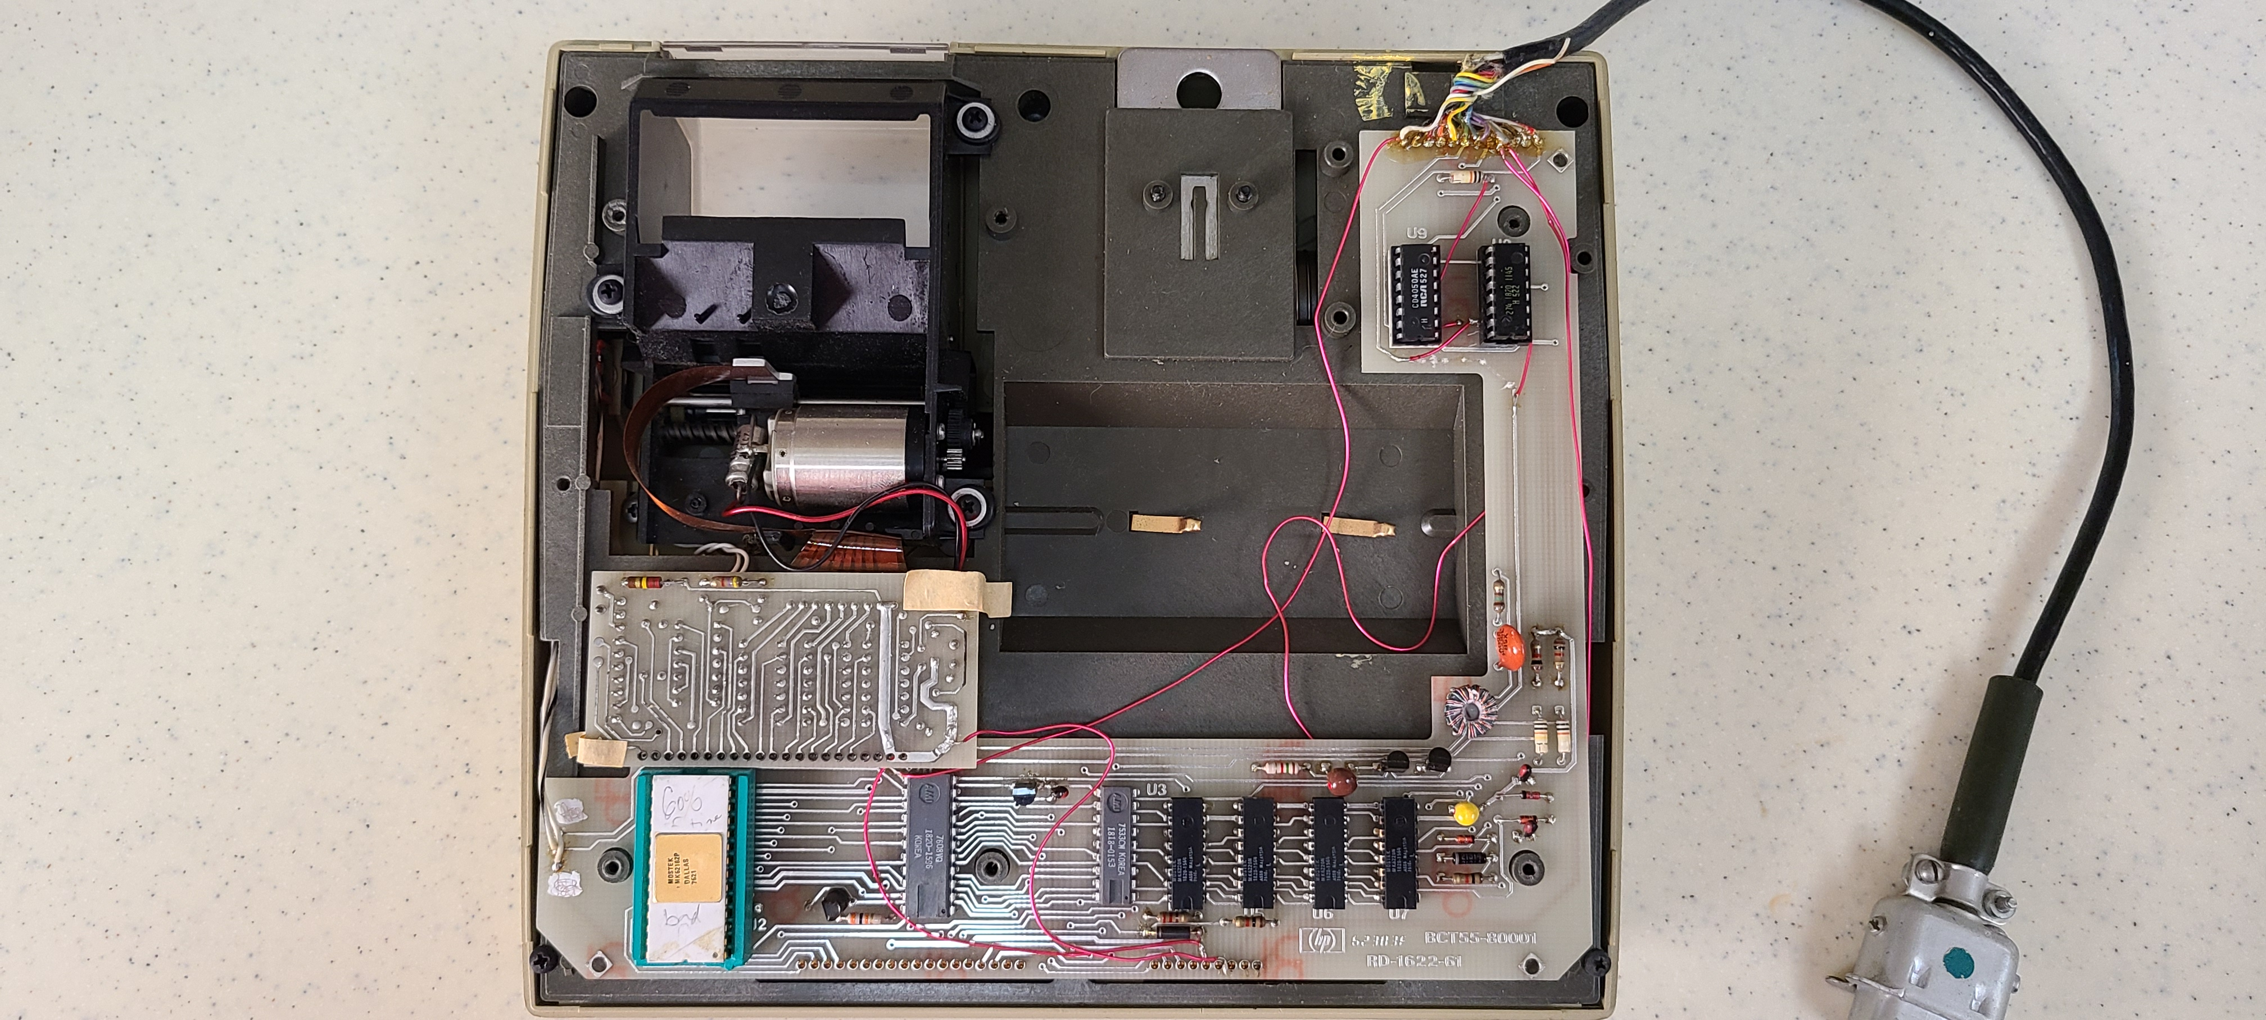
a package of 6 inverters
(4050)
TI CD4049UB INVERTER 6CH 1-INP (1820-1145)
Looking inside
The Bobcat development system…
Pik
ACT
(1820-1596)
ROM0
for the display
(1818-0153)
4 RAM chips
for the 64 memory registers (1820-1564)
Thank you to Tony Nixon for identifying all but one of the ICs!
HP part number reference list:
http://hparchive.com/Bench_Briefs/HP-Bench-Briefs-1987-10-12.pdf
Notes:
This is the Bobcat Development Systems
Pik, Act, Rom0, 4 ram chips, 2 hex buffers
Thank you Tony!
Bench briefs

Slide 16
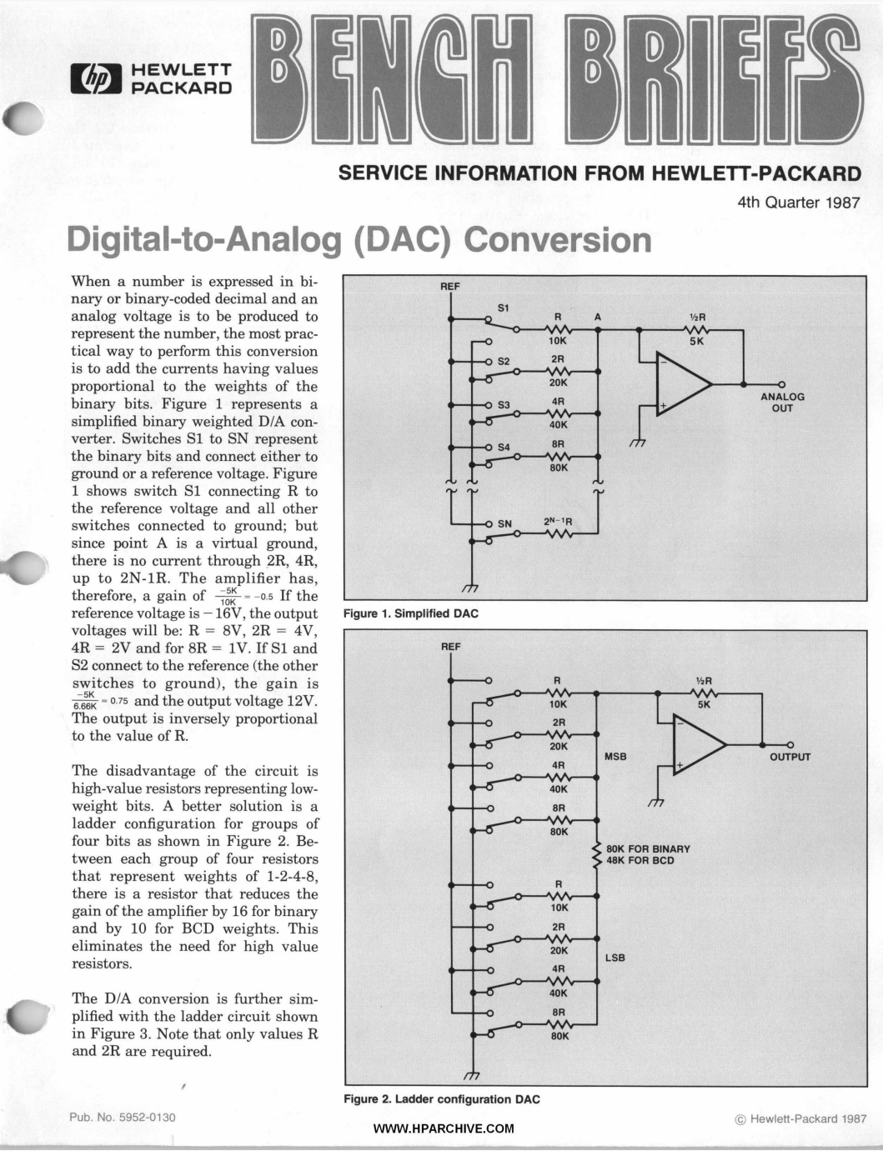
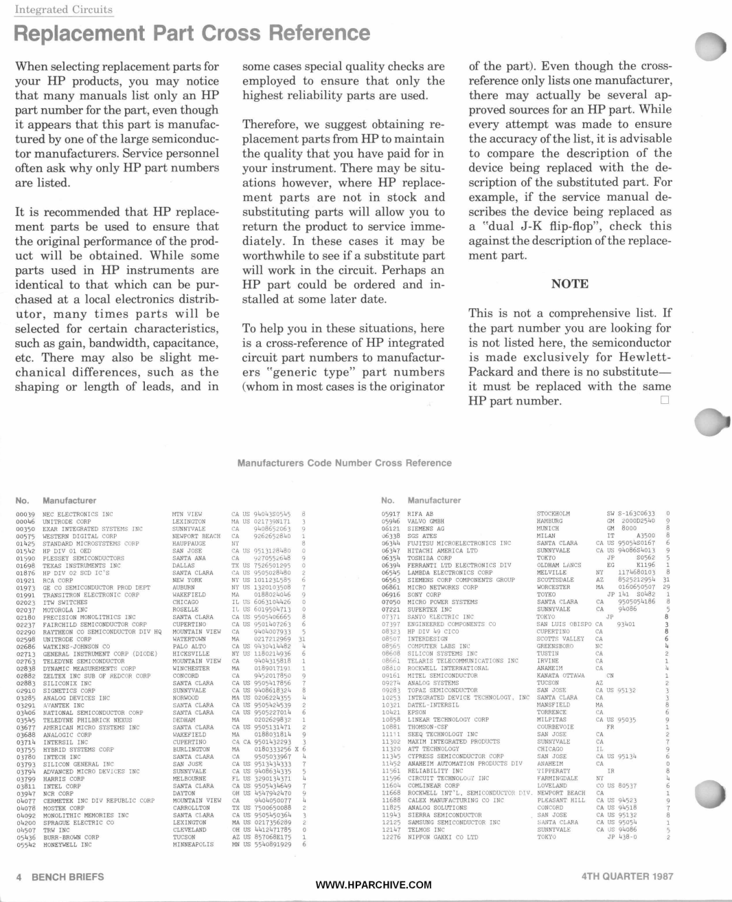
HP Part Cross Reference
Notes:
This bench brief has a handy cross reference to match HP IC number to commercial equivalents, if available.
For example it maps 1820-…. To its standard part number.
This is on Eric’s thumb drive!

Slide 17
Bobcat Dev Sys
HP-92
For Comparison
Notes:
Comparing the HP92 dev system and a production system

Slide 18
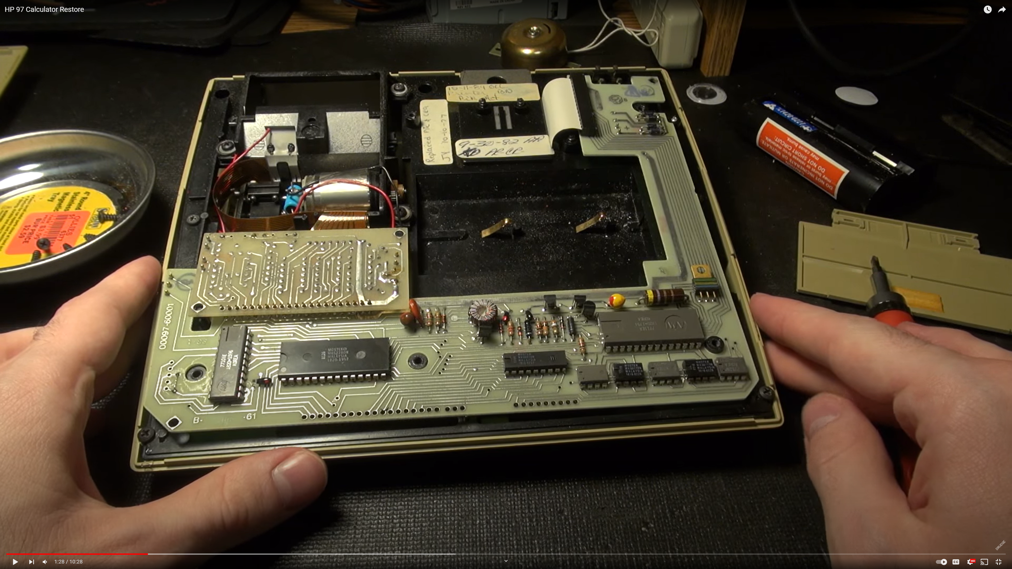
For Comparison
HP-97
Bobcat Dev Sys
Notes:
The bobcat proto board looks a lot like the HP97’s board.
The hp97 routed data up the right side of the unit to the card reader.
The bobcat routes data up the right side to the external cable
97 units were available during 92 dev. PCBs similar.

Slide 19
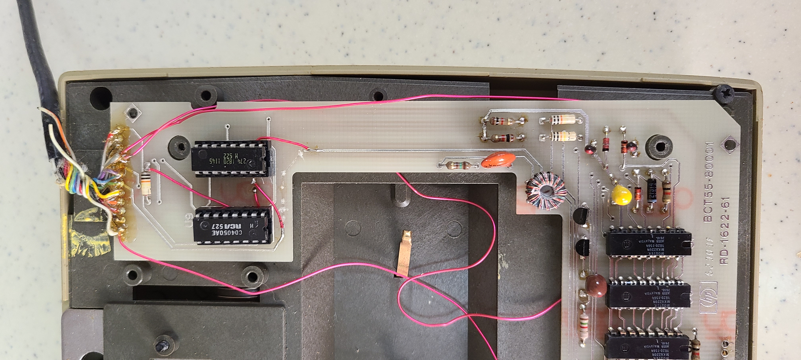
A Close-up of the cable connection…
Notes:
Have to admit wire wrap PCB fixes add that lived in proto look :-)

Slide 20
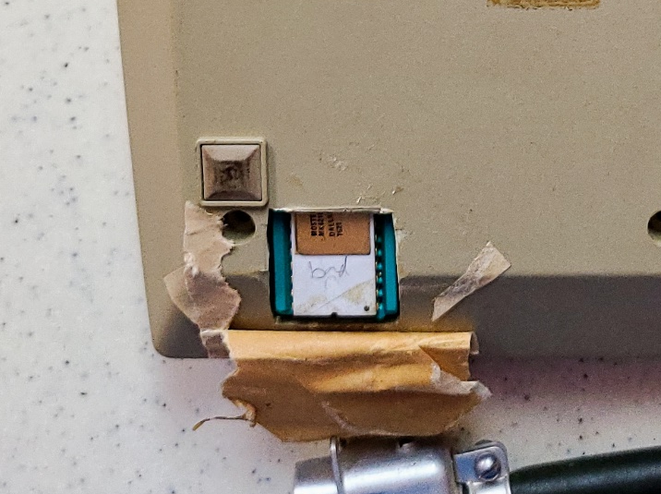
The unit is also likely non-working given the writing on the socketed PIK IC… ☹
Notes:
You’ve probably noticed that the Pik is unfortunately labeled BAD, and
No documentation for the external connection so this development system is not functional

Slide 21
Thank you!
Notes:
I hope you’ve enjoyed this trip down memory lane.
Thank you for your time!

