Slide 1
What if?
We could have another model in the Voyager Series…
Chuck McCord

Slide 2
What if? There was another model in the Voyager Series…
The Goal would be to create a “new” Voyager format calculator that followed previously proven interesting function sets
It would be likely that another Voyager model would have less volume than 12,15,16 so there would be a drive to maximize leverage of an existing model.

Slide 3
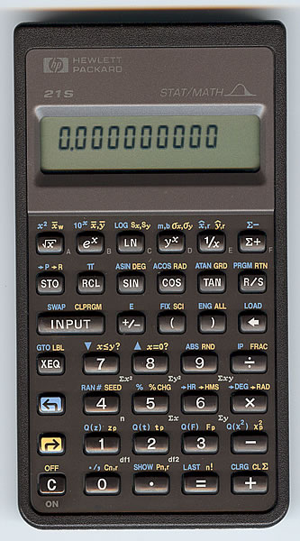
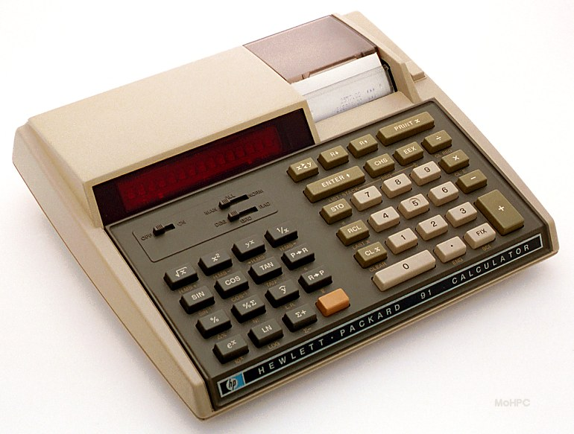
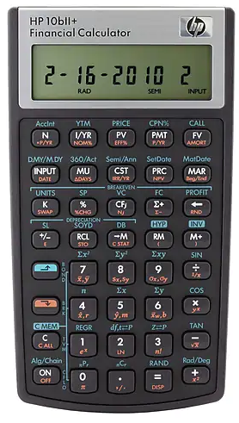
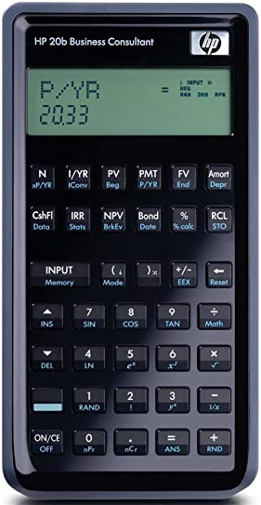
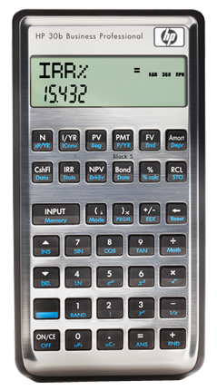
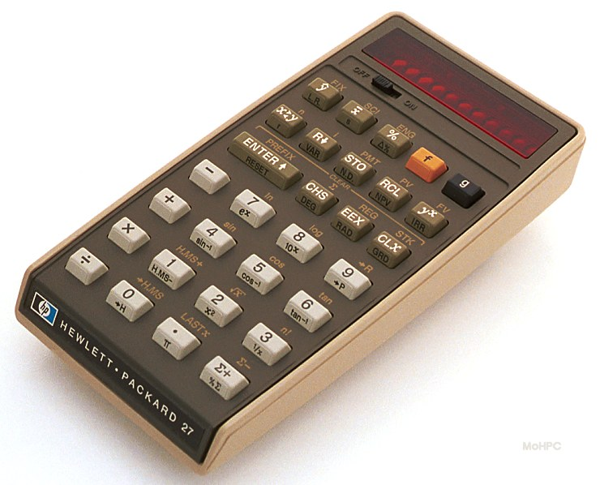
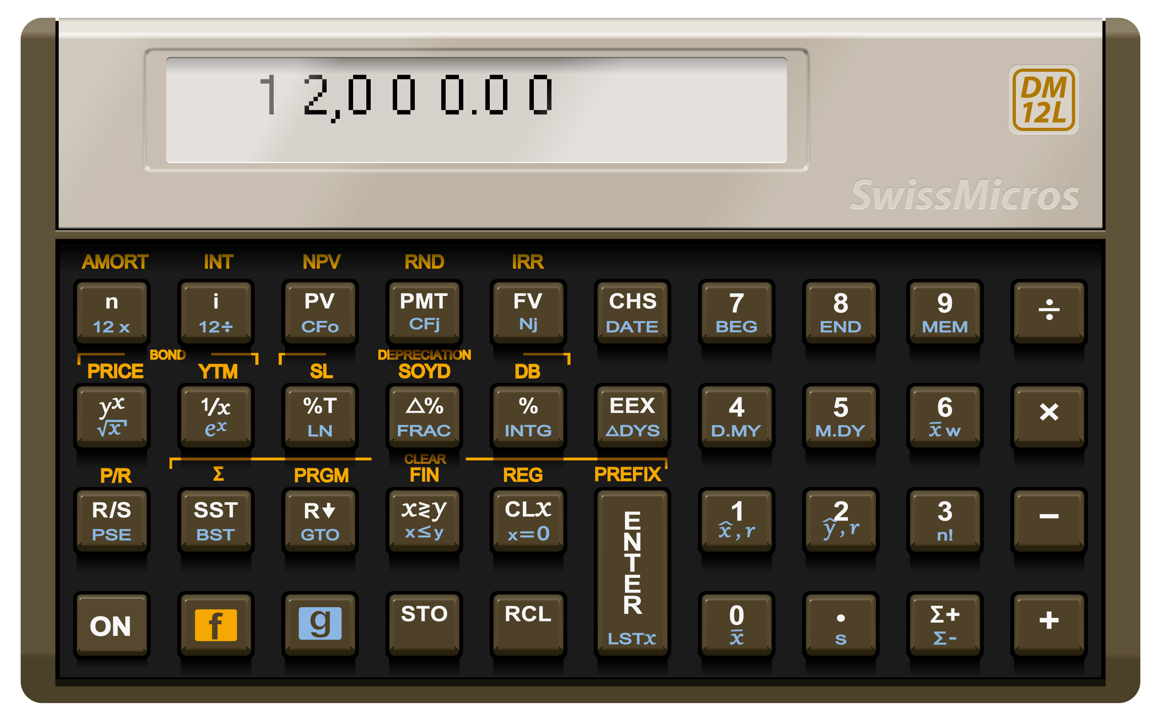
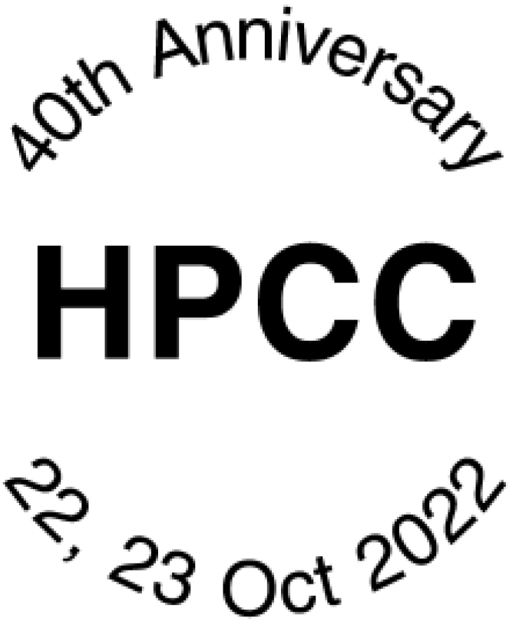
What if?
The function set
Multiple HP calculators
extended the
business calculator function set
by adding Trig functions and
Statistics (probability distributions)
Notes:
Function set: Multiple HP calculators extend business functions with Trig & Stats functions—
For example the HP27 & HP91. A number of the more recent HP & TI calculators have both Financial and Trig functions.
1 of the steps for becoming a registered EE Professional Engineer is a 2 day long test of engineering subject matter including Statics, Dynamics, Thermo, Power, Fields, Engr Econ, and others.
When I took the open book test a slide rule and 1 non-programmable calculator was allowed so using my hp65 was out. I found and borrowed an HP27 for the test.

Slide 4
What if? There was another model in the Voyager Series…
The Goal would be to create a “new” Voyager format calculator that followed previously proven interesting function sets
  Add Trig, Probability Distributions
It would be likely that another Voyager model would have less volume than 12,15,16 so there would be a drive to maximize leverage of an existing model.
  No electronics or display changes
  No key changes
  Assume
    OK to change keyboard overlay
    Additional Firmware will fit
Notes:
Read the blue!
NO KEY CHANGES- as a constraint is both limiting and freeing

Slide 5
So
What if? We create a
Voyager form factor
Financial + Scientific
Calculator.
We start with 12L h/w as is…
Do not change electronics
Do not change keys
Only Change overlay
& firmware
HP-12C as is
Notes:
As an example: Start with the DM 12.

Slide 6
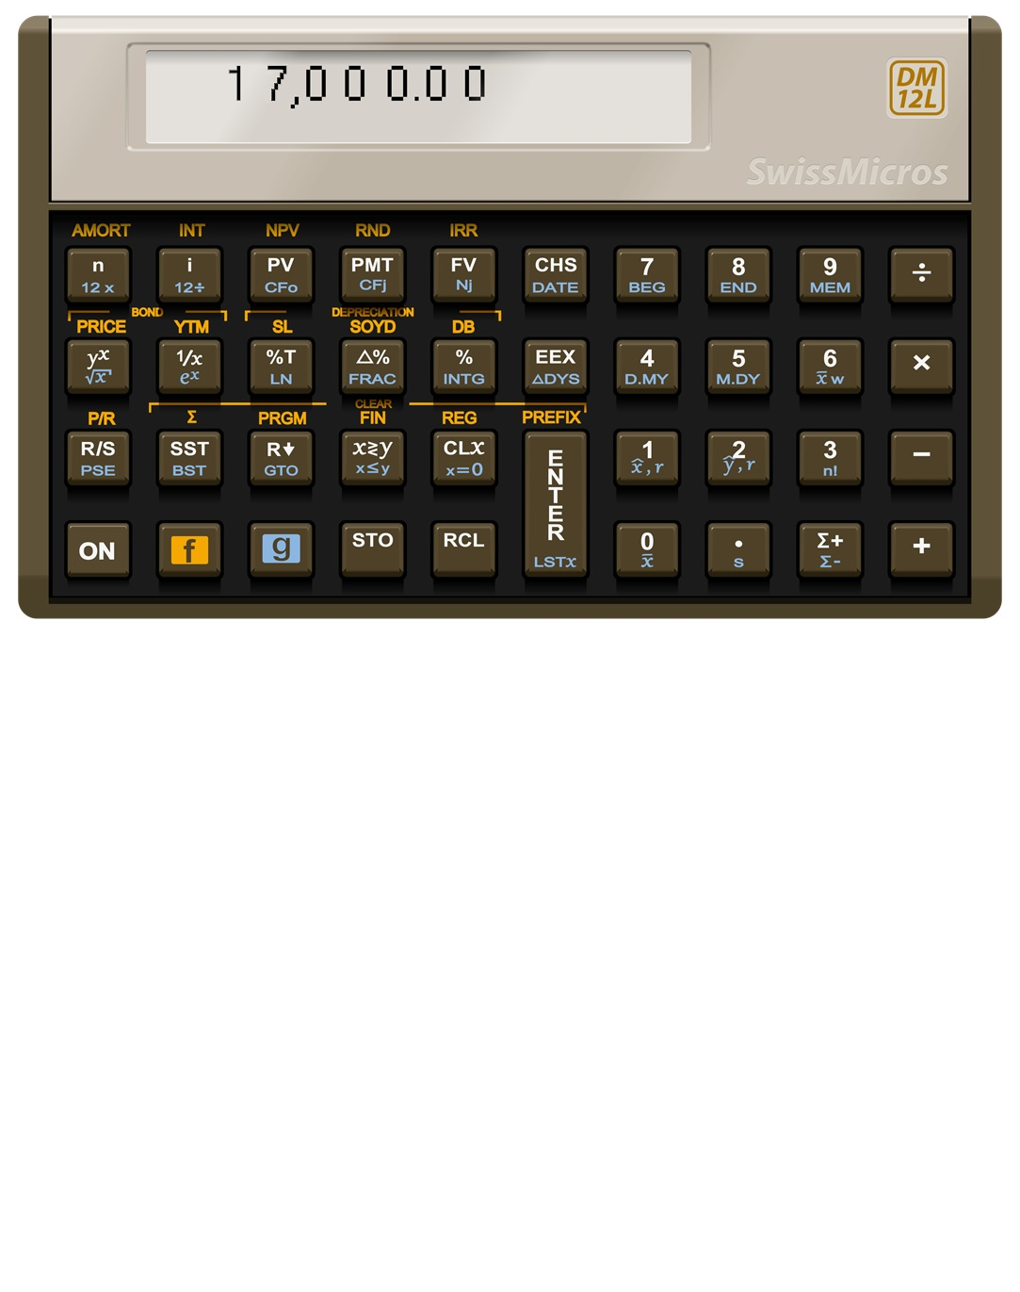


Presenting the
DM17L
All of 12L’s functions
Most of 27’s functions*
+ 21s Probability dist.
All of 12 except f# replaced by Fix #.
Changes
firmware, overlay only
Compatible with
12C/L programs
Historically standard labels
Except:
FSE - 3 way toggle
(Fix/Sci/Eng) with
# of digits in x
DRG - 3 way toggle
(Deg/Rad/Grad)
* Except %Σ
x
Q(z)
zp
SIN -1
H
10
H.MS
Log
Q(t)
tp
COS -1
Py,x
Q(f)
fp
TAN -1
2
$$π$$
χ
R P
Cy,x
Q( )
p
2
OFF
FSE DRG
χ
a What if?
Not a real Swiss Micros Project
Notes:
All of the 12’s functionality. Almost all of the 27’s functionality (no %sum)
3 of the 21’s probability distributions.
Scientific: Trig, rectangular<>polar, H/H.MS, permutations & combinations
Backspace during number entry
Deg/Rad/Grad and Fixed/Sci/Eng display notation
Would be compatible with 12C/L keystroke programs…
Why 17? 1x carries on Voyager naming tradition
7 from 27, lucky number 7, etc.
Big question: enough flash?

Slide 7
DM17L+
Additional Potential features with this configuration (if enough memory ☺):
Use DM12L dot matrix display to display keycap labels in program mode*
n! implements x!
Support additional Program steps
RCLΣ, RCL PRGM, RCL FIN, RCL REG- display corresponding data sequentially with labels
Use STOf[0-9], RCLf [0-9] to save, recall states (current settings, programs, registers and financial registers)*
Use STOg[0-9], RCLg[0-9] to save, recall register sets*
x
Q(z)
zp
SIN -1
H
10
H.MS
Log
Q(t)
tp
COS -1
Py,x
Q(f)
fp
TAN -1
2
$$π$$
χ
R P
Cy,x
Q( )
p
2
OFF
FSE DRG
χ
a What if?
* Bruce Horrocks
Not a real Swiss Micros Project

Slide 8
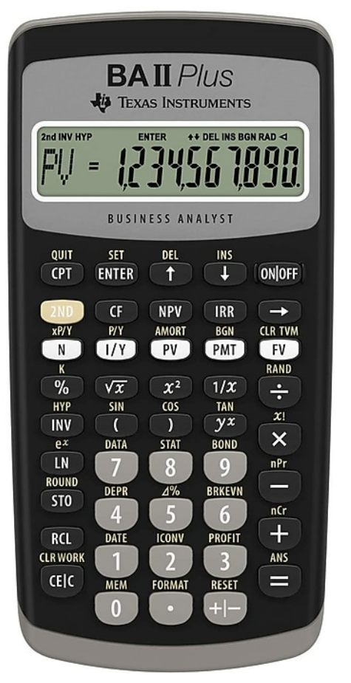
Speed up Sequential display
Slow down Sequential display
Start/Stop (Pause) Sequential display
Interrupt Sequential display
n
=
P
M
T
=
d
∑
n
=
∑
y
=
d
d
d
d
d
d
d
d
d
d
d
d
d
d
d
d
d
d
d
d
d
d
d
d
d
d
d
d
d
d
d
d
d
d
d
d
d
d
d
d
d
i
=
F
V
=
∑
x
=
∑
y
²
=
d
d
d
d
d
d
d
d
d
d
d
d
d
d
d
d
d
d
d
d
d
d
d
d
d
d
d
d
d
d
d
d
d
d
d
d
d
d
d
d
P
V
=
∑
x
²
=
∑
x
y
=
d
d
d
d
d
d
d
d
d
d
d
d
d
d
d
d
d
d
d
d
d
d
d
d
d
d
d
d
d
d
a What if?
Not a real Swiss Micros Project
Notes:
Both HP & TI recent calculators display alpha data labels
RCL FIN sequentially displays financial register’s labels and their values.
RCL Summation sequentially displays summation register’s labels and their values.
During this display mode + speed up, - slow down, R/S start stop display, ON interrupt display

Slide 9
r
.
5
=
C
F
1
5
d
d
d
d
d
d
d
d
d
d
r
0
=
C
F
0
0
r
5
=
C
F
0
5
r
.
0
=
C
F
1
0
r
.
6
=
C
F
1
6
d
d
d
d
d
d
d
d
d
d
d
d
d
d
d
d
d
d
d
d
d
d
d
d
d
d
d
d
d
d
d
d
d
d
d
d
d
d
d
d
r
1
=
C
F
0
1
r
6
=
C
F
0
6
r
.
1
=
C
F
1
1
r
.
7
=
C
F
1
7
d
d
d
d
d
d
d
d
d
d
d
d
d
d
d
d
d
d
d
d
d
d
d
d
d
d
d
d
d
d
d
d
d
d
d
d
d
d
d
d
r
2
=
C
F
0
2
r
7
=
C
F
0
7
r
.
2
=
C
F
1
2
r
.
8
=
C
F
1
8
d
d
d
d
d
d
d
d
d
d
d
d
d
d
d
d
d
d
d
d
d
d
d
d
d
d
d
d
d
d
d
d
d
d
d
d
d
d
d
d
r
3
=
C
F
0
3
r
8
=
C
F
0
8
r
.
3
=
C
F
1
3
r
.
9
=
C
F
1
9
d
d
d
d
d
d
d
d
d
d
d
d
d
d
d
d
d
d
d
d
d
d
d
d
d
d
d
d
d
d
d
d
d
d
d
d
d
d
d
d
r
4
=
C
F
0
4
r
9
=
C
F
0
9
r
.
4
=
C
F
1
4
F
V.
=
C
F
2
0
d
d
d
d
d
d
d
d
d
d
d
d
d
d
d
d
d
d
d
d
d
d
d
d
d
d
d
d
d
d
d
d
d
d
d
d
d
d
d
d
a What if?
Not a real Swiss Micros Project
Notes:
Displaying registers with labels makes CF storage more friendly

Slide 10
x
=
t
=
d
0
0
S
t
o
+
0
0
0
6
R
c
l
0
1
d
d
d
d
d
d
d
d
d
d
d
d
d
d
d
d
d
d
d
d
0
1
R
↓
0
7
R
c
l
0
2
0
2
S
t
o
+
0
1
0
8
+
y
=
L
a
s
t
X
=
0
3
R
↓
0
9
+
d
d
d
d
d
d
d
d
d
d
d
d
d
d
d
d
d
d
d
d
4
S
t
o
+
0
2
0
R
/
S
0
4
S
t
o
+
0
2
1
0
z
=
0
5
R
c
l
0
0
d
d
d
d
d
d
d
d
d
d
a What if?
Not a real Swiss Micros Project
Notes:
RCL PREFIX displays stack like PRINT STACK on multiple HP calculators
RCL PRGM displays program steps sequentially

Slide 11
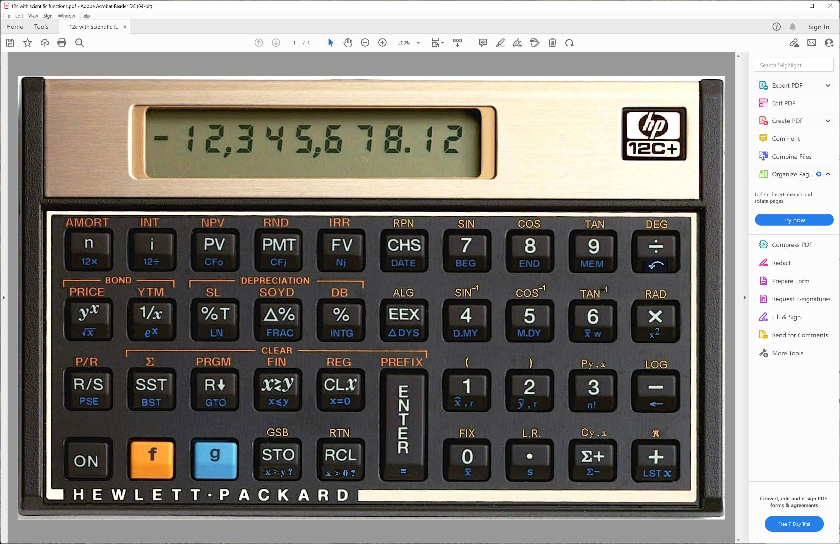

An Alternate 12C+
Thinking about extending the 12C is not new…
This was presented to HP management in 2006*
All of Platinum 12C except f# replaced by Fix #.
Most keys same except STO, RCL which have added blue shift.
Adds Trig,π,DEG,RAD (no R<>P)
Adds Perm, Comb, Log
Adds 4 programming functions: GSB,RTN, X>Y?, X>0?
* Thank you Gene Wright for this history
$$=$$
a What if?
Not a real HP Project

Slide 12
Presenting the
HP-17
All of 12C’s functions
Most of 27’s functions*
+ 21s Probability dist.
Changes
firmware, overlay only
All of Platinum 12C except f# replaced by Fix #.
Compatible with
12C/L programs
Historically standard labels
Except:
FSE - 3 way toggle
(Fix/Sci/Eng) with
# of digits in x
DRG - 3 way toggle
(Deg/Rad/Grad)
* Except %Σ
17C
x
Q(z)
zp
SIN -1
H
10
H.MS
Log
Q(t)
tp
COS -1
Py,x
Q(f)
fp
TAN -1
2
$$π$$
χ
R P
Cy,x
Q( )
p
2
FSE DRG
χ
a What if?
Not a real HP Project
Notes:
So an HP17C might look like this…

Slide 13
Presenting the
Platinum HP-17
All of 12C’s functions
Most of 27’s functions*
+ 21s Probability dist.
+ Alg mode
Changes:
firmware, overlay only
Compatible with
12C/L programs
except f#
Historically standard labels
Except:
FSE - 3 way toggle
(Fix/Sci/Eng) with
# of digits in x
DRG - 3 way toggle
(Deg/Rad/Grad)
* Except %Σ
17C
x
Q(z)
zp
SIN -1
H
10
H.MS
Log
Q(t)
tp
COS -1
Py,x
Q(f)
fp
TAN -1
2
$$π$$
χ
R P
Cy,x
Q( )
p
2
OFF
( ALG
) RPN
FSE DRG
χ
$$=$$
a What if?
Not a real HP Project
Notes:
While most here would agree RPN is better this is a version of the HP17 that would support both RPN and Algebraic modes.

Slide 14

“When can I order one? ☺
Thank You!
x
Q(z)
zp
SIN -1
H
10
H.MS
Log
Q(t)
tp
COS -1
Py,x
Q(f)
fp
TAN -1
2
$$π$$
χ
R P
Cy,x
Q( )
p
2
FSE DRG
χ
a What if?
Not a real Swiss Micros Project

Slide 15

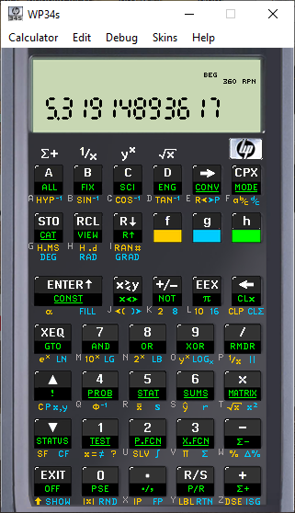
An even less likely What if?
We could also dream of a
DM34L
Key Arrangement maximizes 34 similarity
What to do with extra 2 keys?
34
Shifts on bottom next to Exit
Not a real Swiss Micros Project

Slide 16
We could also dream of a
DM34L
An even less likely What if?
Key Arrangement maximizes 34 similarity
What to do with extra 2 keys?
34
Alt: central shifts Central
Not a real Swiss Micros Project

