Slide 1
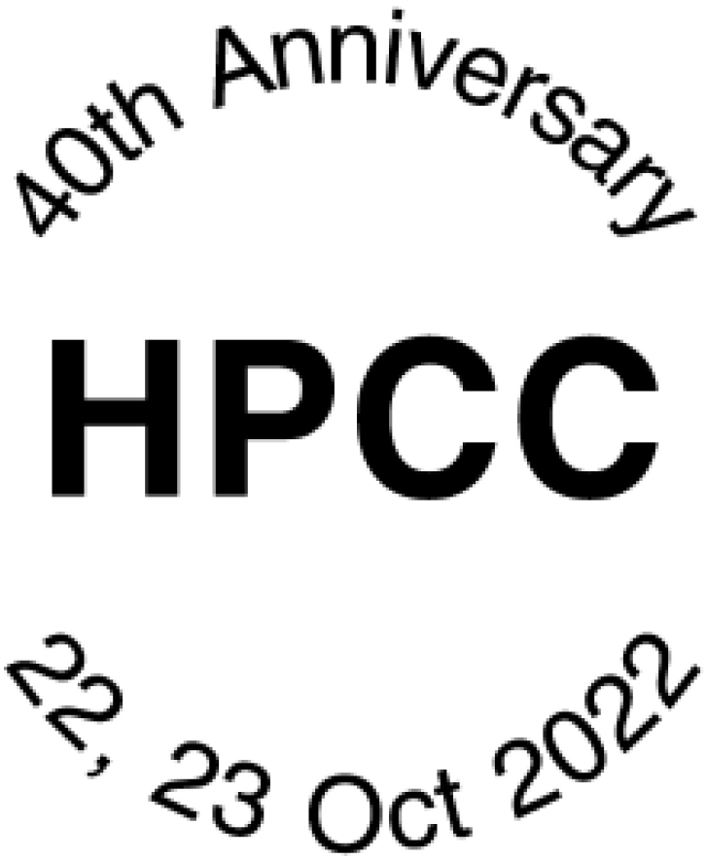
HP Prime Wireless Kit
Mark Power
Many thanks to Moravia for supplying the Wireless Kit

Slide 2
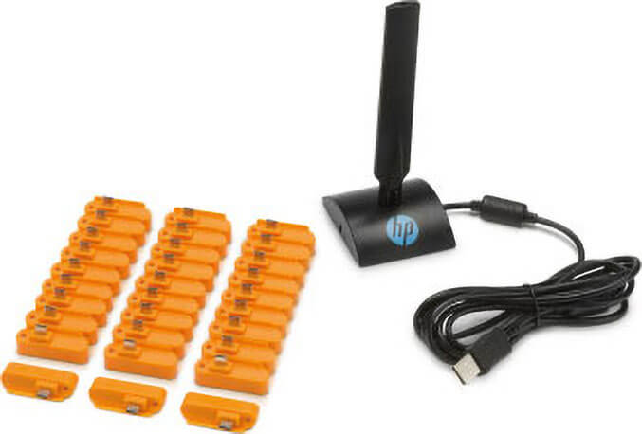
Let’s look at
Purpose
What you get
Compatibility
Capabilities
… and try it out

Slide 3
Purpose
Primarily for use in a classroom environment
Allows a teacher to push and pull content between a personal computer and up to 30 HP Prime calculators
Set exam mode for a class
Zero-touch configuration
Not Wi-Fi, so no configuring SSIDs, no passwords and no eavesdropping

Slide 4
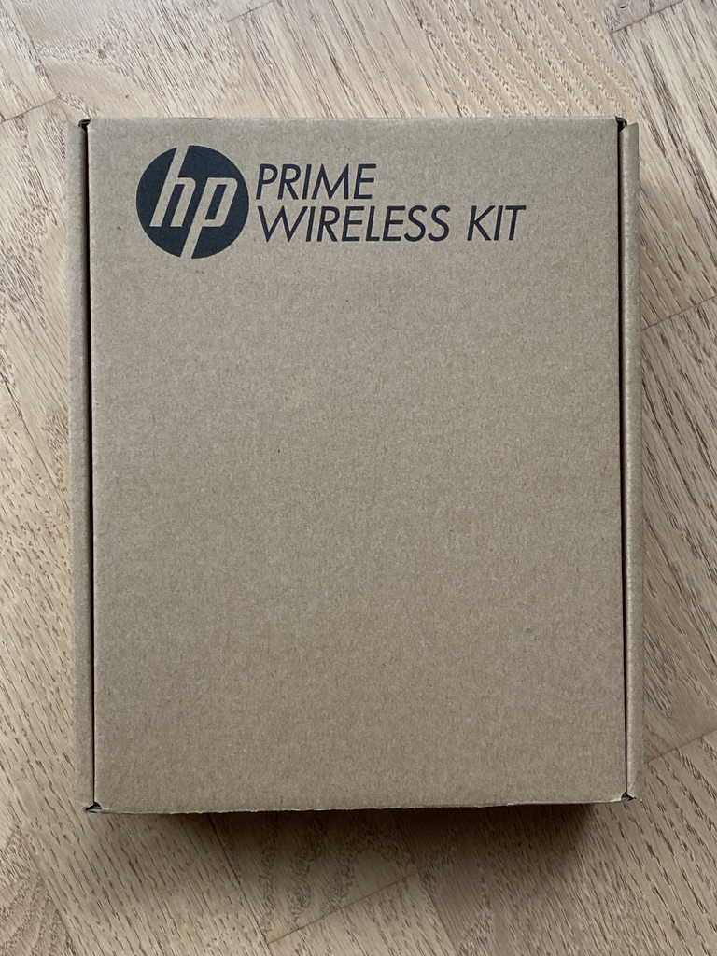
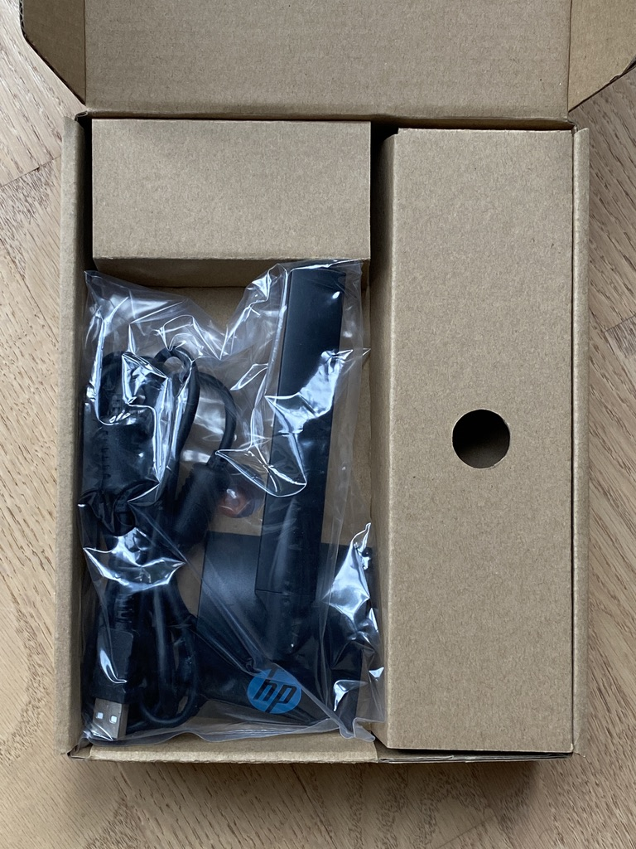
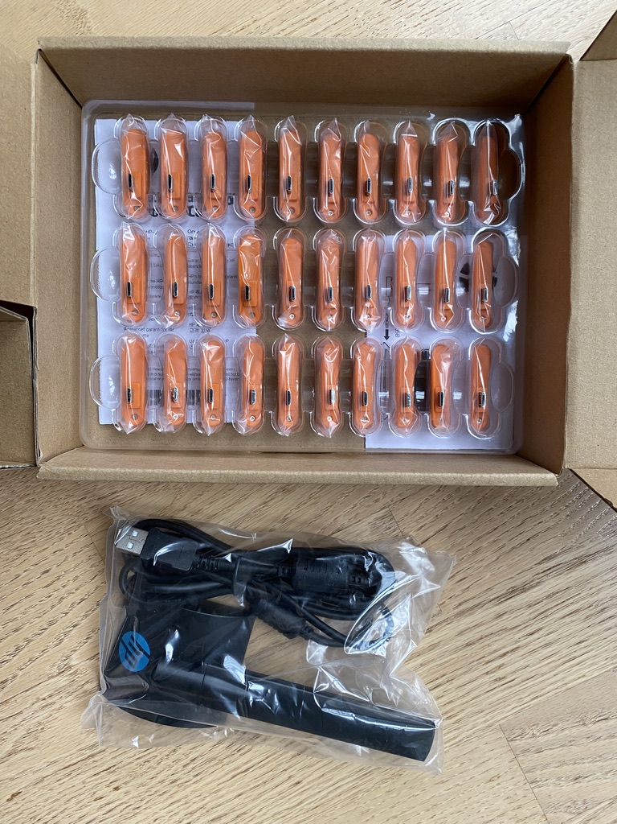
What you get in the box
1 wireless base station with USB-A connector
30 HP Prime wireless dongles + 2 leaflets

Slide 5
Compatibility
HP Prime Rev C (G1) or D (G2)
HP Prime Rev A might work if you have never updated the firmware
Uses the HP Prime Connectivity Kit (CK) – no additional software
Windows 7, 8 and 10 – drivers get automatically installed
Mac Intel and Apple Silicon with macOS Monterey 12.6 – it just works
You need a USB-A port or a suitable USB-A adapter

Slide 6
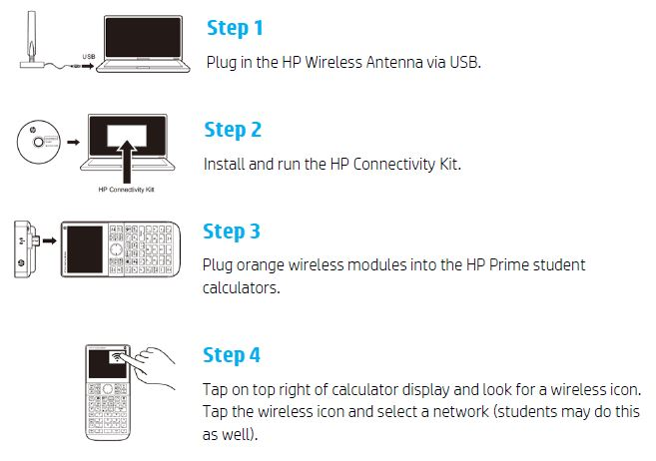
Set up overview

Slide 7
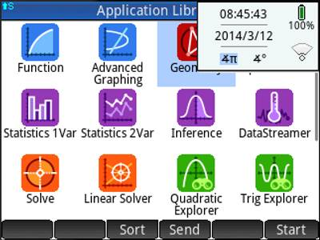
Set up - 1
Connect the dongle
Tap the top right hand corner of the screen

Slide 8
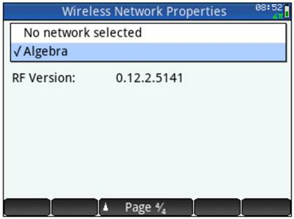
Set up - 2
Select a network
This is also page 4 of Home Settings

Slide 9
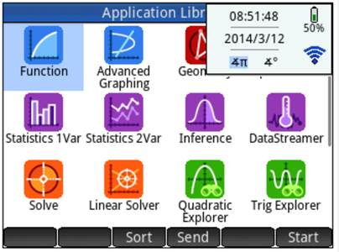
Set up - 3
You are now connected
You cannot turn off the HP Prime until you disconnect from the network by going back to the set up screen

Slide 10
Connectivity Kit Features
Send apps, programs and data to individuals or all on the wireless network and physically connected
Send and receive messages
Monitor all HP Primes
Send polls and receive results

Slide 11
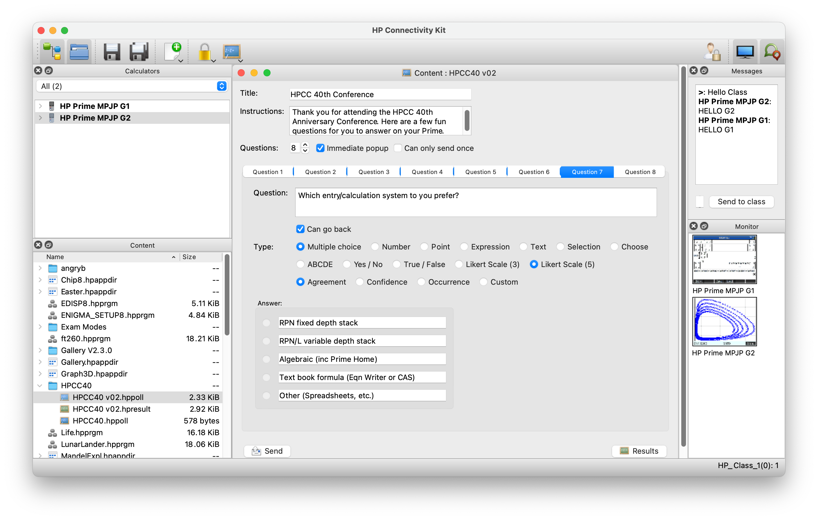
Poll Setup

Slide 12
HP Prime Polls
1 instruction page and one question per page with ▲Page 1/9▼
Multiple choice – shows 5 options but you can only pick one
  Custom or pre-set choices including ABCDE, T/F, Y/N, Likert (3 or 5)
Number
Point
Expression
Text
Selection - allows multiple selections of up to 6 items
Choose – pick one item from a drop-down list of up to 6 items

Slide 13
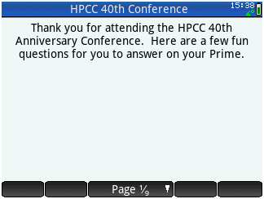
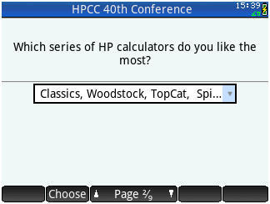
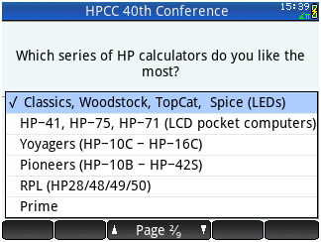
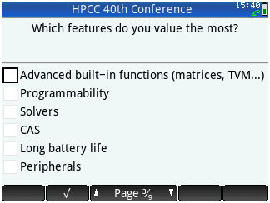
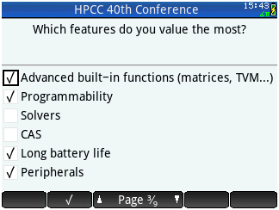
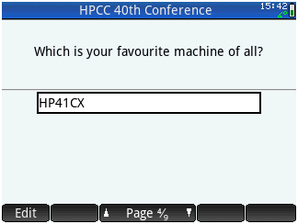
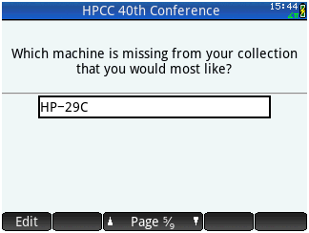
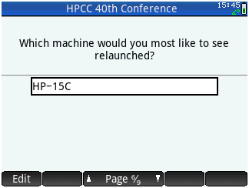
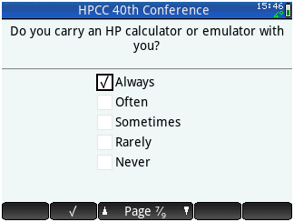
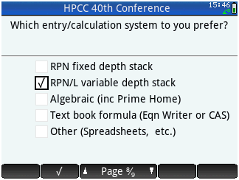
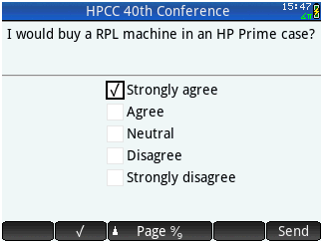
Poll Example

Slide 14
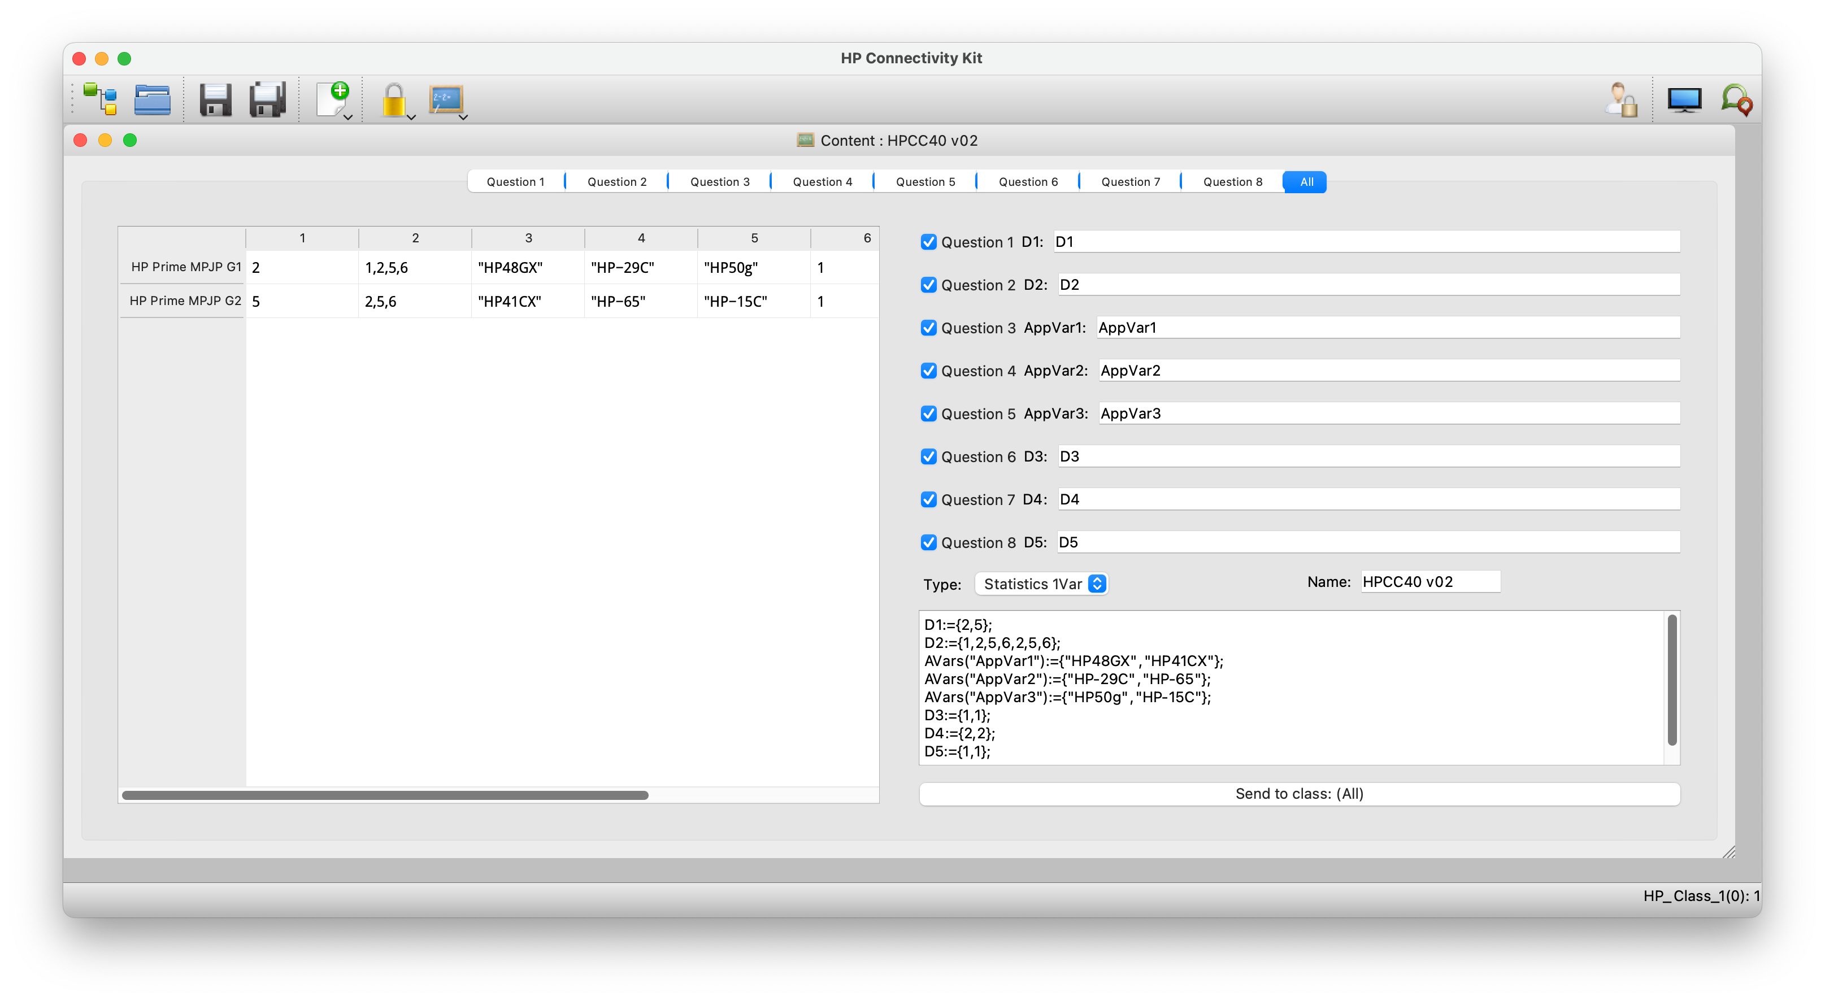
Poll Results

Slide 15
Summary
Quite specific use case – not something for most users
Interesting range of functionality provided by the Connectivity Kit
More poll options would have been nice
Results may need interpretation
Surprising compatibility with Macs even via USB-C
Connectivity Kit software reliability needs to be improved

